Slide 1
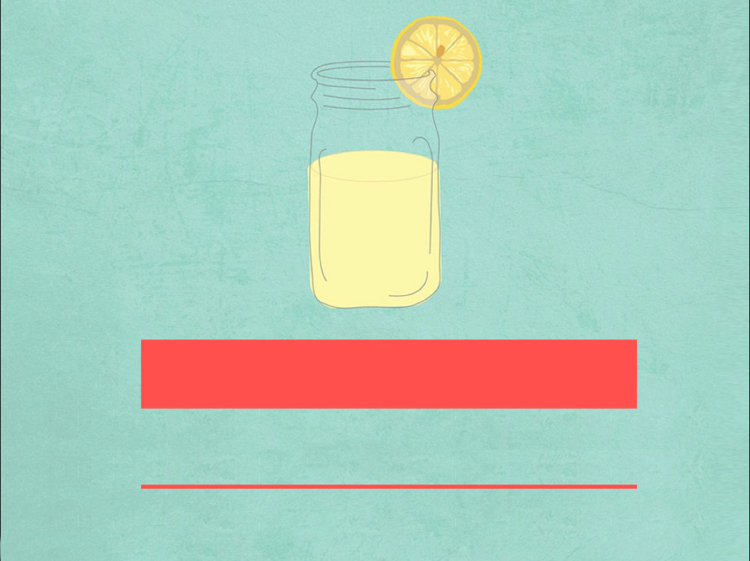
BOOK 6 Unit 4 Words
come about, range & quantities of
华南师范大学外国语言文化学院 郭绮君

Slide 2
CONTEXT
come about
range
quantities of

Slide 3
CONTEXT
come about
range
quantities of

Slide 4
come about
不及物短语
发生，造成
相当于 happen
Eg. Do you know how the
traffic accident came about?
选 C
句意为：已经十点了，这么短的路途她竟然晚了两个小时，我真不知道这是怎么回事。
come over 顺便来访
come out 出现，出版
come up 走近，上来，提出
It’s already 10 o’clock. I wonder how it ____ that
she was two hours late on such a trip. (湖北 06)
A. came over B. came out
C. came about D. came up

Slide 5
come about
归纳拓展
come along 出现，发生
come out 出来，长出 ， 出版
come to oneself 苏醒，醒悟 come up with 赶上， 提出
come over 顺便来访

Slide 6
range
n. 种类；范围
vt. 排列；归类于
Eg. This is outside the range of our study.
这不是属于我们研究的范围
归纳拓展
within / in range
在…...范围之内
beyond／out of the range of…
超越…….的范围
out of one’s range
某人达不到的
range oneself
站在……的方面
range from…to.. / between… and…
从……到….. 不等
This restaurant has become popular for its wide ___ of foods that suit all tastes and pockets. (湖北 2010)
C
A. division B. area
C. range D. circle
句意：这家饭馆的食品种类丰富，可以满足不同口味和收入的顾客，因此深受大家的喜爱

Slide 7
quantities of
大量的 ( 其后可加可数名词，也可加不可数名词 )
Eg. Before they enter an entrance examination, they have to do quantities of exercise.
在参加入学考试之前，他们得做大量的练习。
归纳拓展
quantities of +名词（可数/不可数）
许多的；大量的
a quantity of +名词（可数/不可数）
许多的；大量的
an amount of/ amounts of +不可数名词
许多的；大量的

Slide 8
quantities of
“quantities of / a quantity of +名词”作主语，谓语动词的数取决于quantity的数，而与修饰名词无关
Eg. There is a large quantity of snow in this area.
There are quantities of snow in this area.
“a great amount of / great amounts of + 不可数名词”作主语时，谓语动词的数取决于amount的数
Eg. A great amount of data exists in other format.
Under flood conditions, great amounts of topsoil are washed to receiving streams.

Slide 9
quantities of
归纳拓展：表示许多，大量的词语或词组
1. many a / an + 可数 n. + 单v.
eg. Many a student fails to pass in the examination
Many a student likes popular songs.
2. many, a good many, quite a few, a great number of, scores of,
dozens of + 可数 n. + 复v。
3. much, a great deal, a great amount of + 不可数 n. +单v.
4.lots of, a lot of, plenty of, a great quantity of, quantities of
+可数n./ 不可数n.

Slide 10
Thank you
谢谢大家

