Slide 1
The Olympic Games
制作人：河源市河源中学 程燕秋
华南师范大学外文学院 王婉清 郭晓丹
指导老师：河源市河源中学 程燕秋

Slide 2

As is known to all , the Olympic Games is an international competition. Taking part in the Olympic Games and fighting for nation’s pride mean the greatest honor to an athlete.
take
part
in
参加,参与(比赛/群众性活动/会议等)，常常表示参加者在其中起积极作用
No!!!
join
in
It doesn’t matter whether I win or not. It’s important to take part.
这里的take part可以直接用join来替代吗？

Slide 3



take part in
attend
speech, meeting, concert, class
强调“出席，到场”
参加
会议或活动，强调主动性
be present at
join
团体或组织，并成为其中一员

Slide 4
chunks
take
an
active
part
in
积极参与，积极参加
Liu Xiang always does his part as an outstanding athlete.
take
an
important
part
in
在…起着重要作用
play
a
part
in
在…扮演角色，在…起作用
do
one’s
part
尽自己的职责

Slide 5
Take Liu Xiang, who competed in 2004 Athens Olympic as an example. He competed for our national honor with many excellent runners from other countries. They all competed to win the prizes for their own country.
in
参加…比赛，在…竞争
for
为得到…而竞争
against/with
与…竞争
compete
to do
争着做

Slide 6
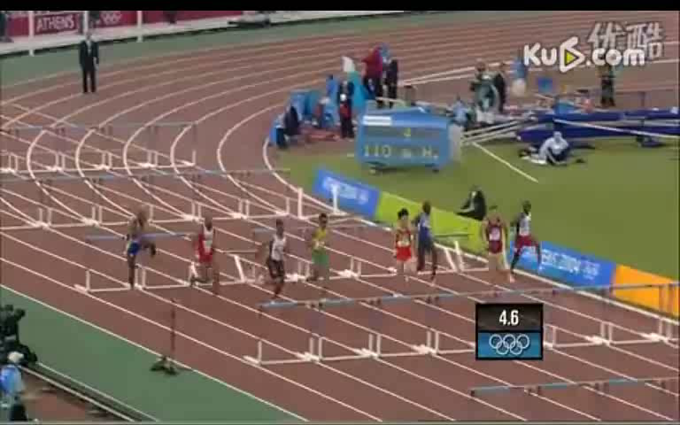

Slide 7
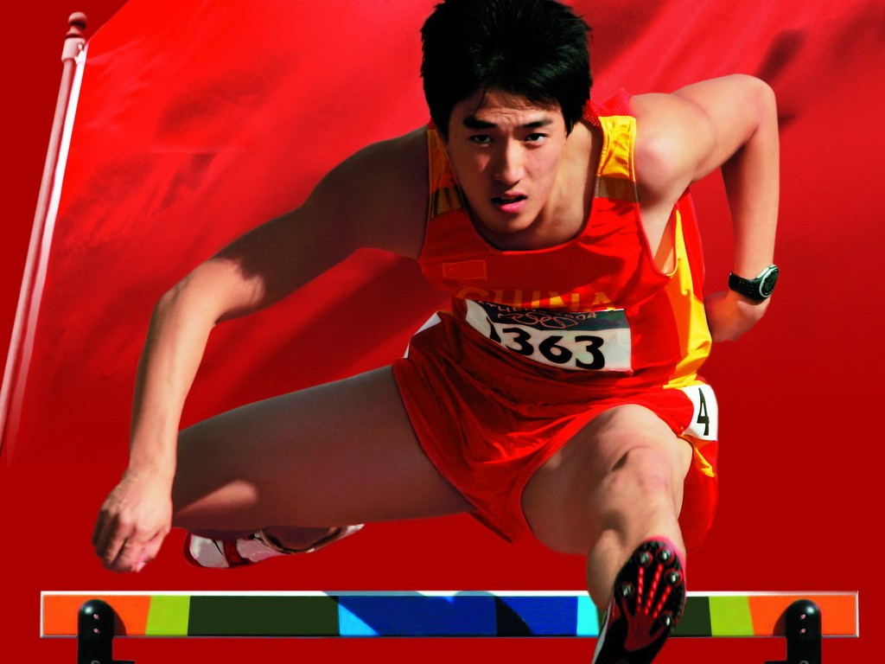
He has been admitted as our national hero since that glorious moment.

Slide 8
chunks
be admitted as
(1)被当作是，被认定是
(2)被录用为…
根据语境猜词义
(1)She admitted driving the car without insurance.
(2)Each ticket admits one adult into the zoo.
(3)Finally, the man admitted to the robbery.
(4)He is admitted to SCNU because of his great
achievements.
(1) 承认 (2)被录取（用） (3)承认 (4)允许进入
作文佳句:
It is generally admitted that…
人们普遍认为…
延伸：
It is universally acknowledged that…
It is well known that…

Slide 9

1. 单项选择
Though he only won the Olympic Games once, he is our national hero!
A. admitted to B. admitted as
2.用下列词组的正确形式填空 take part in/ join / attend / participate in
Liu Xiang the Olympic Games twice and he ______ the party in 2005.
Recently he ____________ public activities actively.
Exercises
嘿嘿嘿，你会做吗？
took part in
joined
has participate in

Slide 10

3.五句话小作文
Who’s your favourite Olympic star?
What competition did he compete in/ take part in?
Why do you admit him as your favourite Olympic hero?
So
easy!

Slide 11







Conclusion
1
take part in
Do you remember?
2
compete in
3
be admitted as
5

Slide 12



Thank You!

