Slide 1
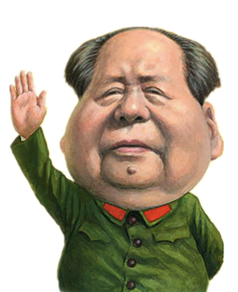
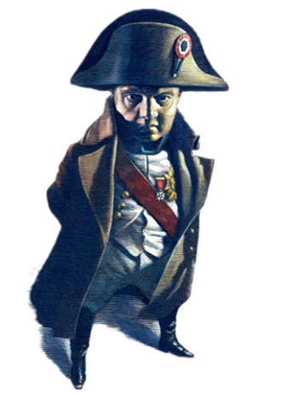
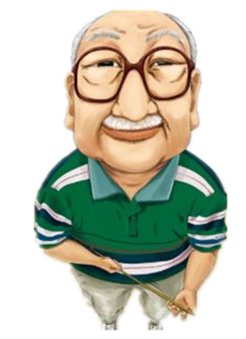
直接引语变间接引语（一） --陈述句
Direct Speech to Indirect Speech One: Declarative Sentences
(人教版高中英语必修一Unit 1: Friendship)
华南师范大学外国语言文化学院
曾敏丽

Slide 2
Observe following sentences from Anne’s Diary:
Anne said : “ I don’t want to set down a series of facts in a diary .”
Anne said : “ I’ve got tired of looking at nature through dirty curtains and dusty windows.”
Anne said : “ I shall call my friend Kitty .”
直接引语（Direct Speech）：直接引用别人的原话，并在原话前后加引号。

Slide 3
What did Anne said about her friend?
Anne said : “ I shall call my friend Kitty .”
Anne said that she should call her friend Kitty.
间接引语(Indirect Speech)：用自己的话转述别人的话，多数以宾语从句的形式构成。

Slide 4
Compare the two sentences:
1. Anne said : “I shall call my friend Kitty .”
Direct Speech
直接引语
2. Anne said that she should call her friend Kitty.
Indirect Speech
间接引语
总结：
1. 引号没了，有了that
2. 第一人称 “ I ”变成第三人称 “ she ”
3.引号中陈述句的现在时变成过去时
句式
人称
时态

Slide 5
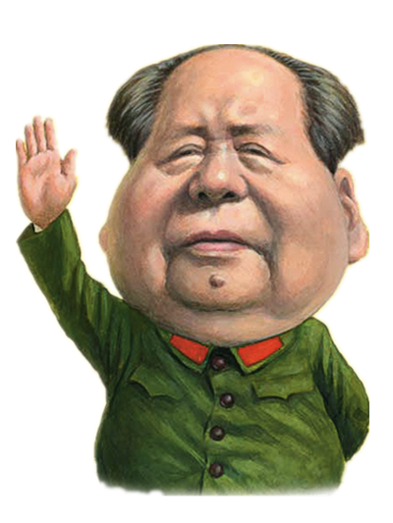
The change of sentence structure
陈述句句式的变化：单句变从句
E.g.: Chair Mao said : “Long live People Republic of China.”
Chair Mao said that Long lives People Republic of China.
宾语从句

Slide 6
The change of persons:
人称的变化：第一第二看主句，第三人称不动摇
Napoleon said : “ Never interrupt your enemies when they are making a mistake.”
Napoleon said that
never interrupt your enemies when they are making a mistake.
never interrupt our enemies when we are making a mistake.
never interrupt our enemies when they were making a mistake.
√

Slide 7
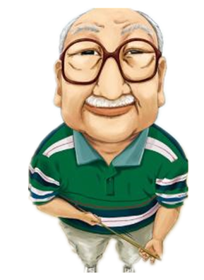
The change of tenses
时态的变化：听主句的
直接引语变间接引语时，间接引语的时态要与主句的时态一致
E.g. Our headmaster said: “ All of you will have a holiday next week. ”
Our headmaster said that all of us would have a holiday next week.

Slide 8
But:
直接引语为客观真理时，间接引语时态不变，仍用一般现在时。
E.g.：Teacher told us:" The moon moves round the earth."
Teacher told us the moon moves round the earth.
主句为一般现在时或一般将来时的时候，间接引语时态不变。
E.g.：He says:" I bought you a book yesterday."
He says that he bought me a book yesterday.

Slide 9
Summary: Direct Speech to Indirect Speech
Declarative sentence
陈述句
Sentence Structure
句式
Person
人称
Tense
时态

