Slide 1
如何制作展示想法的海报
高中英语必修一 Unit 2
华南师范大学外文学院 谭颖希

Slide 2
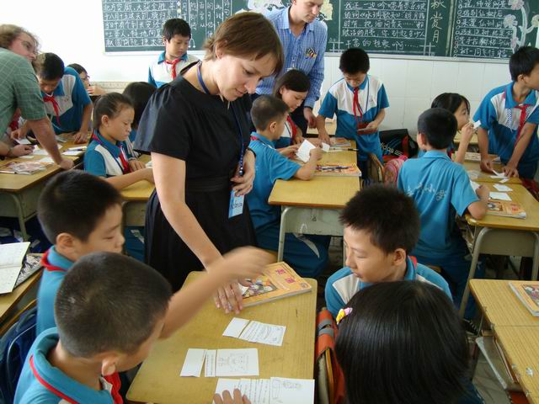
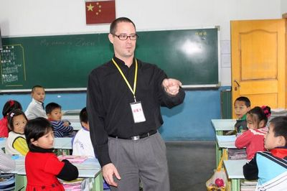
Why should we learn English?

Slide 3


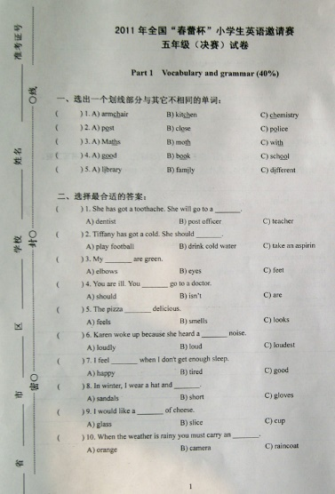
Possible answers
talk to foreigners
take English exams
Unorganized!
read English books

Slide 4
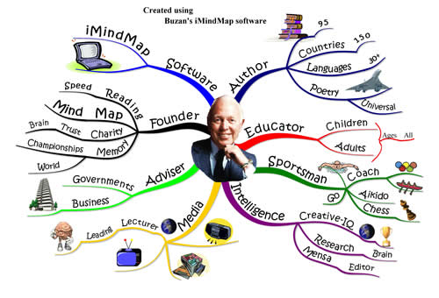
Tony Buzan and His Mind Map

Slide 5
Make Your Own Mind Map
To talk to native speakers
To read English books
Why should we learn English?
To succeed in the exams
……

Slide 6

A Sample Poster
Why should we do exercise?
◎ to keep fit
◎ to make us strong
◎ to fight illness and disease
◎ to enjoy ourselves
◎ to build up our skills
Some exercise a day keeps the doctor away!
Title
Reasons
Conclusion

Slide 7

Make Your Own Poster
Why should we learn English?
◎ to read English books
◎ to talk to native speakers
◎ to succeed in the exams
◎ to watch English movies
◎ to go travelling in foreign countries
◎ …
Learning English can help us know more about the world!
Title
Reasons
Conclusion

Slide 8
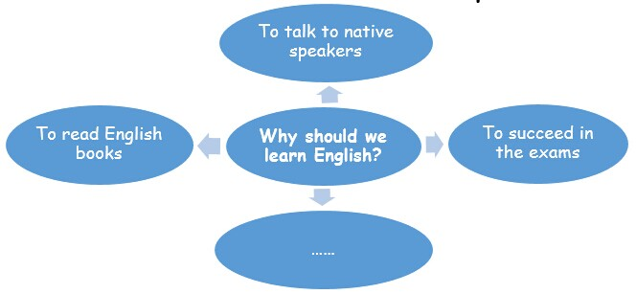
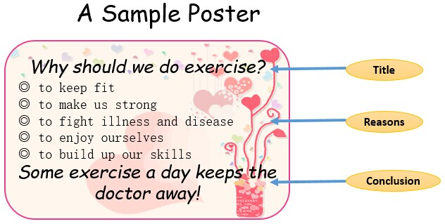
Summary
Organizing ideas with a mind map.
Showing ideas with a poster.

Slide 9
Thank you!

