Slide 1

The relative pronoun
in Attributive clause
--USING “THAT”
新课标高中英语 M1U4Earthquakes
大朗中学 吴妍博
华南师范大学 梁斯媚

Slide 2



1.A plane is a machine _________ can fly.
Can we always interchange “which” and “that” in attributive clauses?
2.They planted the trees which/that didn’t need much water.
3.The earthquake which/that hit the city in 1906 was the biggest in American history.

Slide 3
In these situations, we can only use “that” instead of “which”:

Slide 4
先行词为all, everything, nothing, something, anything, little, much 等不定代词时。
He has something that you want to buy.
We should do all that is useful to the people.
Please tell me anything that you know about the matter.

Slide 5
先行词被the only, the very修饰时
This is the very book that he is looking for.
The only thing that we could do was to wait.

Slide 6
先行词被最高级修饰时
This is the most delicious food that I have eaten.
The best that I could do was to apologize.

Slide 7
先行词既有人又有物时
I will always remember the people and things that I am fond of.
They are talking of the heroines and their deeds that interest them.

Slide 8
先行词被序数词修饰时
This is the first prize that he has won.
This is the fourth film that has been shown in our school this term.

Slide 9
先行词被 all, every, no, some, any, little, much 等修饰时
I have read all the books that are about Harry Porter.
You can take any seat that is free.

Slide 10
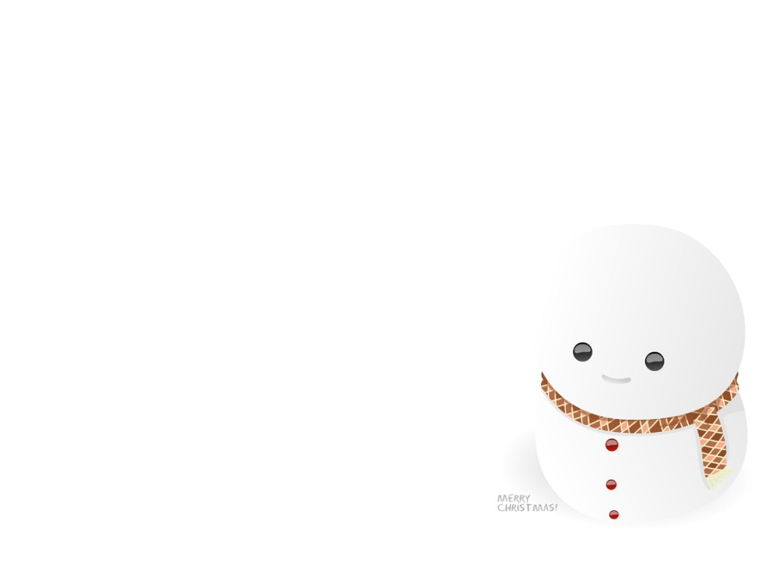






SUMMARY
先行词为all, everything, nothing, something, anything, little, much 等不定代词时。
先行词被the only, the very修饰时
先行词被最高级修饰时
先行词既有人又有物时
先行词被序数词修饰时
先行词被 all, every, no, some, any, little, much 等修饰时

Slide 11

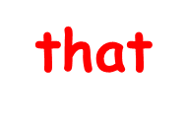

EXERCISES
1.We should do all _______ is useful to the people.
2.When people talk about the cities of China, the first ________ comes to my mind is Beijing.
3.Those pictures _____________were drawn by Tom are nice.
4.They talked about the persons and things _________ most impressed them.

Slide 12


EXERCISES
5.That is one of the most interesting books _______are sold in the bookshop .
6.My necklace is not the only thing ______is missing .
7.This is the hotel ___________ I visited last month.

Slide 13

Thank you

