Slide 1


JOURNEY DOWN THE MEKONG
(PART 1 THE DREAM AND THE PLAN)
How to get the main idea of a narrative passage?
新课标高中英语必修一M1U3
东莞市第二高级中学
黄中总
华南师范大学
关智桢

Slide 2
How to get the main idea of a narrative passage?
Who
What
Why
Where
When
How
Who did what?
｛
What was the result?

Slide 3
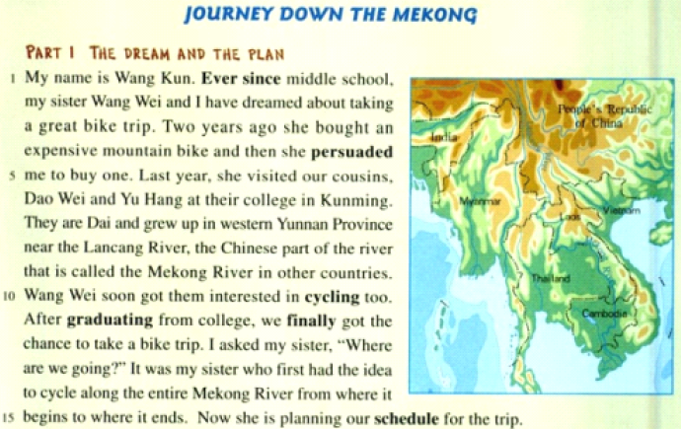
Who did what?

Slide 4
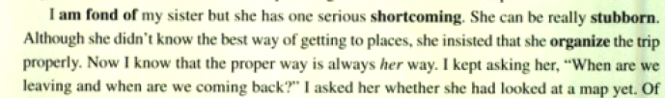
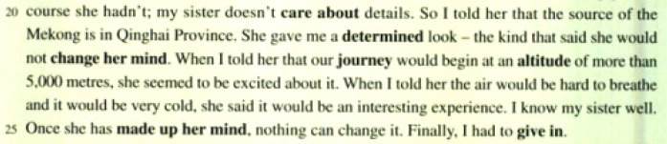
Who did what?
Why?

Slide 5
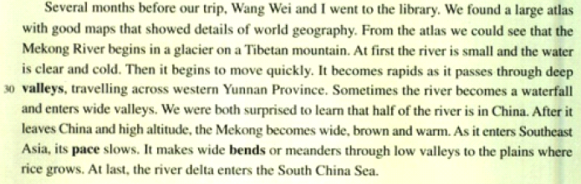
What was the result?

Slide 6
Match the main idea with each paragraph.
A. The preparation before the trip and details about the Mekong River.
Para.1
B. Wang Kun and Wang Wei decided to take a great trip along the Mekong River.
Para.2
C. Wang Wei was stubborn and the whole trip was organized by her.
Para.3

Slide 7

The main idea of the whole passage:
Wang Kun and her sister Wang Wei decided to cycle along the entire Mekong River .Since Wang Wei was a stubborn girl, so she insisted organizing the trip .They went to the library and searched the information of the Mekong River for the preparation of their trip.

Slide 8
How to get the main idea of a narrative passage?
Who
What
Why
Where
When
How
Who did what?
｛
What was the result?

Slide 9

THANK YOU!

