Slide 1

Unit2 Working the Land
Writing
How to describe a person
人教版 高中英语必修4第二单元 写作课
李敏意 华南师范大学外文学院

Slide 2

A pioneer for all people
Name:
Age:
Occupation:
characteristics：
Education:
Achievements:
Yuan Longping
Basic information
84 ( as of 2014 )
scientist / farmer
Satisfied with his life
Has many hobbies
Cares little about money
Characteristic
Appearance
graduated from Southwest
Agriculture College in 1953
Experience Achievements
developed hybrid Rice
in 1974
He devotes his life to agricultural research and made great contribution to rid the world of hunger.
Influence
evaluation

Slide 3
Four main parts for writing about a person
Basic information
Characteristic
Appearance
Who do you want to introduce to others?
What is this person like？
What impresses you most？
Experience Achievements
Influence
evaluation

Slide 4


Basic information
Characteristic
Appearance
Experience
Achievements
Influence
evaluation
eg：G.E.M. is a popular Hong Kong singer-songwriter, dancer, musician, and actress.
She was born in Shanghai in 1991 and moved to Hong Kong at the age of four.

Slide 5
Basic information
Characteristic
Appearance
Experience
Achievements
Influence
evaluation
What is/was this person like？
What impresses you most？
sunburnt face
good-looking
sweet smiles
1.80 metres tall
determined
capable
warm – hearted
easy – going
intelligent
eg：G.E.M. has a baby face.
She is very lovely and out-going, who is interested in performing.

Slide 6
Basic information
Characteristic
Hobby
Appearance
Experience
Achievements
Influence
evaluation
Why he/she is such a person?
Some evidence?
eg: G.E.M. started writing songs as a composer at the age of ten
entering many singing competitions, winning inter-school singing competitions.
In 2014 G.E.M. entered the Chinese singing competition I Am A Singer which then made her more well-known in mainland-China.
Time order

Slide 7
Basic information
Characteristic
Appearance
Experience
Achievements
Influence
evaluation
eg: Now G.E.M. has a large number of fans not only from Hong Kong and mainland China, but also from Taiwan, Macau, US, Canada, Australia, Great Britain and other south eastern Asian countries.

Slide 8
Born in Shanghai in 1991 and moved to Hong Kong at the age of four, G.E.M. is now a popular Hong Kong singer-songwriter, dancer, musician, and actress. This very lovely and out-going girl with a baby face is interested in performing, and she started writing songs as a composer at the age of ten. When 16 years old, She became a professional singer after winning the first place in "Spice it Up" competition. In 2014 G.E.M. entered the Chinese singing competition I Am A Singer which then made her more well-known in mainland-China. With her great effort and talent, G.E.M. was now famous not only in China, but also in US, Canada, Australia, Great Britain and other south e astern Asian countries.

Slide 9

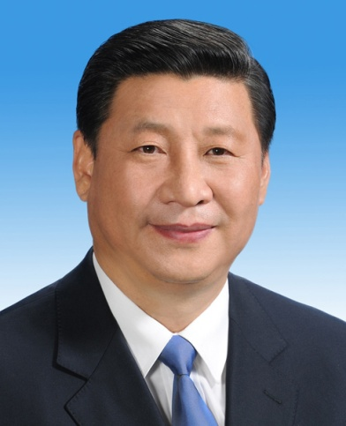
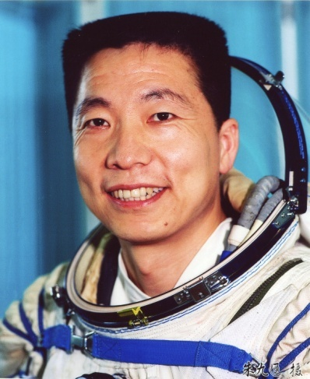
Introduce a person you admire.
You’ve been asked to contribute a short article to the school magazine which is running a series called “A Person I Admire”.
Remember to think before you write:
Who do you want to introduce to others?
What is this person like？
What impresses you most？
Why he/she is such a person?
Some evidence?

Slide 10

Thank you！

Slide 11
Four main parts for writing about a person
Basic information
fgfd
Characteristic
Appearance
Who do you want to introduce to others?
What is this person like？
What impresses you most？
Experience Achievements
Influence
evaluation

Slide 12
Basic information
Characteristic
Appearance
Experience
Achievements
Influence
evaluation
fgfd
eg：G.E.M. is a popular Hong Kong singer-songwriter, dancer, musician, and actress.
She was born in Shanghai in 1991 and moved to Hong Kong at the age of four.

Slide 13
Basic information
Characteristic
Appearance
Experience
Achievements
Influence
evaluation
fgfd
What is/was this person like？
What impresses you most？
sunburnt face
good-looking
sweet smiles
1.80 metres tall
determined
capable
warm – hearted
easy – going
intelligent
eg：G.E.M. has a baby face.
She is very lovely and out-going, who is interested in performing.

Slide 14
Basic information
Characteristic
Hobby
Appearance
Experience
Achievements
Influence
evaluation
fgfd
Why he/she is such a person?
Some evidence?
fgfd
eg: G.E.M. started writing songs as a composer at the age of ten
entering many singing competitions, winning inter-school singing competitions.
In 2014 G.E.M. entered the Chinese singing competition I Am A Singer which then made her more well-known in mainland-China.
Time order

Slide 15
Basic information
Characteristic
Appearance
Experience
Achievements
Influence
evaluation
fgfd
eg: Now G.E.M. has a large number of fans not only from Hong Kong and mainland China, but also from Taiwan, Macau, US, Canada, Australia, Great Britain and other south eastern Asian countries.

Slide 16
Born in Shanghai in 1991 and moved to Hong Kong at the age of four, G.E.M. is now a popular Hong Kong singer-songwriter, dancer, musician, and actress. This very lovely and out-going girl with a baby face is interested in performing, and she started writing songs as a composer at the age of ten. When 16 years old, She became a professional singer after winning the first place in "Spice it Up" competition. In 2014 G.E.M. entered the Chinese singing competition I Am A Singer which then made her more well-known in mainland-China. With her great effort and talent, G.E.M. was now famous not only in China, but also in US, Canada, Australia, Great Britain and other south e astern Asian countries.
fgfd
fgfd

Slide 17
Introduce a person you admire.
fgfd
You’ve been asked to contribute a short article to the school magazine which is running a series called “A Person I Admire”.
fgfd
Remember to think before you write:
Who do you want to introduce to others?
What is this person like？
What impresses you most？
Why he/she is such a person?
Some evidence?

Slide 18
Thank you！

