Slide 1
华南师范大学
邹媛媛
A Taste of English Humor M4U3

Slide 2
Revision of V-ing form
Be+ V-ing)
Present/past progressive tense
现在进行时)
What you have learned？
My mother is sweeping the floor when I walk into the house.
Formation of some adjectives
verb | Adj.
interest | interesting
astonish | Astonishing
surprise | Surprising
excite | Exciting
confuse | confusing

Slide 3
V-ing form as subject & object
Smoking may cause cancer.
subject
Walking is my sole exercise.
Talking mends no holes.
object
What she wants is realizing her dreams.
I suggest bringing the meeting to an end.
Seeing is believing.
Talking to him is talking to a wall.
Subject
object

Slide 4
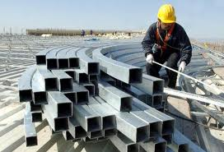
building materials
= materials for building

Slide 5
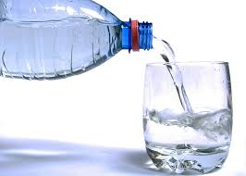
drinking water
= water for drinking

Slide 6
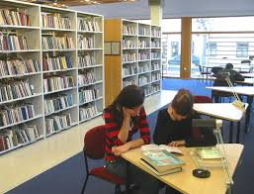
reading room
= a room for reading

Slide 7
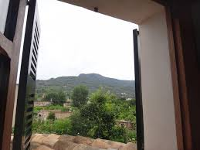
I live in a room that faces the mountain
=I live in a room facing the mountain.
.

Slide 8
V-ing form as attribute(定语)
The man standing there is Peter’s father.
= The man who is standing there is Peter’s father.
Anybody swimming in this river will be fined.
= Anybody who is swimming in this river will be fined.

Slide 9
V-ing form as attribute（定语）
V-ing
前置定语
Drinking water
后置定语
The man standing there

Slide 10
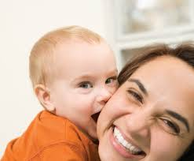
Exercise
There is a
smiling
mother
in the picture
baby
kissing his mother

Slide 11
What we learned today?
V-ing
revision
Subject&object
Attribute

Slide 12

Do you know other use of V-ing？

