Slide 1


Slide 2

Vocabulary
人教版B4U4 Body Language
Teaching aim: Leaning the use of key words and phrases: represent, defence, misunderstanding, turn one’s back to.
东莞光明中学：梁颖婵
华南师范大学外文学院：郑主均
Notes:
我第一次当老师，可能会有些啰嗦，还望各位童鞋海涵！

Slide 3
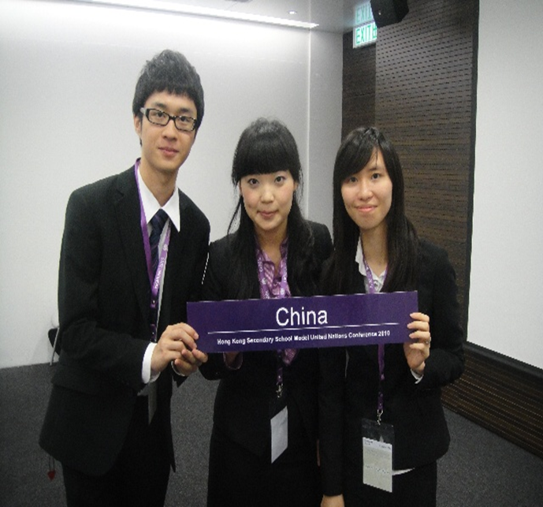
1.Yesterday, another student and I, representing our university’s student association, went to the Capital International Airport to meet this year’s international students.
1.represent: to be a member of a group of people and act or speak on their behalf at an event, a meeting, etc. 代表
e.g. Mike, Amy and Alice represented China to take part in the competition.
Notes:
我第一次当老师，可能会有些啰嗦，还望各位童鞋海涵！

Slide 4
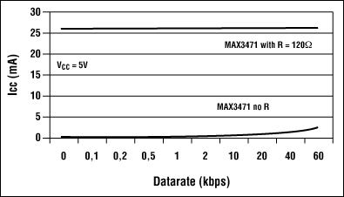
1.represent: to show sb/sth, especially in a picture 展示，描绘
e.g. The results are represented in the picture below.
结果如下图所示。
Notes:
我第一次当老师，可能会有些啰嗦，还望各位童鞋海涵！

Slide 5

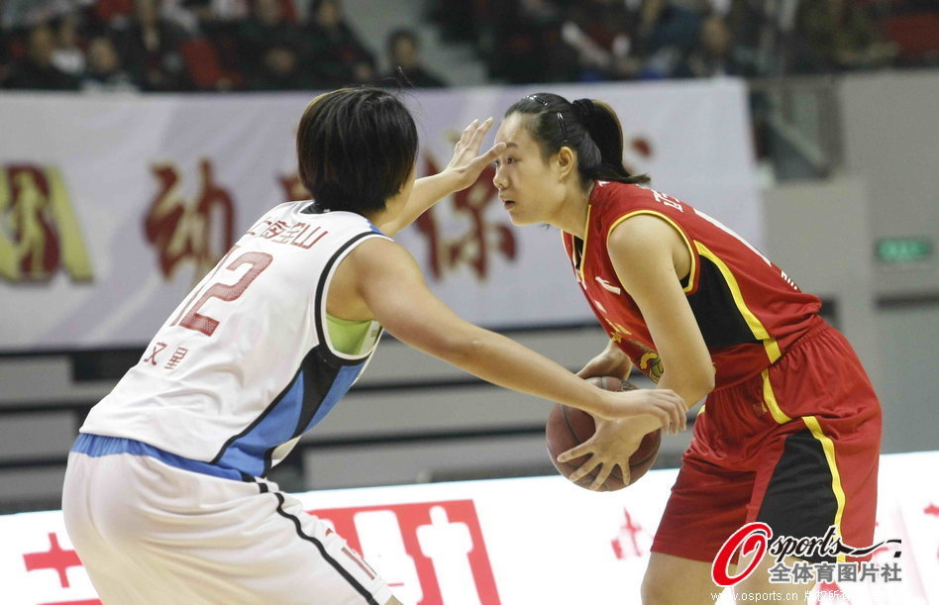
2.She stepped back appearing surprised and put up her hands, as if in defence.
2.defence: the act of protecting sb/sth from attack, criticism, etc. 防御；保护，保卫
They were willing to do anything in defence of their right.
他们愿意做任何事来保护他们的权利。
The woman in white plays in defence.
穿白色球衣的女运动员打防守。
Notes:
我第一次当老师，可能会有些啰嗦，还望各位童鞋海涵！

Slide 6
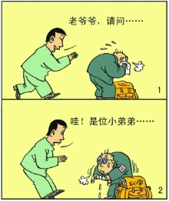
3.I guessed that there was probably a major misunderstanding.
3.misunderstanding(n.): a situation in which a comment, an instruction, etc. is not understood correctly 误解，误会
Mr. Li had a misunderstanding of the age of the person in front of him.
李先生搞错了在他前面的人的年龄。
misunderstand v.
Notes:
我第一次当老师，可能会有些啰嗦，还望各位童鞋海涵！

Slide 7

4.In most places around the world, frowning and turning one’s back to someone shows anger.
4.turn one’s back to: to reject sb/sth that you have previously been connected with 不理睬；背弃，抛弃
e.g. The mother and the daughter turned their backs to each other.
这对母女互不理睬。
Notes:
我第一次当老师，可能会有些啰嗦，还望各位童鞋海涵！

Slide 8
Task
Write only five sentences to link the pictures below into a story with the key words and phrases just learned.
Notes:
我第一次当老师，可能会有些啰嗦，还望各位童鞋海涵！

Slide 9
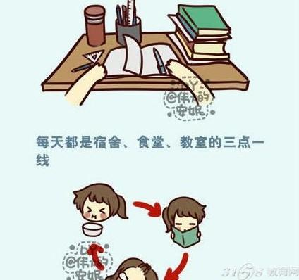
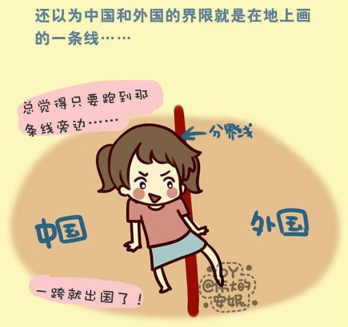

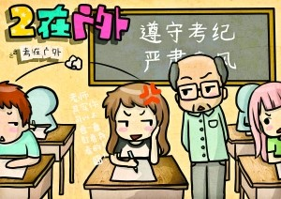
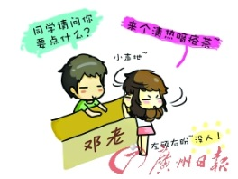
represent, defence, misunderstanding, turn one’s back to
Notes:
我第一次当老师，可能会有些啰嗦，还望各位童鞋海涵！

Slide 10
Example
Mary’s school life represents most of Chinese students’ lives in which the dormitory, canteen and classroom are three places they mostly frequent. Although Mary studied very hard, she still had some misunderstanding of knowledge, for example, she misunderstood that the boundary between China and foreign countries was just a line on the ground.
During an exam, Mary stood up and answered no firmly in defence of her innocence when the teacher suspected that she was cheating for the noise she made by accident .
After the exam, she went to the shop to buy herbal tea to cure her pimples caused by lack of sleep.
She decided to turn her back to the shopkeeper because he made fun of her pimples.

Slide 11
Homework
Write a few sentences to describe a kind of body language with the words and phrases we just learned.
Notes:
我第一次当老师，可能会有些啰嗦，还望各位童鞋海涵！

Slide 12
Thank you!

