Slide 1

The –ing form as the Attributive
-ing分词做前置定语表“主动或正在…的”语法学习
教材：人教版高中B4U4
东莞光明中学 李胜坚
华南师范大学 庄佳珊

Slide 2
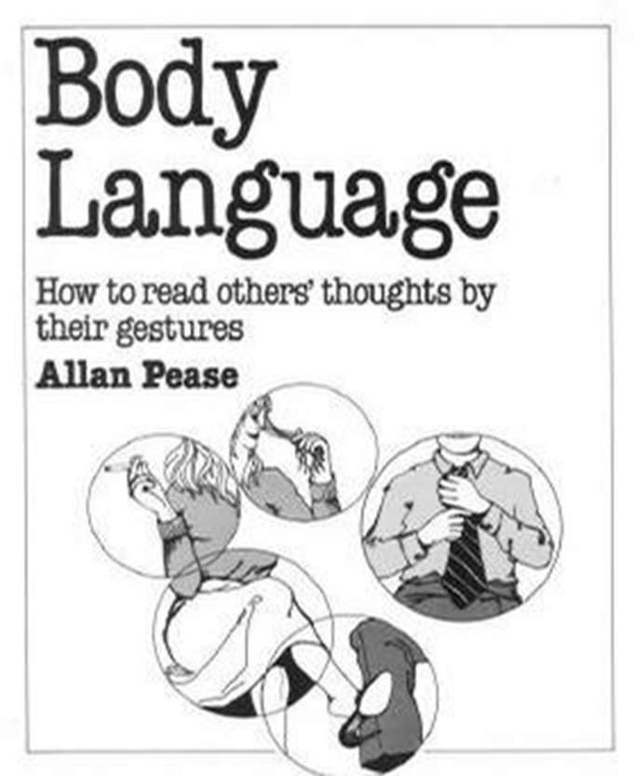
This is a very interesting book which contains
a lot of funny things.

Slide 3
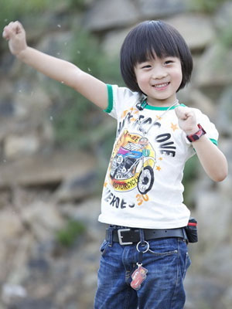
Smiling faces show that people are in good mood.
This smiling boy acted as Super Man.

Slide 4
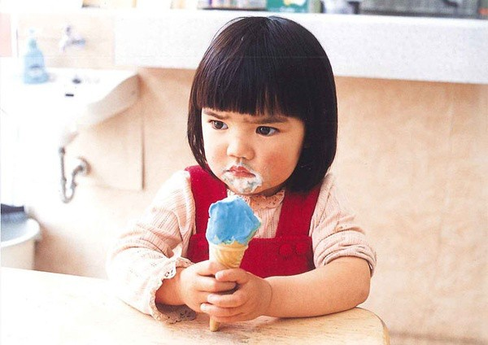
Frowning faces shows that people are angry.
The frowning girl was unhappy because she was criticized by her mother .

Slide 5
V+ing could be attributives to describe a noun.
-ing 分词可以做形容词，表示” …….的”
This is a very interesting book which contains a lot of funny things.
This smiling boy acted as a super man.
The frowning girl was unhappy because she was criticized by her mother .

Slide 6
This is a very interesting book which contains a lot of funny things.
arousing curiosity
interesting
interested
showing curiosity or concern about something or someone

Slide 7
由表示人的某种感情或情绪的动词变化而来的- ing结尾的形词，修饰物，表示“令人……的”常见的有： amusing, astonishing, boring, exciting, interesting, inspiring, moving, surprising；
对应的-ed结尾的形容词修饰人或表示人的声音、感情方面的词，表示“觉得……的”。
His __________ (interest) look suggested that the book was very __________ (interest).
他那种（对这本书）感兴趣的表情表明这本书很有趣。
interested
interesting

Slide 8

Make a poster
激动的声音
有趣的故事会
振奋人心的演讲

Slide 9

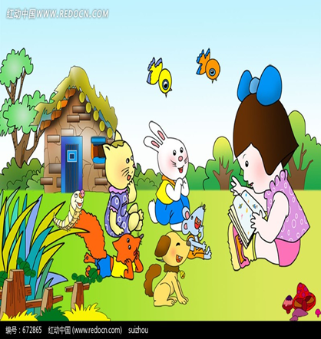

Excited Voice
Interesting Story-telling Section
Exciting Speech

Slide 10
The smiling boy acted as the Superman.

Slide 11
The smiling boy acted as the Superman.
The
boy
was
smiling
.
The
boy
acted
as the
Superman
.

Slide 12
Combine the two sentences into one.
1. The boy is sleeping.
The boy held his dad’s hand tightly.
2. I looked up to see a long line of birds.
The birds were flying.

Slide 13
Combine the two sentences into one.
The boy is sleeping.
The boy held his dad’s hand tightly.
The sleeping boy held his dad’s hand tightly.

Slide 14
Combine the two sentences into one.
2. I looked up to see a long line of birds.
The birds were flying.
I looked up to see a long line of flying birds.

Slide 15
Summary
现在分词作定语,当分词单独做定语时,放在所修饰的名词前,说明其修饰名词的性质或特征,表示“…的”和“供作…之用” 。
I think this book is interesting.
The crying boy wanted to buy a toy car.
I found the book in our school’s reading room.

Slide 16
Exercises
1. ________(bark) dogs seldom bite.
2. It’s pleasure to watch the face of a ________(sleep) baby.
3. The ______ (shake) buildings showed us that an
earthquake was coming.
4. This trip was the most ________(excite) adventure of
her life.
5.The _______ (excite) girl was lost in the park.
Barking
sleeping
shaking
exciting
excited

Slide 17
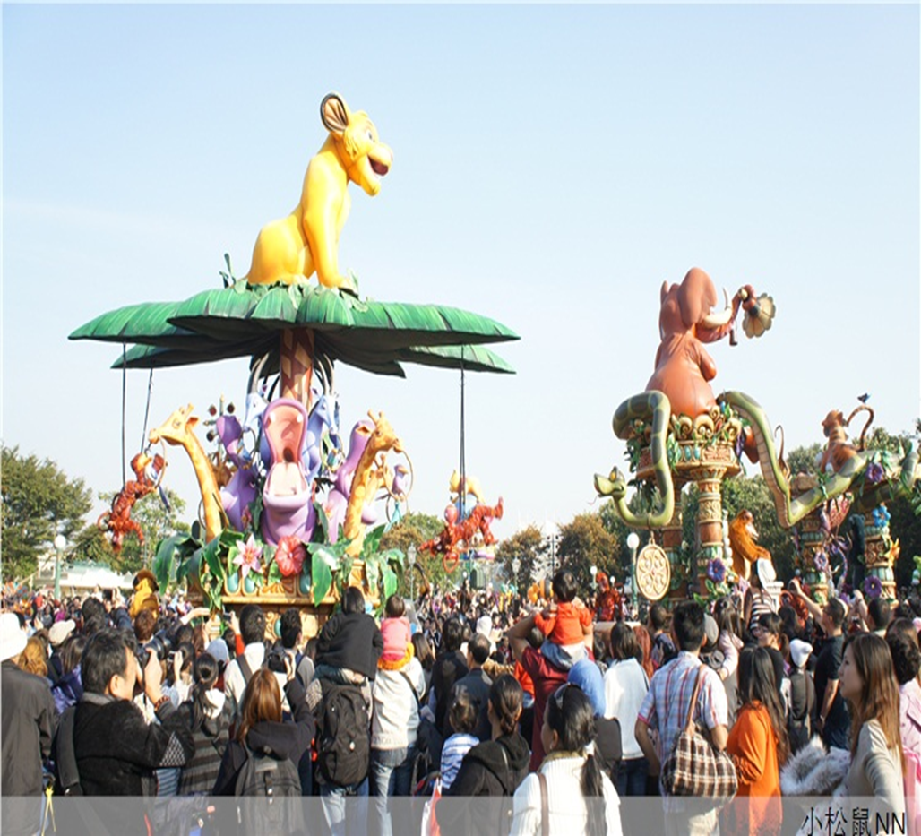

Let’s practice!
Alice gets lost with her parents. Will you give her a hand?

Slide 18
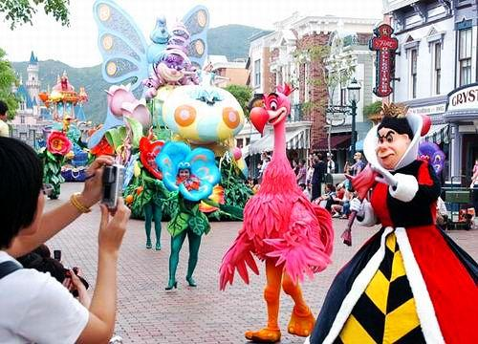
The moving bird is kind and taking photos with people.

Slide 19
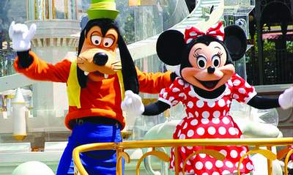
The smiling Minnie and her friend greet to people all the time.

Slide 20
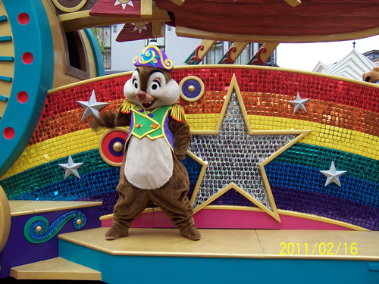
The dancing squirrel acts very well on the stage.

Slide 21
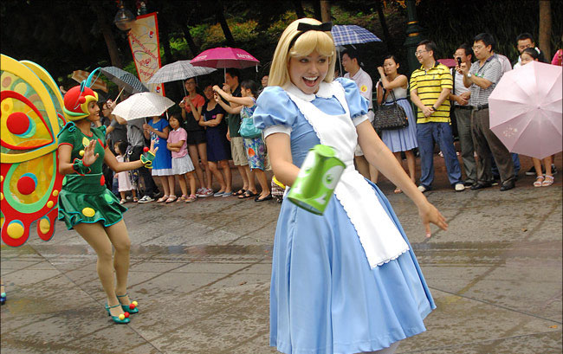
The laughing maid holds a tin in her hand.

Slide 22
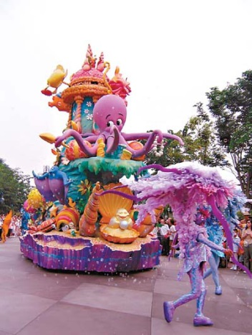
There is an approaching car with octopus on it.

Slide 23
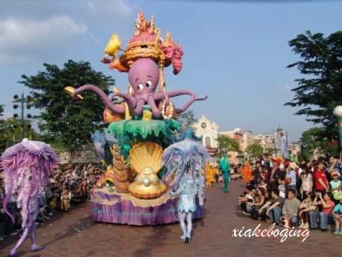

Slide 24
Summary
单个的-ing分词作定语时,放在所修饰的名词前,说明其修饰名词的性质或特征,表示“…的”或“供作…之用” 。

Slide 25
Homework
Make a short paragraph with the sentences you have used before.

