Slide 1

The Past Participle as the predicative
过去分词做表语
人教版高中英语
Book 5 Unit1
Great Scientists
华南师范大学 李青桦

Slide 2
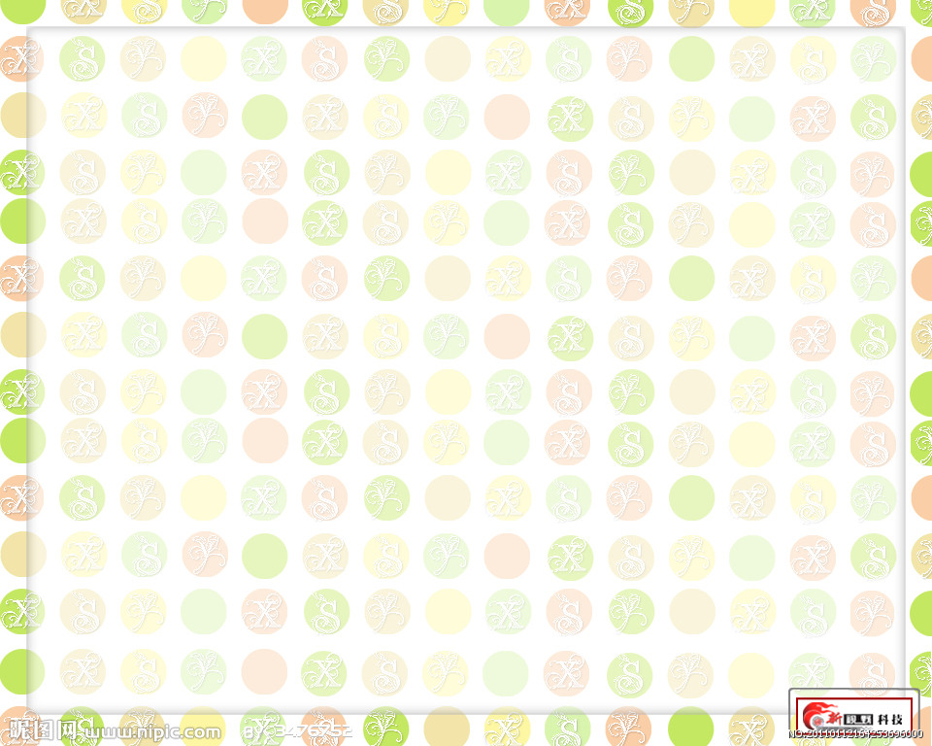
主+系+表
He is a student.
The book is interesting.
Be + n./adj.
He looks handsome.
It tastes delicious.
感官动词 + adj.
The leaves turn yellow at autumn.
The boy becomes taller.
表示变化的动词+ adj.
You should keep quiet.
Don’t worry. Stay cool.
延续性动词+adj.

Slide 3
1 过去分词（短语）作表语时，其作用相当于adj.,
说明的是主语的状态
He got interested in two theories explaining how cholera killed people.
All the windows are broken.
This man is married.
常见作表语的过去分词有： disappointed, drunk, amused, frightened, married, excited, experienced, interested, confused, pleased, puzzled, satisfied, tired, worried等。

Slide 4
2 过去分词做表语与现在分词做表语的区别
动词ing表示事物的 特征
动词ed表示主语所处的状态
The result of the test is disappointing.
I feel disappointed with the result of the test.
The story is very interesting
He is interested in the book.
He is interesting.

Slide 5
注意
过去分词作表语时和动词的被动语态结构相似，但两
者表达的意思明显不同，前者说明主语所处的状态，而后
者强调动作。
The glass is broken.
The glass is broken by my little brother.
(状态)
(动作）

Slide 6
Compete the sentences using the right form of the given verb.
I had nothing to do. I was __________ (bore) and lonely.
Jack looked even more _______ (amaze) than he felt.
The results were very _____________(disappoint).
bored
amazed
disappointing

Slide 7

Wonderful!

