Slide 1

新课标人教版B5U4
完全倒装
FULL inversion
东莞南城中学
何承城
华南师范大学
郭志仪

Slide 2
句子语序
1.英语句子的正常语序(the natural order):
主语在前，谓语动词在后。

Slide 3

基本语序natural order
subject 主+ predicate 谓 + …
I love you.

Slide 4
句子语序
1.英语句子的正常语序(the natural order):
主语在前，谓语动词在后。
2.倒装结构(the inverted order):
语序颠倒，谓语动词在前主语在后。
A.部分倒装（partial inversion）:
只把助动词或情态动词放在主语之前;

Slide 5
部分倒装
partial inversion
助动词/情态动词 + subject主 + V.谓 + …
Never will I forget you.

Slide 6
句子语序
1.英语句子的正常语序(the natural order):
主语在前，谓语动词在后。
2.倒装结构(the inverted order):
语序颠倒，谓语动词在前主语在后。
A.部分倒装（partial inversion）:
只把助动词或情态动词放在主语之前;
B.完全倒装（full inversion）:
把谓语的全部放在主语之前。

Slide 7
完全倒装
full inversion
predicate谓 + subject主+ …
Here came my cat.

Slide 8

方式
本
节
课
知
识
点
方位
句首
完全倒装
介词短语
V+S

Slide 9



Enjoy the music!
Notes:
Ferris Wheel 3-D transition effect and pictures
(Basic)
To reproduce the picture effects on this slide, do the following:
On the Home tab, in the Slides group, click Layout, and then click Blank.
On the Insert tab, in the Images group, click Picture. In the Insert Picture dialog box, select a picture and then click Insert.
Select the picture. Under Picture Tools, on the Format tab, in the Size group, click the Size and Position dialog box launcher. In the Format Picture dialog box, resize or crop the image so that the height is set to 3.86” and the width is set to 5.79”. To crop the picture, click Crop in the left pane, and in the right pane, under Crop position, enter values into the Height, Width, Left, and Top boxes. To resize the picture, click Size in the left pane, and in the right pane, under Size and rotate, enter values into the Height and Width boxes.
Also under Picture Tools, on the Format tab, in the Picture Styles group, click Drop Shadow Rectangle.
To reproduce the shape effects on this slide, do the following:
On the Home tab, in the Drawing group, click Shapes, and then under Basic Shapes, click Oval.
On the slide, drag to draw an oval.
Select the oval. Under Drawing Tools, on the Format tab, in the Size group, enter 0.13” in the Height box and enter 0.0” in the Width box.
Also on the Format tab, in the Shape Styles group, click the Format Shape dialog box launcher. In the Format Shape dialog box, click Fill in the left pane, on the Fill pane, select Solid fill, and then do the following:
Click the button next to color and then click White, Background 1 (first row).
In the Transparency box, enter 90%.
Also in the Format Shape dialog box, click Line Color in the left pane, in the Line Color pane, click No line.
Also in the Format Shape dialog box, click Size in the left pane, in the Size pane, under Size and rotate, in the Rotation box, enter 15°.
On the Home tab, in the Clipboard group, click the arrow to the right of Copy, and then click Duplicate. Repeat this process until there are 90 ovals on the slide.
Select one of the ovals. Position the oval below the bottom right edge of the picture.
Select another oval. Position the oval slightly over the right edge of the slide.
Press and hold CTRL, and then select all 90 ovals. On the Home tab, in the Drawing group, click Arrange, and then do the following:
Point to Align, and then do the following:
Click Align Selected Objects.
Click Distribute Horizontally.
Click Align Middle.
Under Group Objects, click Group.
To reproduce the text effects on the slide, do the following:
On the Insert tab, in the Text group, click Text Box, and then on the slide drag to draw your text box.
Enter text in the text box, and then select the text. On the Home tab, in the Font group, do the following:
Select Cambria from the Font list.
Select 24 pt. from the Font Size list.
Click Font Color and then click White, Background 1.
Click Italic.
To reproduce the animation effects on this slide, do the following:
On the slide, select the group of circles. On the Animations tab, in the Advanced Animation group, click Add Animation, and then click More Entrance Effects. In the Add Entrance Effect dialog box, under Moderate, click Float In.
Also on the Animations tab, in the Timing group, do the following:
In the Start list, select After Previous.
In the Duration box, enter 1.00 seconds.
Also on the Animations tab, in the Animation group, click Effect Options, and then click Float Down.
On the slide, select the text box. On the Animations tab, in the Advanced Animation group, click Add Animation, and then click More Entrance Effects. In the Add Entrance Effect dialog box, under Moderate, click Float In.
Also on the Animations tab, in the Timing group, do the following:
In the Start list, select With Previous.
In the Duration box, enter 1.00 seconds.
Also on the Animations tab, in the Animation group, click Effect Options, and then click Float Up.
To reproduce the transition effects on this slide, do the following:
On the Transitions tab, in the Transition to This Slide group, click More, and then click Ferris Wheel.
Also on the Transitions tab, in the Transition to This Slide, click Effect Options, and then click From Right.
Also on the Transitions tab, in the Timing group, do the following:
Clear the On Mouse Click box.
Select After, and then in the After box enter 4.00 seconds.
To create the second and third slides, do the following:
Select the slide. On the Home tab, in the Slides group, click the arrow below New Slide, and then click Duplicate Selected Slides. Repeat this process for a total of three slides.
In the Slides pane, select the second slide.
On the slide, select the picture. Under Picture Tools, on the Format tab, in the Adjust group, click Change Picture. In the Insert Picture dialog box, select a picture and then click Insert.
In the Slides pane, select the third slide.
On the slide, select the picture. Under Picture Tools, on the Format tab, in the Adjust group, click Change Picture. In the Insert Picture dialog box, select a picture and then click Insert.
To reproduce the background on this slide, do the following:
On the Design tab, in the Background group, click Background Styles, and then click Style 12.
(Note: Taking this action will change the colors on the slide.)

Slide 10

完全倒装
full inversion
adv for place
地点副词
₊
s
V
Here comes the sun, here comes the sun,
and I say, it's all right.
Little darling, it's been a long cold lonely winter.
Little darling, it feels like years since it's been here.
Here comes the sun, here comes the sun,
and I say, it's all right.

Slide 11

The bus comes here!
地点副词
谓语动词
主语
Here comes the bus!

Slide 12

A dog is inside the box.
介词短语
谓语动词
主语
Inside the box is a dog.

Slide 13


表示方式或方位的副词或介词短语，如there，now, then， up， down， away，in front of the house等置于句首时，要使用完全倒装。
V+S
the bell
goes
there
the chairman
came
then
the river
lies
in front of the school

Slide 14


注意：上述全部倒装的句型结构的主语必须是名词，如果主语是人称代词则不能倒装。
Here he comes.
Away they went.

Slide 15


Describing the pictures
V+S
adv for place
subject
verb
There lives an old fisherman.

Slide 16
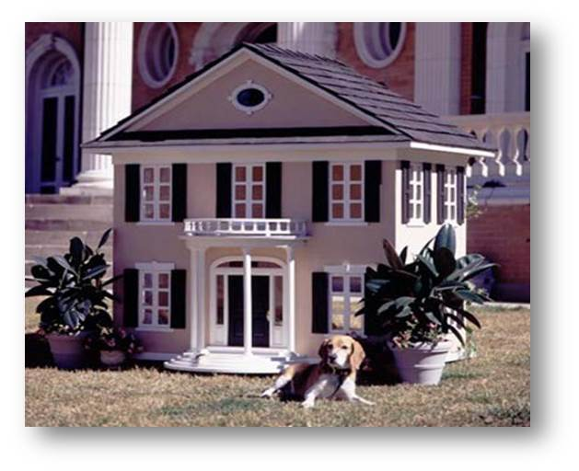
V+S
Prep phrase
verb
subject
Outside the house sits the dog.

Slide 17

用完全倒装句翻译以下句子
1.Here for you.
这儿有你一封信。
as
letter
is s
rushed s
students s
2.Out to welcome the foreign friends. 学生们涌出去欢迎外国朋友。
the
3. Look, there !
看，你朋友来了。
comes
your
friend
fell
the
man
4. Down .
那个男的倒下了。
comes
your
turn
5.Now to play.
现在轮到你玩了。

Slide 18



