Slide 1

新课标人教版
B
O
O
K
5
华南师范大学外国语言文化学院
陈海莲

Slide 2

Let’s listen to a dialogue
in our daily life!

Slide 3

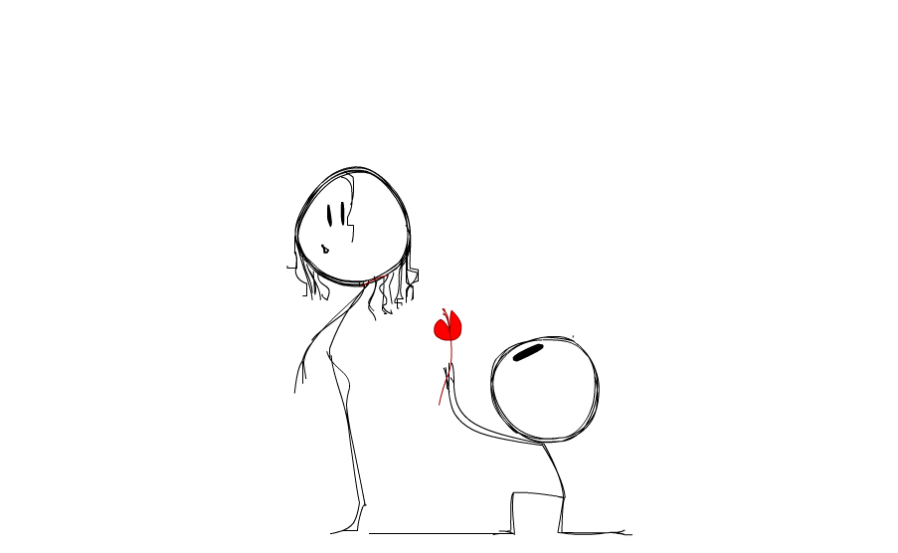

S
C
E
N
E
A customer and a server in a restaurant.
Fruit juice, cakes and refreshments（茶点）, and everything（应有尽有）.
Would you like to have a dish of cream of wheat(麦片粥）?
Sir, what can I do for you?
Yeah, I’d like to, and I also want some bacon and eggs with buttered toast.
Any cereal(谷类食品), sir?
I’d like to have a glass of tomato juice, please!
I’d like to, and I also want some bacon and eggs with buttered toast.
Do you have any recommendation?
What have you got this morning?
No, that’s enough. Thank you.
Sir, anything more?
Beg your pardon?

Slide 4
Let’s listen to the dialogue again and find out the difference!

Slide 5
S
C
E
N
E
A customer and a server in a restaurant.
We have got fruit juice, cakes and refreshments （茶点）, and everything（应有尽有）.
Yeah, I’d like to have a dish of cream of wheat, and I also want some bacon and eggs with buttered toast.
Would you like any cereal(谷类食品), sir?
Do you have any recommendation?
I’d like to have a dish of cream of wheat , and I also want some bacon and eggs with buttered toast.
Would you like to have a dish of cream of wheat(麦片粥）?
I’d like to have a glass of tomato juice, please!
Sir, what can I do for you?
Sir, would you like anything more?
What have you got this morning?
I beg your pardon?
No, that’s enough. I thank you.

Slide 6

Version 1
Which version do you prefer？
Why version 1 is better?

Slide 7
Version 1 : Yeah, I’d like to, and I also want some bacon and eggs with buttered toast.
Version 2 : Yeah, I’d like to have a dish of cream of wheat, and I also want some bacon and eggs with buttered toast.
Version 1 : Fruit juice, cakes and refreshments, and everything.
Version 2 : We have got fruit juice, cakes and refreshments, and everything.
Version 1 : Beg your pardon?
Some unnecessary words are missing, but the meaning can be still understood in the context.(上下文/语景）The dialogue is more brief and clear!!!
Version 2 : I beg your pardon?

Slide 8
Ellipsis（省略）
(Grammar) The act of leaving out a word or words from a sentence deliberately, when the meaning can be understood without them.
为了使语言简洁或避免重复，省略句中的一个或几个句子成分，这种语法现象称为省略。
这些句子就叫做省略句（elliptical sentences）。

Slide 9
Elliptical sentences（省略句）
(I )Beg your pardon?
★omitting the subject（省略主语）
(I) Thank you.
(We have got) Fruit juice, cakes and refreshments, and everything.
★omitting the subject & the predicate（省略主谓）
(Would you like) anything more?
Yeah, I’d like to (have a dish of cream of wheat) , and I also want some bacon and eggs with buttered toast.
★omitting the verb after “to” in an infinitive
（不定式to后省略动词）

Slide 10
Let’s see some elliptical sentences from our text book!

Slide 11
One or more words have been left out, could you know the missing words?
1.For first degree burns, you place cool, clean, wet cloths on them
until the pain is not so bad. (省略主语)
2.You remove clothing using scissors if necessary unless it is stuck to the burn. (省略主语)
3.You take off other clothing and jewellery near the burn. (省略主语)
4.First degree burns (省略主谓)
● First degree burns are dry, red and mildly swollen.
● First degree burns are mildly painful.
● First degree burns are turn white when pressed.
1.For first degree burns, place cool, clean, wet cloths on them
until the pain is not so bad.
2.Remove clothing using scissors if necessary unless it is stuck to the burn.
3.Take off other clothing and jewellery near the burn.
4.First degree burns
● dry, red and mildly swollen
● mildly painful
● turn white when pressed

Slide 12
1.omitting the subject（主语）
2.omitting the subject & the predicate
(主语&谓语）
oral
3. omitting the verb after “to” in an infinitive （不定式to后省略动词）
Ellipsis
（省略）
e.g.
I’d love to, I’d like to…
1.omitting the subject（主语）
written
2.omitting the subject & the predicate
(主语&谓语）
PS: Ellipsis is more often used in daily conversation.

Slide 13

THANK YOU!

