Slide 1
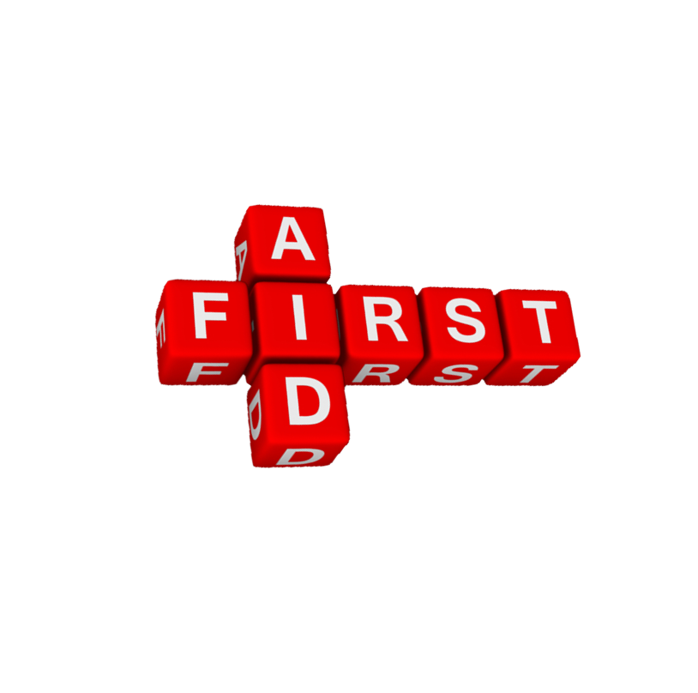
Book 5 Unit 5 First Aid
Workbook Speaking Task
习题讲解
First Aid Quiz
授课者：
华南师范大学
陈丹琳 Catherine

Slide 2
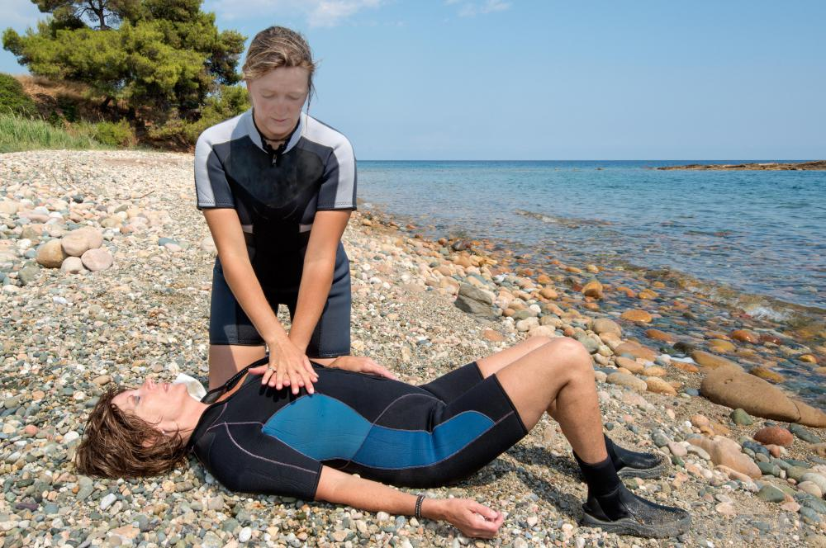
1
Which person would you help first ?
rescue breathing
心肺复苏
人工呼吸
A. Li Yan who has cut her foot on glass
B. Xue Jin whose nose is bleeding
C. Gao Yuan who is on the ground not breathing
D. Wang Feng who has broken her arm

Slide 3
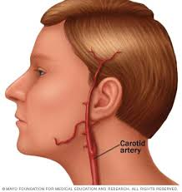
2
When you are carrying out rescue breathing. Where do you check for a pulse?
A. the neck
B. the wrist
C. the foot
D. the chest
carotid arteries
颈动脉

Slide 4
3
When carrying out rescue breathing. How many times a minute should you blow air into the victim’s mouth?
A. 4
B. 8
C. 15
D. 20

Slide 5
4
What should the first step be when you carry out rescue breathing?
A. clear the airway
B. blow into the victim’s mouth
C. check the pulse
D. check for breathing

Slide 6
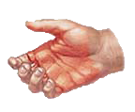
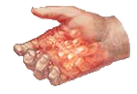
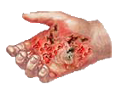
5
What is the most serious type of burn?
A. first degree
B. second degree
C. third degree
D. all burns are serious

Slide 7
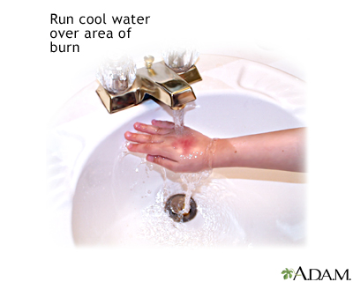
6
A friend took a hot pan off the fire with her bare hands. Her fingers are red and blistered and extremely painful. What should you for her?
A. tell her to put her fingers in her mouth
B. take her to the doctor
C. put butter on her fingers and wrap them in bandages
D. put her burned fingers under cool running water

Slide 8
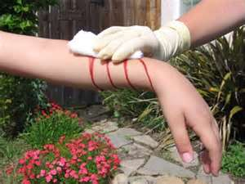
7
How would you stop severe bleeding?
A. cover the wound with plastic
B. wash the wound
C. do nothing, as the bleeding will stop by itself
D. put a bandage over the wound and then press on it

Slide 9
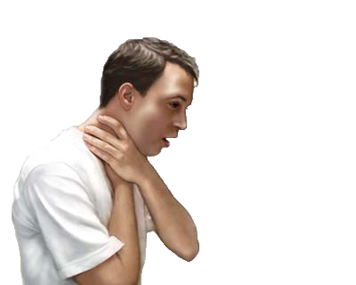
8
A friend is chocking on a piece of food and is coughing badly. What should you do?
A. nothing
B. have her lie down and rest
C. carry out rescue breathing
D. slap her four or five times on her back

Slide 10
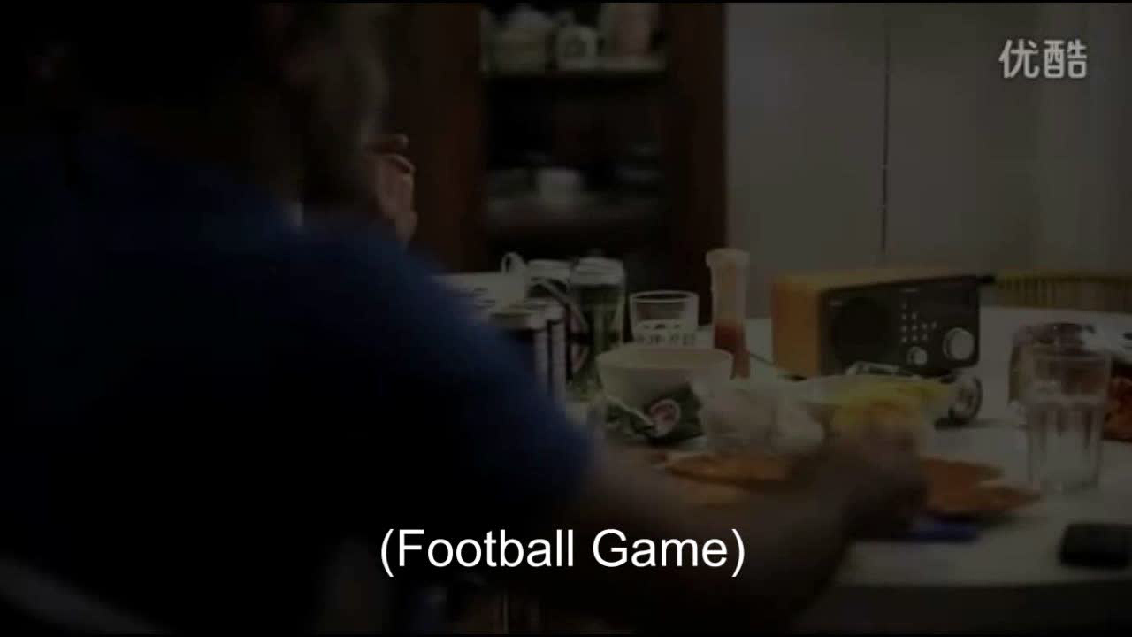

Slide 11
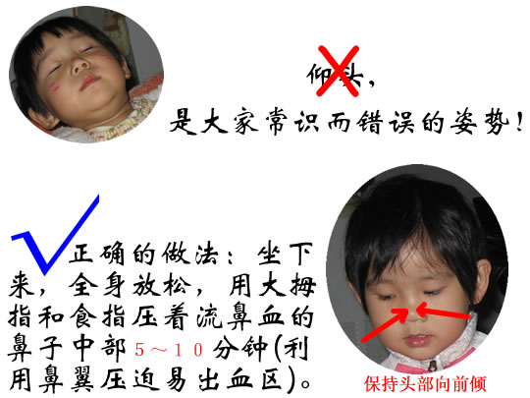
9
If a friend has a nosebleed, what should she do?
A. pinch her nose and jump up and down
B. lie down and pinch her nose
C. sit down, bend her head forward and pinch her nose
D. sit down, bend her head backward and pinch her nose

Slide 12
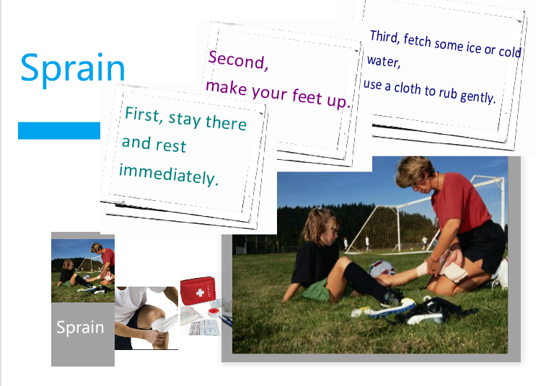
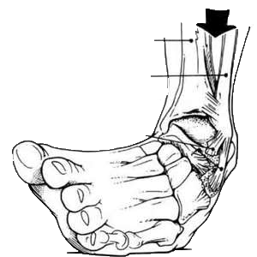
10
If your friend sprained his ankle, what should he do?
A. take off his shoe
B. keep walking around
C. put his foot up on a chair and then put warm clothes on his ankle
D. put his foot up on a chair and then put an ice pack on his ankle

Slide 13


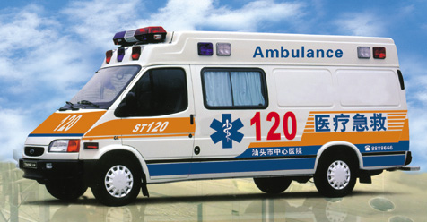
11
In a medical emergency in China what telephone number should you call?
A. 110
B. 114
C. 120
D. 119

Slide 14
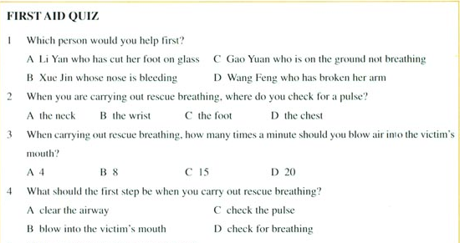
Form of a quiz
1.no punctuation
2.ellipsis

Slide 15
Thank you！
授课者：
华南师范大学
陈丹琳 Catherine

