Slide 1
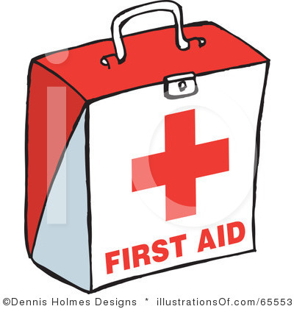
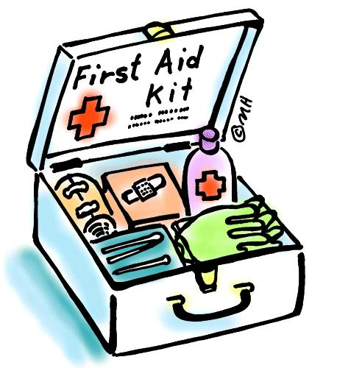
高中人教版必修5 unit 5 First Aid
——重点词汇讲解
授课者：洪小婷
指导老师：何亚菲
华南师范大学外国语言文化学院

Slide 2
burn v. 灼伤,烧伤
get burnt 烧伤
organ n. 器官
treatment n. 对待,治疗,处理
damage v/n. 毁坏,损坏
authentic adj. 真实的,真迹的
electric adj. 用电的,电动的
over and over again 重复

Slide 3
burn v. 烧伤，灼伤
(burnt/burned, burnt/burned)
Take care not to burn your fingers. 注意别烧着手指头。
If you are badly burnt, seek medical attention.
如果是严重烧伤，就得去看医生。

Slide 4
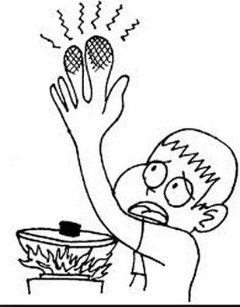
get burnt 烧伤
The boy got badly burnt.

Slide 5
burn v. 燃烧，着火
(burnt/burned, burnt/burned)
That boy was rescued from a burning house.
那个男孩被人从失火的房子中救了出来。
The building burned for hours.
这幢大楼燃烧了好几个小时。

Slide 6
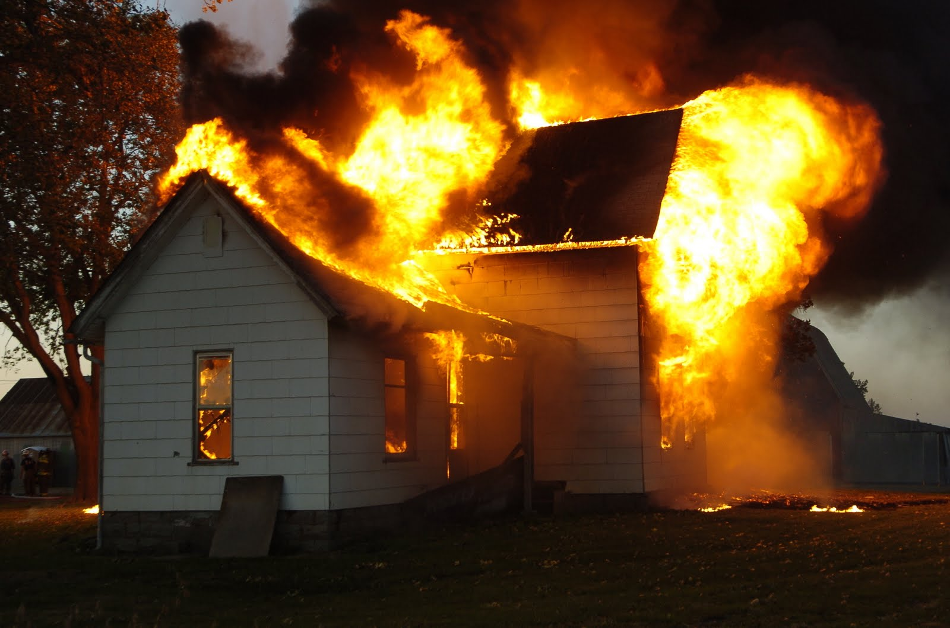

Slide 7
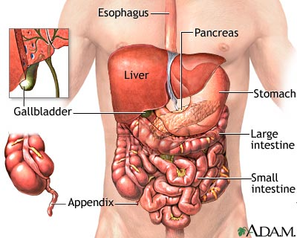
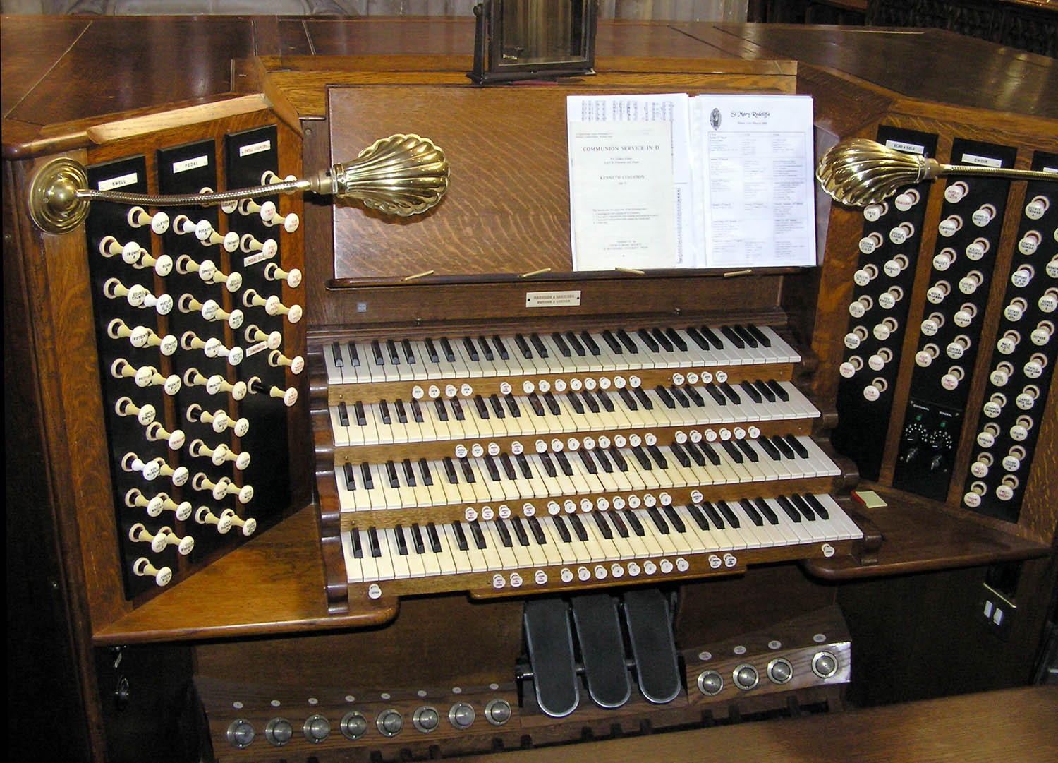
organ n. 器官; 风琴，管风琴
organization n. 组织，机构

Slide 8
treatment n. 处理；治疗
Many patients are not getting the medical treatment they need.
很多病人没有得到他们需要的医治。
treat v. 对待；处理
She adored Paddy but he didn't treat her well. 她深爱帕迪，但他对她却并不好。

Slide 9
damage n/v. 毁坏，损坏
He damaged a car with a baseball bat. 他用棒球棒恶意损毁了一辆汽车。
The blast caused extensive damage to the house.
爆炸给这所房子造成了大面积的损坏。

Slide 10
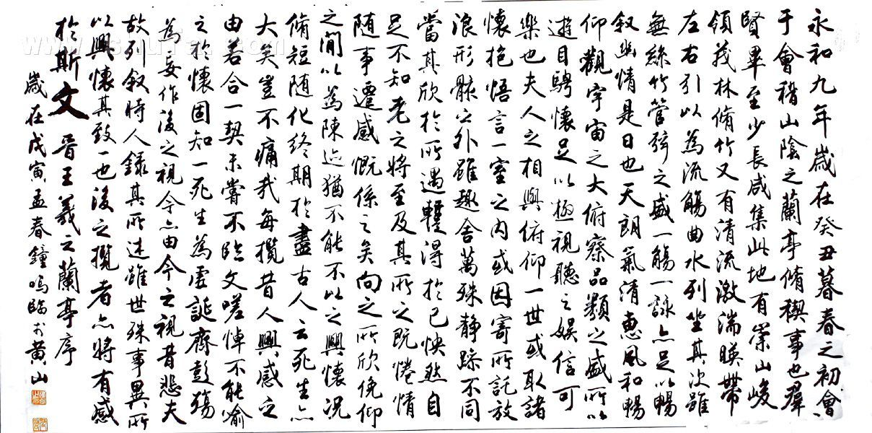
authentic adj. 真实的,真迹的,可信的
authority n. 权威,权力

Slide 11
electric adj. 用电的,电动的,带电的
He has an electric guitar. 他有一把电吉他。
He was sent to the electric chair.
他被送上电椅处决。
electrical adj. 电的,有关电的
electricity n. 电

Slide 12
electric adj. 用电的,电动的,带电的
electrical adj. 电的,有关电的
electronic adj. 电子的
electrical appliances 电器
electrical faults 电路故障
electronic computer 电子计算机
electronic music 电子乐

Slide 13
over and over again 重复
She combed her hair again and again.
她把头发梳了又梳。
synonyms:
over and over
again and again
time and again
time and time again

Slide 14
THANK YOU
授课者：洪小婷

