Slide 1

PPT模板下载：www.1ppt.com/moban/ 行业PPT模板：www.1ppt.com/hangye/
节日PPT模板：www.1ppt.com/jieri/ PPT素材下载：www.1ppt.com/sucai/
PPT背景图片：www.1ppt.com/beijing/ PPT图表下载：www.1ppt.com/tubiao/
优秀PPT下载：www.1ppt.com/xiazai/ PPT教程： www.1ppt.com/powerpoint/
Word教程： www.1ppt.com/word/ Excel教程：www.1ppt.com/excel/
资料下载：www.1ppt.com/ziliao/ PPT课件下载：www.1ppt.com/kejian/
范文下载：www.1ppt.com/fanwen/ 试卷下载：www.1ppt.com/shiti/
教案下载：www.1ppt.com/jiaoan/
Unit 1 Art
人教版高中英语选修六

Slide 2
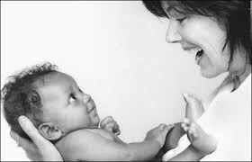


People began to concentrate less on religious themes and adopt a more humanistic attitude to life.
adopt vt. 1) take into one's family
2) choose and follow
adapt vt. 改编，使适应
Meaning?

Slide 3
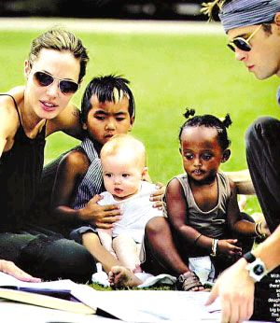
People began to concentrate less on religious themes and adopt a more humanistic attitude to life.
Peter adopted Angelina’s advice to adopt babies.

Slide 4
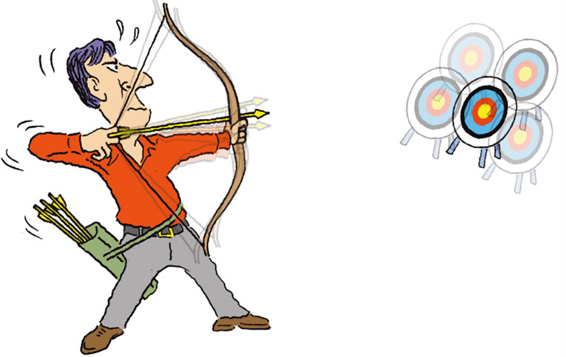

During the middle ages, the main aim of painters was to represent religious themes.
aim n．瞄准；目标，目的 v． 瞄准，对准，旨在
(1)without aim 漫无目的地
with the aim of 意在……
achieve one’s aim 达到目的
take aim at 向……瞄准
(2)aim at/for sth.力求达到
aim at doing sth.力争做到
aim to do sth. 旨在做某事
be aimed at 目的是，旨在
(3)aimless adj.无目的的

Slide 5
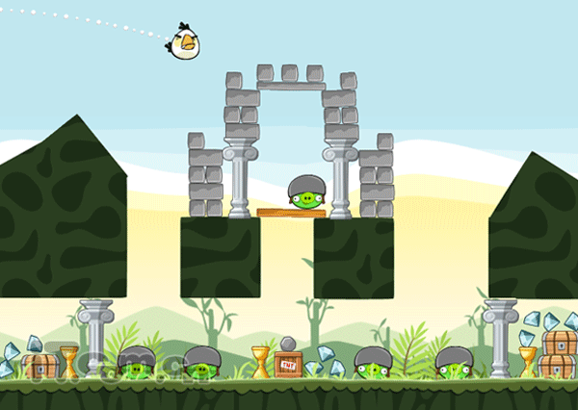
What is the angry bird _______ to do?
It is taking ____ at the pigs.
To achieve its _____, some exercises
are ______ at improving skills.
aiming
aim
aim
aimed

Slide 6
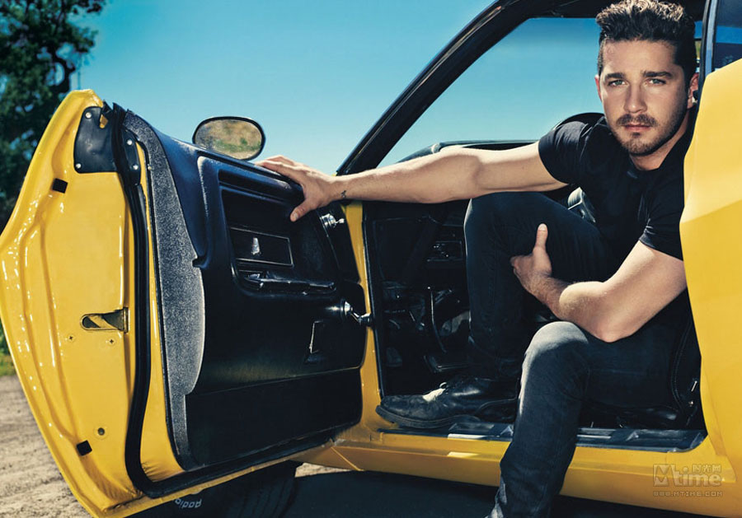
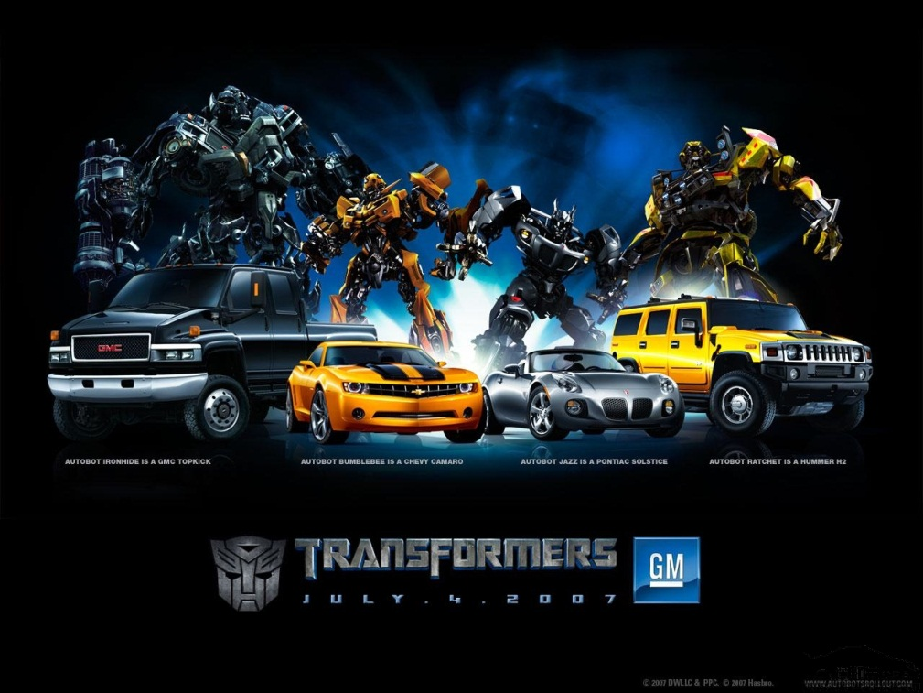
Possess/possession
The car Bumblebee（大黄蜂）Sam
was in possession of was once
in the possession of a worker.

Slide 7

Rich people wanted to possess their own paintings.
possess vt. 拥有；具有；支配
(1)possession n．(尤作复数)所有；财产
be in one’s possession(或be in the possession of)
为……所有；归……所有
be in possession of sth.拥有某物；占有某物
have possession of拥有(指买来或从别人那里拿来)
take possession of sth.拥有(占有)某物；拿到某物
(2)possessed adj.
be possessed of具有(某种品质、能力等)

Slide 8

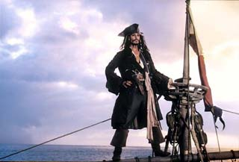
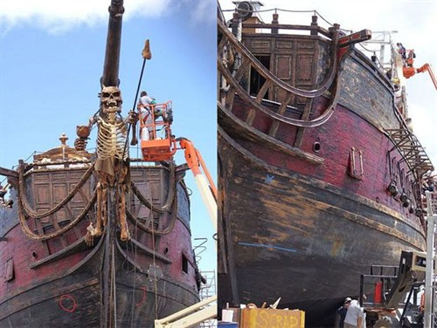
Have a try
possessed
Who _________ the boat “the Black Pearl”?
The boat was ________________ Captain Jack.
in the possession of

Slide 9
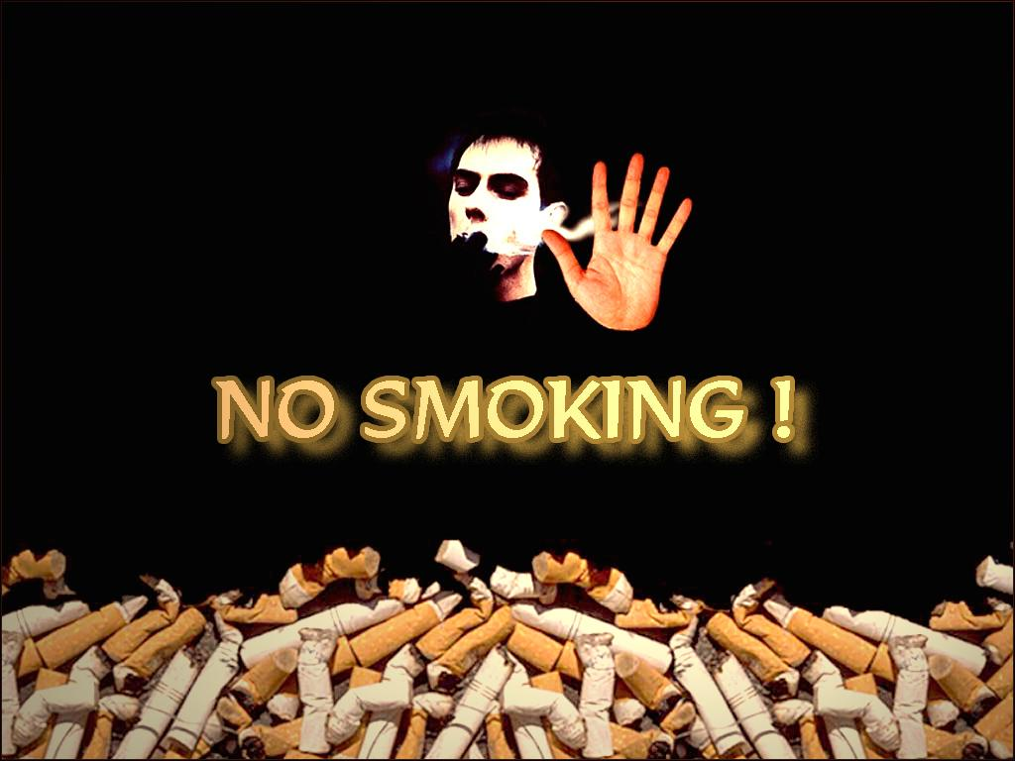

appeal
urgent request
The advertisement aims at appealing to people not to smoke.
The government makes an appeal for people’s health.
Does the idea of it appeal to you?

Slide 10
appeal v.
1) attract 2) ask for aid 3)call on
This film doesn’t appeal to me.
Our school is appealing to everyone to
donate money to Sichuan.
对某人有吸引力
呼吁某人去做某事
n. 为某事发出呼吁
a. appealing
1
3
appeal to sb.
appeal to sb. to do sth.
make an appeal for sth.

Slide 11


Have a try
lead a low-carbon life

Slide 12
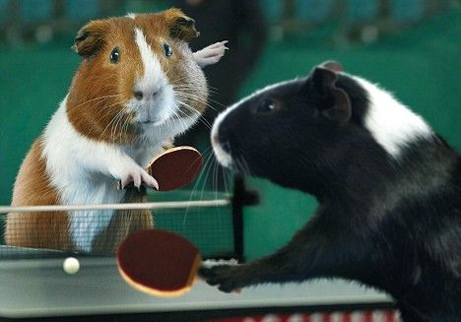
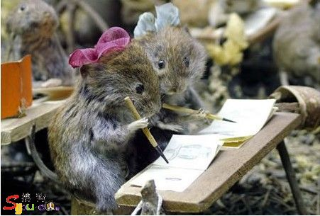
make an effort; try
attempt
They attempted to attend the Olympic Games.
They made an attempt at passing the exam, but it was so difficult that they passed it
at the fifth attempt.


Slide 13
  attempt n．
  make an attempt at doing
at one’s first attempt
attempt to do
a. attempted
尝试做某事
某人的第一次尝试
试图做某事

Slide 14

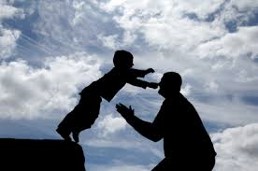
Art is influenced by the
customs and faith of a people.
n. 信用，信任； 宗教信仰； 忠诚； 宗教
e.g. I have great faith in you.
break faith with: 背信弃义
in good faith: 真心实意
have faith in: 对…有信心；信任
The boy has faith in his dad.

Slide 15


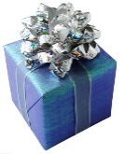

Exercise
1
7
3
5
8
2
4
6

Slide 16
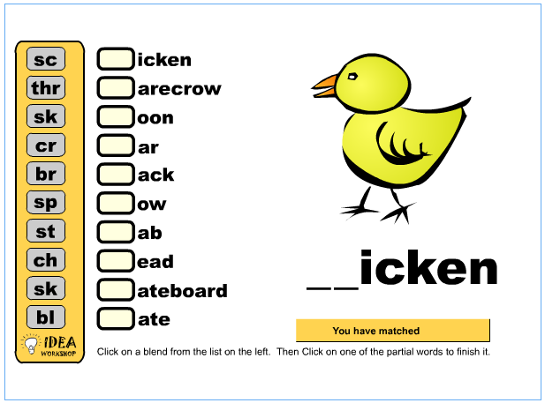
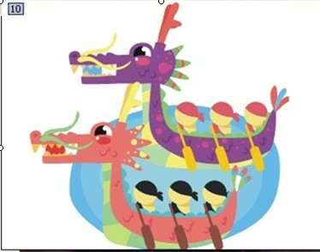
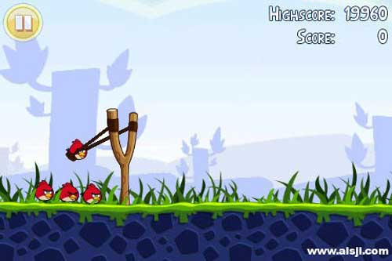
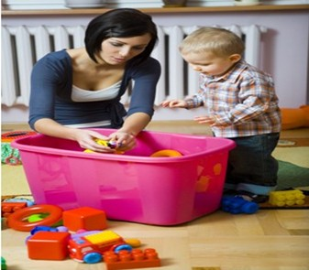
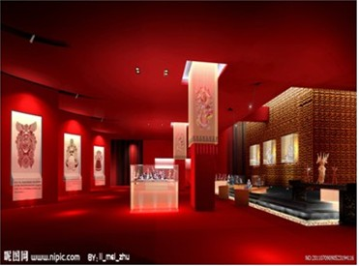
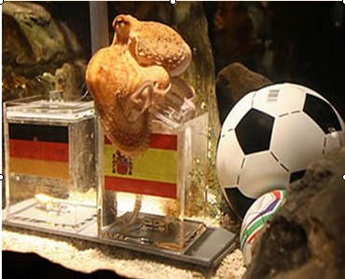
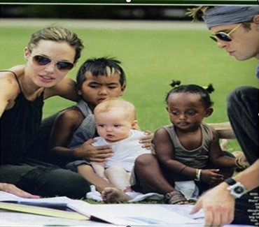
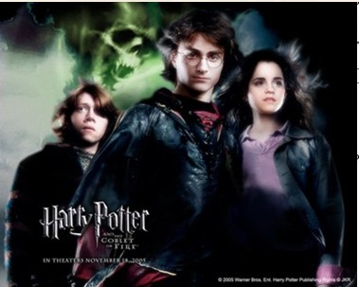
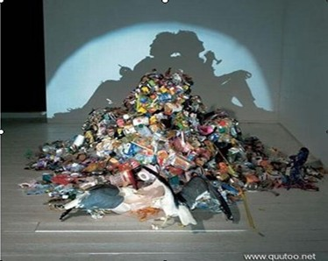
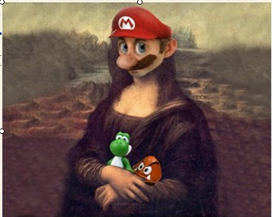

ap
hibition
po
peal
sp
ssess
ty
gure
ai
m
pr
pical
ad
adow
sh
ecific
fi
opt
ex
edict

Slide 17



have
The famous film Harry Potter was _______ from J.K. Rowling’s books, in which a young couple ________ an orphan who __________ _____________magic. Harry didn’t _____ to his new life, so he
_______to escape.
adapted
adopted
possessed
a great deal of
adapt
attempt
much

Slide 18

Completion (介词填空)
at
He aim the gun ___ the door.
I passed my driving test ___ the first attempt.
at
in
The ball was ___ the possession of Kobe.
They needed to appeal ___ his sense of humor.
to

Slide 19

Error correction(改错,句中只有一处错)
He managed to escape from the prison, but he couldn’t find anybody to help him.
attempted
He studied hard, aimed at passing the exam.
aming

Slide 20


<高考链接>
---How did you like Nick’s performance last night?
---To be honest, his singing didn’t ____ to me much. （2010 北京）
appeal B. belong C. refer D. occur

Slide 21
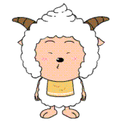
______ soldiers were sent to the area where the earthquake had happened.
A great deal of
B. A large number of
C. A great amount of
D. A plenty of

Slide 22

Jack is late again. It is____ of him to keep others waiting .
（2008 江西）
normal B. ordinary
C. common D. typical

Slide 23

aim
summary
adopt
possess
a great deal
appeal
attempt

