Slide 1

BOOK 6 UNIT 2
POEMS
Element of Poetry: Rhyme
东莞市中学英语微课堂
东莞市第四高级中学·袁洁宁
华南师范大学·罗家欢

Slide 2
Element of Poetry: Rhyme
If two words share the same “accented vowel sound(发重音的元音）and all of the following sounds, then they rhyme with each other. The use of rhyme often makes a poem more musical, more interesting and easier to remember.

Slide 3


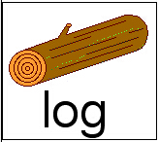
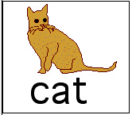

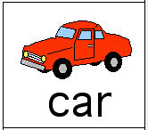
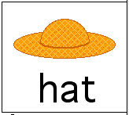

What is rhyme?

Slide 4
Exercise A
Find examples of rhyme by circling the words in the following poem

Slide 5
I saw a fish-pond all on fire
I saw a fish-pond all on fire
I saw a house bow to a squire
I saw a person twelve-feet high
I saw a cottage in the sky
I saw a balloon made of lead
I saw a coffin drop down dead
I saw two sparrows run a race
I saw two horses making lace
I saw a girl just like a cat
I saw a kitten wear a hat
I saw a man who saw these too
And said though strange they
all were true

Slide 6
I saw a fish-pond all on fire
I saw a fish-pond all on fire
I saw a house bow to a squire
I saw a person twelve-feet high
I saw a cottage in the sky
I saw a balloon made of lead
I saw a coffin drop down dead
fire-squire
high-sky
lead-dead

Slide 7
I saw two sparrows run a race
I saw two horses making lace
I saw a girl just like a cat
I saw a kitten wear a hat
I saw a man who saw these too
And said though strange they
all were true
race-lace
cat-hat
too-true

Slide 8
Exercise B
A Poem in Rhyme
Listen to the speaker reading the poem below and then fill in the blanks with the missing words.

Slide 9

Poetry
What is poetry? Who knows?
Not a rose, but the scent of the ______
Not the ____, but the light in the ____
Not the ___, but the gleam of the _____
Not the sea, but the sound of the ____
Not myself, but what makes me
See, hear, and feel something that prose
Cannot: and what it is, who _______
rose
sky
sky
fly
fly
sea
knows

Slide 10
Exercise C
Make your list of words that rhyme.
The first one has been done for you.
ring
race
string
king
space
face
wing
thing
place
case
fling
chase

Slide 11
too
sky
clue
two
tie
pie
canoe
shoe
lie
my
blue
fly

Slide 12
THANK YOU!

