Slide 1




Writing class
Unit 3 How to write an English Letter of Advice
suggestion
-----B6U3 A Healthy Life
华南师范大学
莫常林

Slide 2

On what occasions people need to give suggestions?
So, can anyone figure out solutions to this problem?
Well, I suggest that we can launch an advertisement campaign.
At the meeting

Slide 3
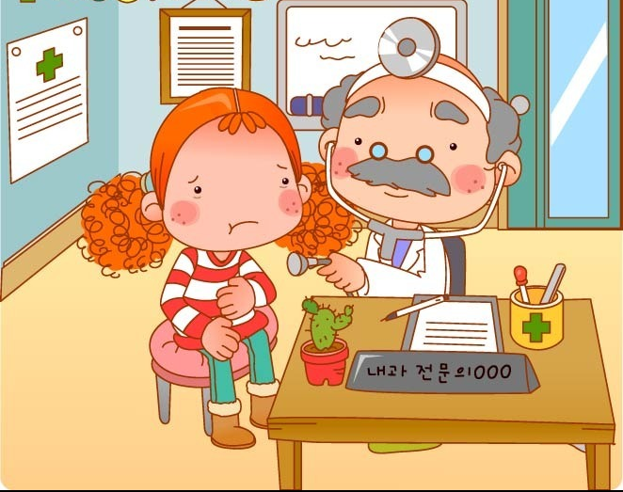
On what occasions people need to give suggestions?
Well. Nothing serious. Just have a stomachache. you’d better pay an careful attention to what you eat..
Doctor, what’s wrong with me? I feel terrible!
At the hospital

Slide 4







We always give others suggestions ！
Task: Imagine you are an adviser who deals with students’ problems. Now, you received a letter from a student called Li Xiaomei. Please read and reply it.

Slide 5



Slide 6
A letter asking for suggestions from Xiaomei
Dear Linda,
Can you help me please? My best friend has just started smoking. I do not like it and I told her what I thought, she laughed at me and said that I was not grown-up enough.
Then she offered me a cigarette and I felt so embarrassed and awkward. I did not know how to refuse it. Please help me. I do not want to start smoking, but I do not want to lose my best friend, either.
Yours sincerely,
Li Xiaomei
为晓梅劝其朋友戒烟出谋划策

Slide 7
A letter of advice (outline)
Salutation(称呼）
Dear Xiaomei,
Response: (回应) eg: I have received your letter.
Show your sympathy and understanding: （表示同情）eg：I know how you feel now.
Give your suggestions (给建议）
eg：Firstly, …. Secondly, …. Thirdly,….
Encourage Xiaomei to try given suggestions and wish her success （鼓励尝试并祝成功)
Yours sincerely,
Linda
Introduction (开头）
Main body（主体）
Complimentary close(结束语）
signature（签名)）

Slide 8


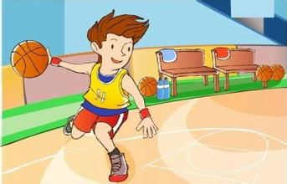
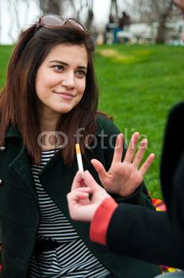

Brainstorm
头脑风暴
换位思考
The damages of smoking
Develop new positive hobbies
Suggestions
On Giving up smoking
Encouragement
and support
Say No to cigarettes directly

Slide 9


Useful sentence structures of giving suggestions:
.
You’d better do……
Eg: You’d better tell your friend the damages of smoking.
I suggest that you ………
Eg: I suggest you refuse your friend directly.
Perhaps you could do ……..
Eg: Perhaps you could help her develop other positive hobbies.

Slide 10
范文及分析
Dear Xiaomei, (salutation)
I have received your letter. Thanks for your trust. Actually, I can fully understand your present conflict feeling. I do hope my following suggestions would help you to deal with the problem: (introduction---response + understanding)
Firstly, you’d better tell your friend the damages of smoking both to one’s body and mind. Only when he knows this, can he realize smoking is not a behavior of mature. Secondly, I suggest you refuse your friend directly when she offers you a cigarette again to let her know your position. Thirdly, perhaps you could help her develop other positive hobbies, such as: singing, reading. New interests can distract her attention from smoking. Most importantly, give her support and encouragement of giving up smoking. (main body---suggestions)
Please try methods above and wish you success. (encourage her to try and wish)
Yours sincerely, (complimentary close)
Linda (signature)

Slide 11


Homework
Your brother wrote a letter to you and told you that he had no idea about how to persuade dad out of drinking. Now, reply your brother and give him your suggestions.

Slide 12

Thank you !

