Slide 1
先行主语It
新课标人教版 B6 U4
用法（一）不定式为真正主语
塘厦中学---谢贵华
SCNU---苏嘉丽

Slide 2
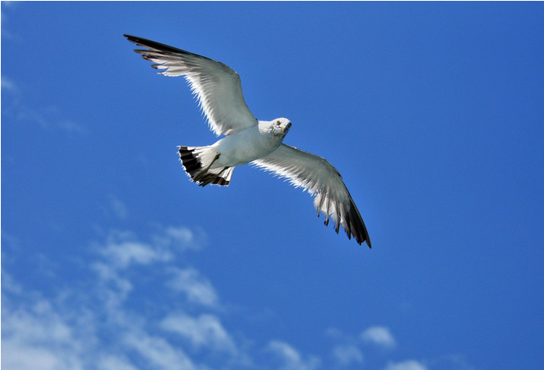

It is impossible for us to fly in the sky like a bird.
The bird is flying in the sky
It is a good idea to have an ice-cream now!

Slide 3
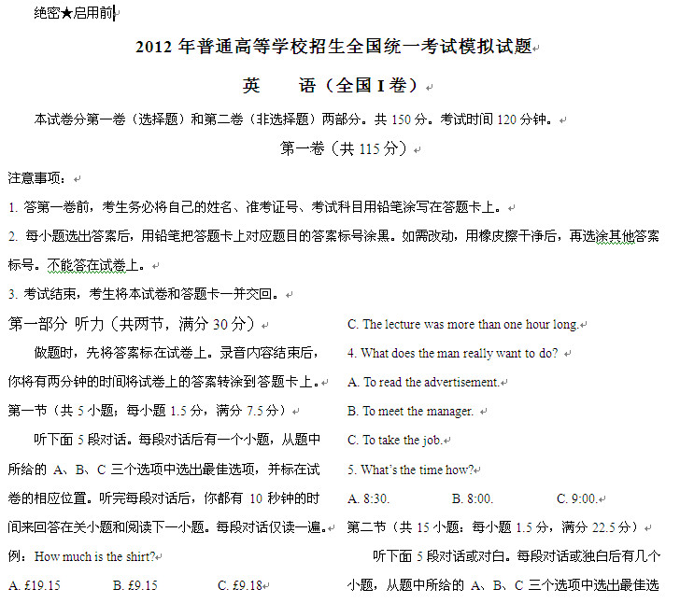
It takes us two hours to finish this paper!

Slide 4
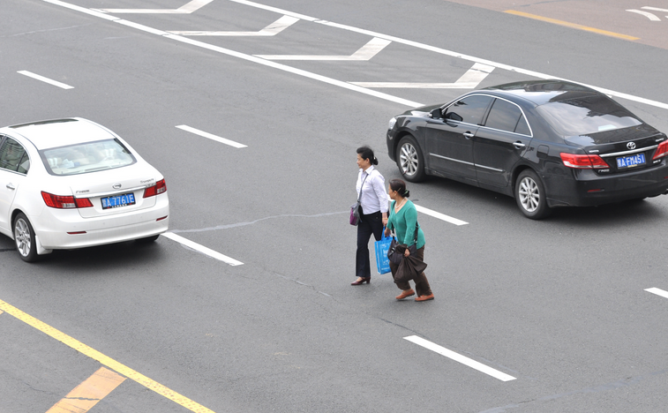
They are jaywalking. (乱穿马路)
It is against the law to do this.

Slide 5
先行主语it----Form
It is impossible for us to fly in the sky like a bird.
Be+adj.
It is a good idea to have an ice-cream now!
Be+n.
It takes me two hours to finish this paper!
It + V+…
It is against the law to do that.
Be+prep. phrase
Notes:
5

Slide 6
It + is/was + adj+ to do sth.
It + is/was + n. + to do sth.
It + is/was + prep. Phrase +to do sth.
It作现行主语
不定式作主语四种Form
It + v. +to do sth.
TIPS: 如果要说明不定式表示的动作是谁做的，
可以在不定式前加for + 名词或代词 + to do sth.
It is impossible for us to fly in the sky like a bird.
It’s necessary for the young to master two foreign languages.
Why “to do…” is the real subject???

Slide 7
先行主语it----Meaning
从中文的角度不难得知，不定式是真正的主语，it是形式主语。
TIPS： 在翻译时，把不定式部分的内容作为主语，颠倒英语中的语序。
It is important to know your limitations.
知道自己的局限性很重要。
It is a good idea to have a little notebook handy.
手边有个小笔记本是个好主意。
It is against the law to do that.
这样做是违法的。
It gave me great pleasure to see the movie.
观看电影让我很高兴。
Advantage???
Notes:
7

Slide 8
It is necessary to use a short-wave radio to pick up the programmers.
is necessary
to use a short-wave radio to pick up the programmers
主语过长，句子“头重脚轻”。
先行主语it----Meaning
作为形式主语的it并无实际语义，只是为满足语法上的需要。
避免句子头重脚轻，它代替的是句子的真正主语。
It’s wrong to lie.
=
To lie is wrong.
当不定式成分不会造成头重脚轻的影响时，可以不使用it 作为先行主语。
Notes:
更多模板、视频教程：http://www.mysoeasy.com
8

Slide 9
1. Giving up smoking is difficult.
2. We should take off shoes when entering the lab. (necessary)
3. The police think to keep order in an football match is a hard job.
4. 我们花费三年时间才完成了这项工作。（took）
5. To take part in the competition is full of challenge.
It’s difficult to give up smoking.
It’s necessary for us to take off shoes when entering the lab.
It’s a hard job for the police to keep order in a football match.
It took us three years to finish this job.
It’s full of challenge to take part in the competition.
先行主语it----Use Rewrite the Sentences
Notes:
更多模板、视频教程：http://www.mysoeasy.com
9

Slide 10
先行主语it用法（之一）
It为形式主语，不定式为真正主语
It + is/was+ adj. /n. /prep. phrase+ (for sb)to do sth
It+ v. +(for sb.) to do sth
Thank you
Notes:
更多模板、视频教程：http://www.mysoeasy.com
10

