Slide 1
华南师范大学外国语言文化学院
石榴菲
出品人

Slide 2


Book 5, Unit 3, Life in the Future
Time Travel
to the Future
(Vocabulary)

Slide 3
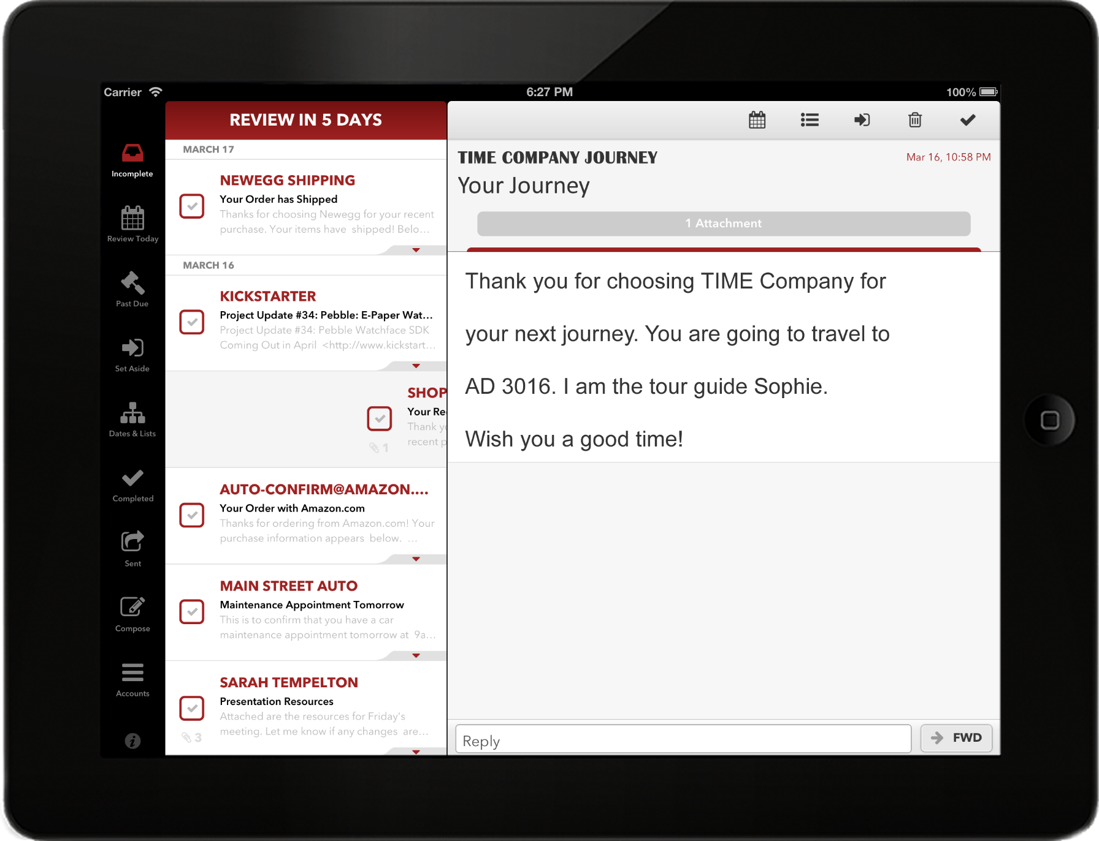


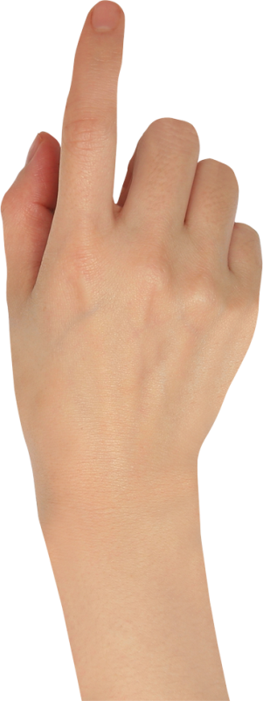
New Message

Slide 6
Welcome
Time Travel Laboratory
TIME

Slide 7
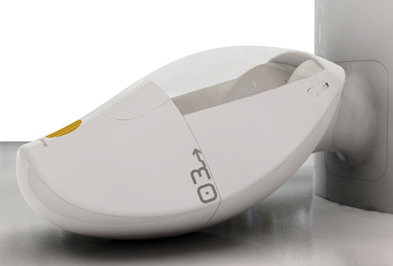



Vehicle for Time Travel
c psu e
capsule ['kæpsjuːl]
Time Capsule
n. ①A kind of medicine
②A spacecraft

Slide 8
In case of “time lag”,
you’d better take some tablets before starting the journey.

Slide 9
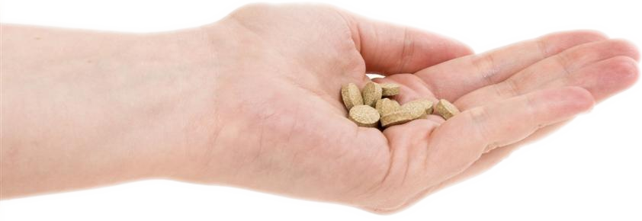
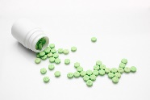

tablets
tablet [ ˈtæblət ]
n. a small, round medicine
Comparison
Capsule → elliptical
Pill → round or ball-shaped

Slide 10
Ladies and gentlemen, welcome aboard!
The destination of this flight is AD 3016.
We are ready to take off. Please be seated and fasten your
seat belt. We hope you enjoy the flight. Thank you.

Slide 11
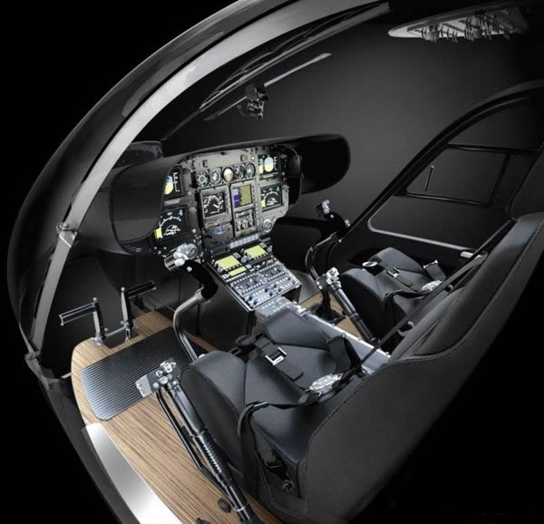

Learning Tips - suffix -en
strength → strengthen
length → lengthen
short → shorten
deep → deepen
fasten [ ˈfɑ:sn ]
vt. ① close sth by means of buttons or a strap
② attach one thing to another
Fasten the seat belt

Slide 12


Slide 13
March 16, 3016
Welcome to the future…
10:00 am

Slide 14
Welcome to AD 3016.
To visit the city, please transfer to a hovering carriage.

Slide 15
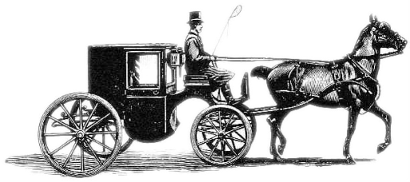
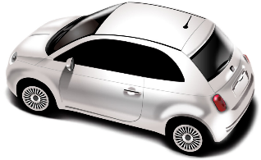

Transportation
Carriage [ ˈkærɪdʒ ]
19C
Car
21C
Hovering Carriage
31C

Slide 16


Hovering Carriage
A Carriage that could fly ?

Slide 17
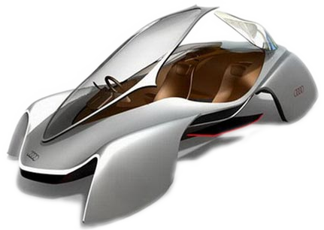
Carri
Car
Carriage
age
n.a mini-plane
Hovering Carriage
car
carri
age
Suffix
package
bandage
appendage
carry

Slide 18
The hovering carriage is driven by computer.
It frees the hands of human beings.
Next, let’s examine one of the latest forms of
communication among future citizens.

Slide 19
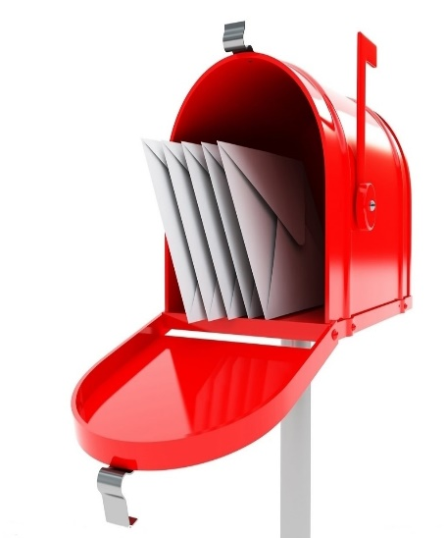
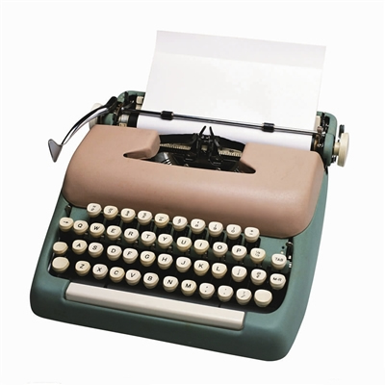
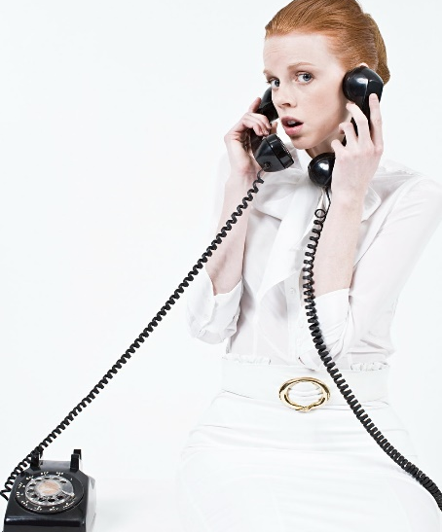
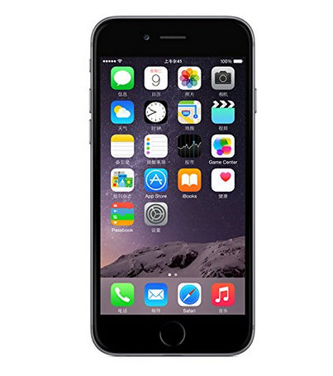
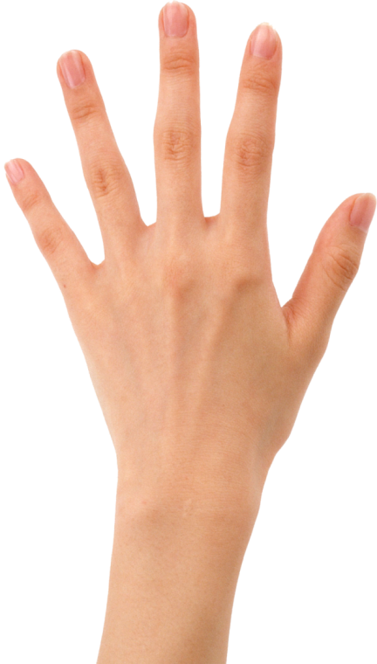
Communication
Letter
Typewriter
Telephone
Smartphone

Slide 20

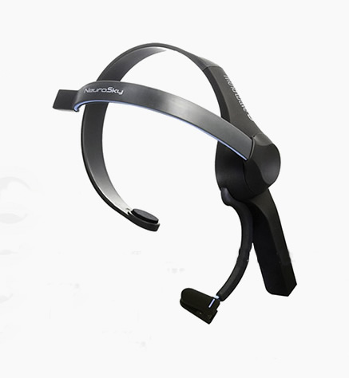








Communication
Button [ ˈbʌtn ]
Metal band
n. ①a small hard object used to fasten clothing
②small object on a machine
Sending button
Music
Every Single Day
Mad-Ne-Yo
Thoughtpad
Butt n

Slide 21
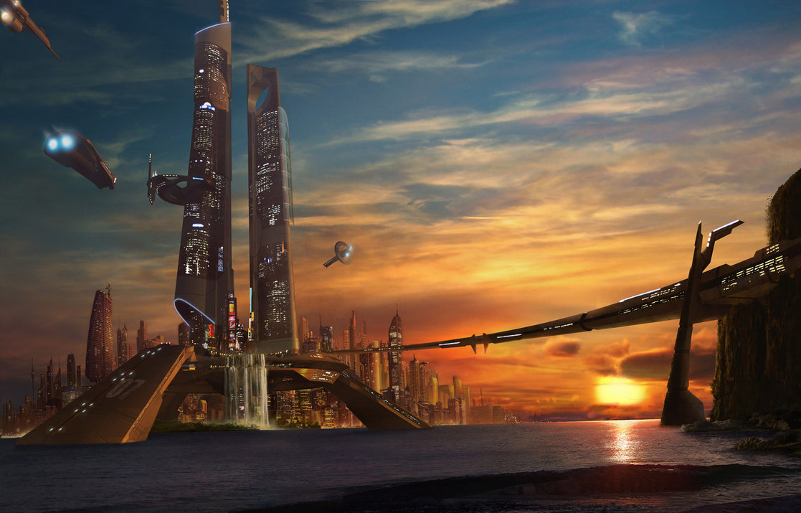
March 16, 3016
Have a nice day…
18:00 pm

Slide 22
Ladies and gentlemen, our journey is drawing to a close.
Next time, we will travel to AD 3516.
You can share your experience with your friends.
We are looking forward to see you again.

Slide 23
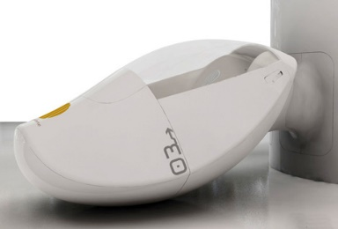


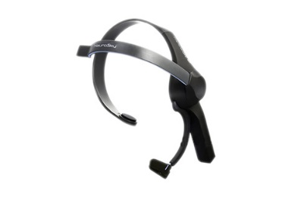
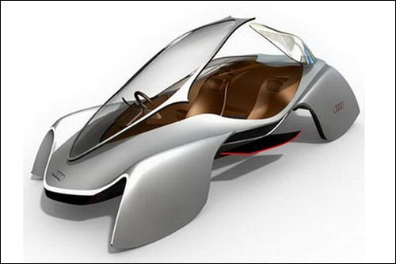
Flashback
time capsule
tablet
fasten
button
hovering carriage

Slide 24
THE CREW
Production manager SOPHIE
Voice Over SOPHIE
Production Supervisor PAUL
Copyright © 2016 Sophie.
All Rights Reserved.

Slide 25
THANK YOU

