Slide 1

Making the News
Unit 4
vocabulary new lesson
华南师范大学外国语言文化学院 王可君
龙川县实验中学 苏菊芳

Slide 2





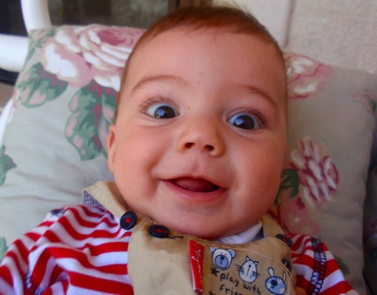
joyful?
delighted
excited?
happy?
Very happy and pleased

Slide 3
delighted
be delighted to do sth 对做某事感到高兴
be delighted at/by/with sth 因某事感到非常高兴
搭配
He was delighted with the present you sent.
他因你们所送的礼物而感到愉快。
例句
（1）我儿子对乘飞机去北京非常高兴。
My son is delighted _________________________________.
（2）我们为你的成功而感到高兴。
We were delighted __________________.
to fly to Beijing / to go to Beijing by plane
at / by your success

Slide 4


assist
1.to help someone to do something
2.to make it easier for someone to do something

Slide 5
assist
assist (sb.) with/in sth.在某方面帮助某人
assist (sb.) in doing sth.帮助某人做某事
搭配
错误说法：assist sb. to do sth
(1)我们帮你找个住的地方。
We will assist you ____________ somewhere to live.
(2)人们已经想出好多措施在日常生活方面来帮助残疾人。
People have thought of many measures _________ the
disabled ________ their daily life.
in finding
to assist
in/with

Slide 6
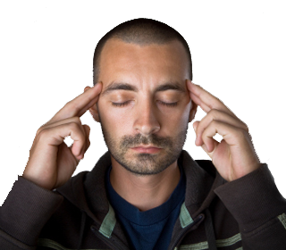

concentrate
to think very carefully about something that you are doing

Slide 7
concentrate
concentrate on (doing) sth 专心(干)某事
concentrate one’s efforts /attention on 把…集中在…
搭配
I can’t concentrate on my studies with noise going on.
吵闹声不绝于耳，我无法集中精神学习。
例句
我们必须致力于改善教育工作。
We must _____________ our efforts ___ improving education.
concentrate
on

Slide 8


acquire
1.to get or gain something
2.to gain knowledge or learn a skill

Slide 9
acquire
You need to acquire a good knowledge of English.
你需要好好掌握英语。
例句
怎样掌握记忆新单词技巧呢？
How to ________________ of memorizing new words?
acquire the skill

Slide 10
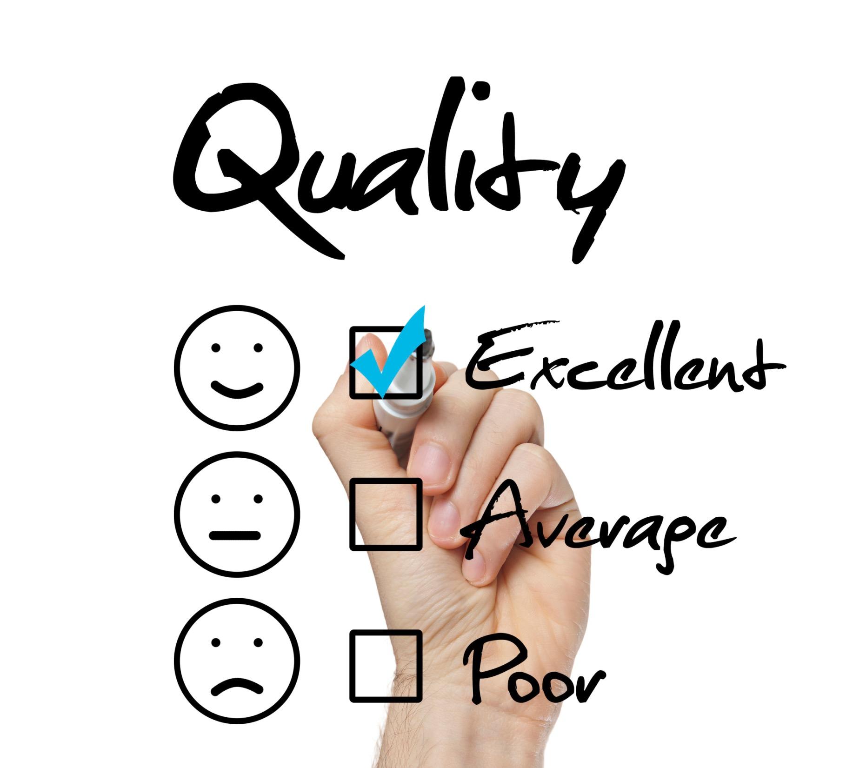

assess
to make a judgment about a person or situation after thinking carefully about it

Slide 11
assess
派生
assessment 评估；评定；估价
It’s difficult for us to assess the future of a man.
我们很难估计一个人的未来
例句
我们怎样评估这些价值呢？
How do we _________________ ?
assess the value

Slide 12


inform
to officially tell someone about something or give them information

Slide 13
inform
搭配
inform sb. of sth./that… 告知某人某事
Please inform us of your address.
请将您的地址告诉我们。
例句
当我到达这里时，我便告知母亲我已安全到达。
When I arrived here, I _____________________ my safe arrival.
informed my mother of

Slide 14
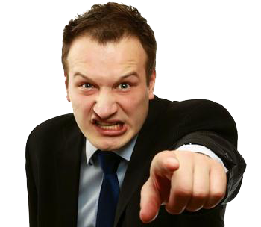

accuse
to say that you believe someone is guilty of doing something bad

Slide 15
accuse
搭配
accuse sb. of sth. 因…指责/控告某人
Sam accused her of lying.
山姆指责她说谎。
例句
（1）她控告他偷她的钱包。
She accused him _____________________.
（2）他指责老板不守信
_______________________ having broken his word.
of stealing her purse
He accused his boss of

Slide 16

demand
1. v.to ask for something very firmly, especially because you think you have a right to do this.
2. n.the need or desire that people have for particular goods and services:

Slide 17
demand
demand sth. of/from sb 向某人要某物
demand of sb. to do sth. 要求某人做某事
meet one’s demands 满足某人的要求
搭配
例句
I demand to know what’s going on.
我要求知道发生了什么。
Supply should rise to meet demand.
增加供给以满足需求。
(1)他要求被告知一切事情。
He demanded _____________(tell) everything.
(2)他要求我关上大门。
He demanded ______ me ___________(shut) the door.
(3)我要求你打扫完教室。
I demand that you ________________ (finish) cleaning the classroom.
to be told
of
to shut
(should) finish

Slide 18


approve
to officially accept a plan

Slide 19
approve
搭配
approve of 赞成，赞许，同意
例句
Do you approve of Jill’s new hairstyle?
你赞成吉尔的新发型吗？
The city council approved the building plan.
市议会批准了这项建筑计划。
（1）我的父母不准许我吸烟。
My parents don’t approve __________________.
of me/my smoking

Slide 20

process
n. A process is a procedure, something you do to achieve a certain result/goal.
v. to deal with an official document etc in the usual way ; to deal with information using a computer

Slide 21
process
in process 在进行中
in the process 在…的过程中
搭配
He was delighted with the present you sent.
他因你们所送的礼物而感到愉快。
例句
（1）我有些重要文件要处理。
I have some important documents ___________.
（2）那位老人正在手术中。
That old man was ___________________________.
to process
in the process of operation

Slide 22


Slide 23

Jane is a housewife, but delighted to work as an amateur journalist.
It is admirable that she is seldom accused of making mistakes because she concentrates on her job and updates herself now and then.

Slide 24


Once she is informed of a new case, she works as her normal working process.
To acquire accurate stories, she demands to record interview.

Slide 25

Her colleague assists her in taking photographs and she assesses the value of the interview.

Slide 26
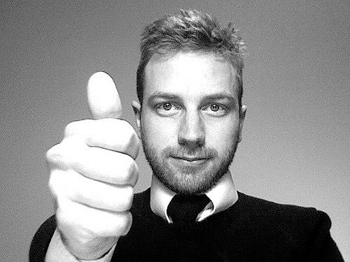
Then she writes thorough stories ahead of the deadline and submits it to the chief editor, who polishes and approves every section.
Finally, her stories will be published.

Slide 27
Thank you

