Slide 1
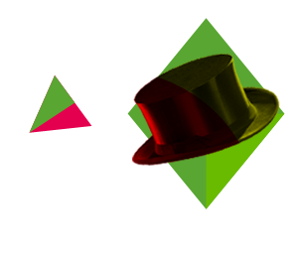

WELCOME
TO
ENGLISH
"WORD"
-- Book3 Unit4
河源市连平县隆街第二中学 叶美心
华南师范大学外国语言文化学院 巫金花
Notes:
请在此页填写作品信息（此页非设计模板）

Slide 2




in time
unlike
lay

Slide 3


in time
Always there when you call, always on time.
in time -- 按时；
及时（有恰好之意，在最后一刻终于...）
on time -- 按时
I arrived at the bus station in time.
I arrived at the bus station on time.
After running as fast as I can, I arrived at the bus station in time.
page25 para.2 line10 " They were in time to produce carbon, nitrogen..."

Slide 4
in time
in time -- 按时；及时
on time -- 按时
in no time -- 立刻；马上
at times -- 有时；经常
at a/one time -- (每)一次
I will be there in no time.
John is stubborn at times.
Enter two at a time.

Slide 5
in time
at one time -- 曾经；一度
at the same time -- 同时
at all times -- 总是；不论什么时候
all the time -- 一直
from time to time -- 偶尔
At one time I used to like her,but not any more.
I am good at math and art at the same time.
John gets the highest grade at all times.
John gets the highest grade all the time.
John gets the highest grade from time to time.

Slide 6
in time
in + month or year
on + date (with the year or without it) or day of the week
at + clock time, midnight, noon
in + season
in + morning, afternoon, evening
on + adj + morging, afternoon, evening
at + night- At night
Notes:
in + month or year- In March, In 2003
on + date (with the year or without it) or day of the week- On April 2, On March 3, 1999, On Saturday
at + clock time, midnight, noon- At 3:30 p.m., At 4:01, At noon
Remember also...
in + season- In the summer, In the winter
in + morning, afternoon, evening- In the morning, In the evening
at + night- At night

Slide 7
unlike
like -- (v.) 喜欢、 (prep.) 与...像
unlike -- un- + like -- 与...不像，与...不同
Unlike Facebook, Google has also found a way to turn this into a massively profitable business.
dislike -- dis- + like -- 不喜欢
I dislike John cordially; he is nothing but a cheat.
page26 line16 " ...unlike the earth, it had disappeared later. "

Slide 8
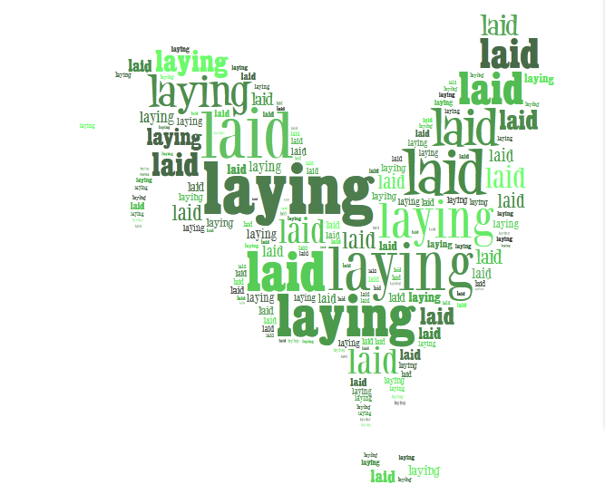
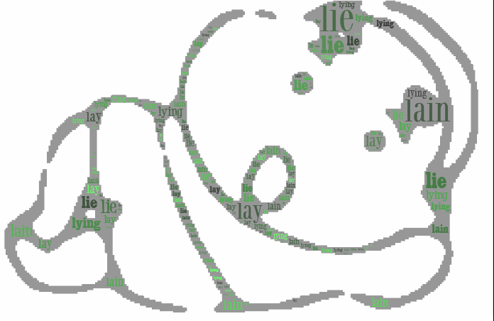

lay
放置；下蛋 lay - laid - laid - laying
躺下；位于 lie - lay - lain - lying
说谎 lie - lied - lied - lying
page 26 line39 " They produced young generally by laying eggs. "

Slide 9
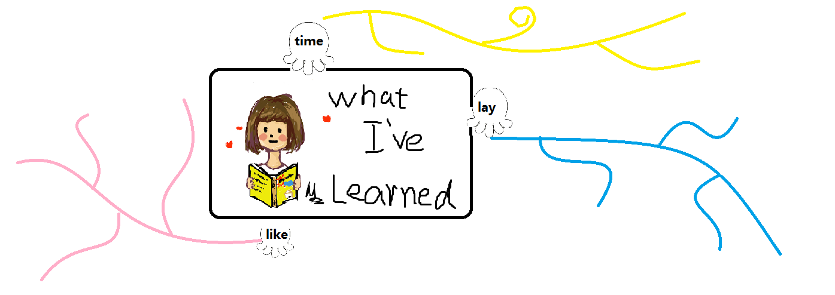
Homework
Draw an interesting mind map about the knowledge you've learned today.

Slide 10

See you next time
Thank you

