Slide 1

Time Travel
to the Future
---石榴菲 吴璇

Slide 2
RE: Welcome to time travel
Dear Guest,
Thank you for choosing us. I am a tour guide from TIME Company.
Now we are going to travel to AD 3016.
Wish you have a good time!

Slide 3
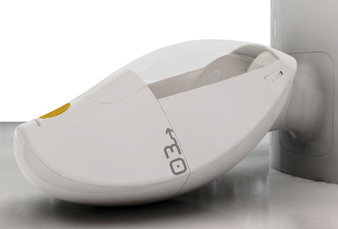


Vehicle for Time Travel
c psu e
Capsule ['kæpsjuːl]
Time Capsule
n. 太空舱；胶囊
Cap n.鸭舌帽

Slide 4
In case of “time lag”,
you’d better take some tablets before starting the journey.

Slide 5
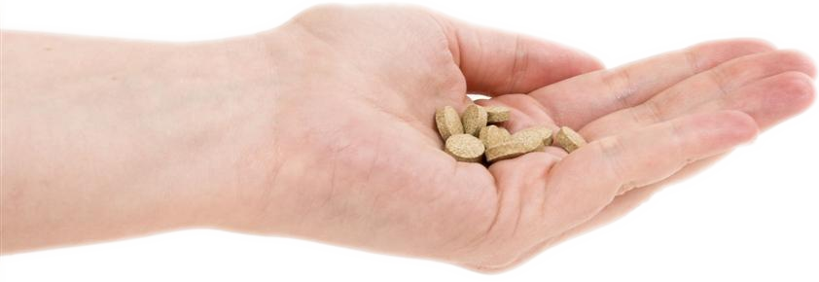
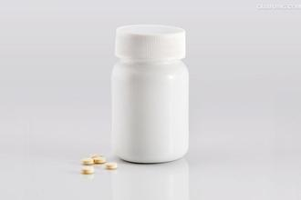
Tablets
Tablet [ ˈtæblət ]
n. 药片
Synonym: pill, medicine

Slide 6
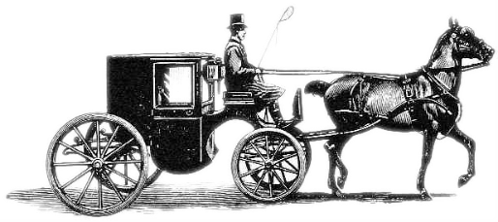
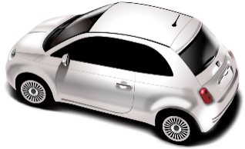
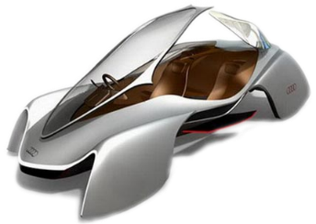
Transportation
Carriage [ ˈkærɪdʒ ]
n.四轮马车；火车客车车厢
19C
Car
n.小汽车
21C
Hovering Carriage
n.飞行器
31C

Slide 7
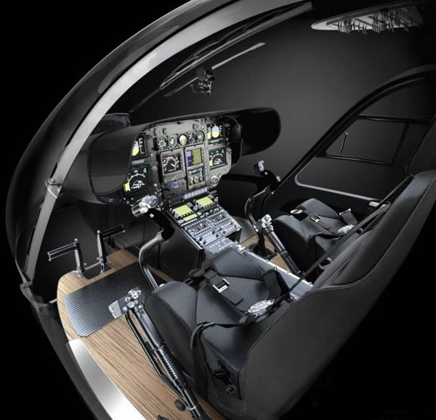

Transportation
fasten [ ˈfɑ:sn ]
vt. 系牢，系紧
Don’t be in a hurry(too fast). You should check whether you have fasten your seat belt before starting the car.
Fasten the seat belt
系好安全带

Slide 8
Transportation
Learning Tips-suffix
-en
Fast  fasten
Strength  strengthen
Length  lengthen
…

Slide 9

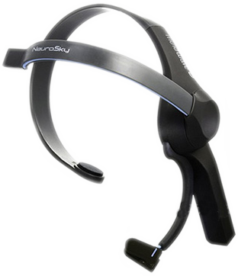

Communication
No more letters
No more typing
No more postage or postcode!
No more typists working on a typewriter.
Thoughtpad
No more cellphones
Is all you need!
You don’t even need a screen.

Slide 10




Communication
Button [ ˈbʌtn ]
n. 按钮；纽扣
Metal band
Butt n
Receiver
Receiver [ rɪˈsi:və(r) ]
n. 接受者；接收器；
电话听筒
Sending button
Thoughtpad

Slide 11
Communication
Learning Tips-suffix
-er
receive  receiver
cook  cooker
fish  fisher
…

Slide 12
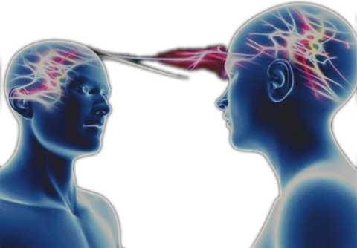
Communication
1
Easy to use
Thoughtpad
2
Efficient
3
Environmentally friendly

Slide 13
Waster disposal
There are many rubbishes made by people.
01
Dustbins are used to protect environment.
02
Recycle the rubbishes and save the energy.
03
To keep ecology balance is our duty.
04

Slide 14
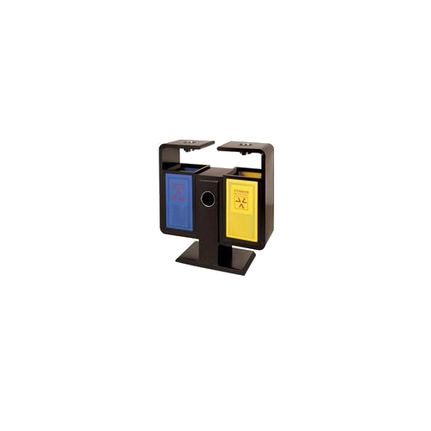

Waster disposal
Dustbin[ˈdʌstbɪn]
n. 垃圾箱; 灰箱; 尘箱

Slide 15

Waster disposal
Recycle [ˌri:ˈsaɪkl]
vt. 回收利用; 使再循环;
vi. 重复利用;

Slide 16
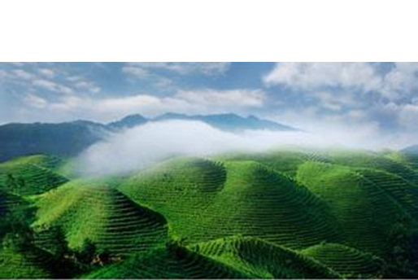
Waster disposal
Ecology[iˈkɒlədʒi]
n.生态学; 社会生态学;
个体生态学;
单击此处添加文字单击添加文字
单击此处添加文字内容
单击此处添加文字添加文字

Slide 17
Waster disposal
Learning Tips-suffix
-ology
Ecology 生态学
Biology 生物学
Phytology 植物学
Zoology 动物学
Psychology 心理学
Anthropology 人类学
…

Slide 18
THANK YOU
Dear Guest,
Your trip of future life is going to end. Thanks for your choice and we hope that it would be a wonderful experience.
Now we are going to go back to AD 2016.
Wish you have a good life!

