Slide 1

新课标人教版英语
Book2 Unit 3
computer
授课者：华南师范大学外国语言文化学院 肖秋菊
合作老师:河源市河源中学 黄小丽

Slide 2
Text in Book 2 Unit 3 ---Who am I?
These changes only became possible as my memory improved. First it was stored in tubes, then on transistors and later on very small chips. As a result I totally changed my shape. As I have grown older I have also grown smaller. Over time my memory has developed so much that, like an elephant, I never forget anything I have been told! And my memory became so large that even I couldn’t believe it! But I was always so lonely standing there by myself, until in the early 1960s they gave me a family connected by a network. I was able to share my knowledge with others through the World Wide Web.

Slide 3
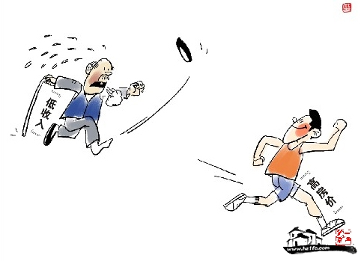
知识点--so…that
so…that 如此……以至于……
The house price is so high.
Those with low income can't
afford the house price.
The house price is so high that those
with low income can't afford it.

Slide 4
Summary
My memory became so large that even I couldn't believe it.
The house price is so high that those with low income can't afford it.
Food is so much that we can't eat it all.
主语+be+so+adj.+that引导结果状语从句

Slide 5
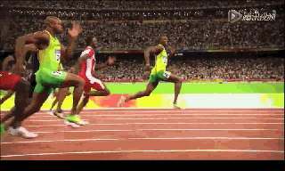
知识点--so…that
The athlete ran so fast.
He won the match.
The athlete ran so fast that he won the match.

Slide 6
Summary
如此…以至于
that
os
adv.
adj.
结果状语从句

Slide 7
高考链接--
so…that与such…that的区别
so…that句式的倒装知识

Slide 8
例句辨析
so+adj./adv.+that
E.g. He is so angry that he couldn’t speak.
It was such a fine day that we went out for a walk.
such+ 名词+that
adj./adv.+
so...that结构中的so为副词,后面跟形容词或副词；
such...that中的such为形容词，后面接名词(名词前可以有形容词或副词修饰)

Slide 9
例句辨析
E.g.There was so much noise outsides that
we couldn't hear the teacher.
He had so many falls that he was black
and blue all over.
当that前的名词有表示数量多少的many, much, few, little等修饰时，只能用so，不能用such.

Slide 10
例句辨析
E.g. She is so lovely a girl that everyone loves her.
so+adj./adv.+a/an+d名词+that+从句
E.g. She is such a lovely girl that everyone loves her.
such＋a/an＋adj.＋单数名词+that+从句
当that前是单数可数名词且该名词前面有形容词修饰时，so与such可以互换。

Slide 11
例句辨析
E.g. It was such fine weather that they all went swimming.
They are such nice apples that we would like to eat them.
such+adj./adv.+复数名词/不可数名词+that+从句
当that前是不可数名词或复数可数名词时，则必须用such，不能用so来代替

Slide 12
Summary-- so…that VS such…that
No.1. so+adj./adv.+that+从句
such+a/an+adj./adv.+单数名词+that+从句
No.2. so+many/much/few/little……+noun+that+从句
No.3. so+adj./adv.+a/an+单数名词+that+从句
such+a/an+adj./adv.+单数名词+that+从句
No.4. such+adj./adv.+复数名词/不可数名词+that+从句

Slide 13
半倒装
so…that句式的倒装
He was so angry that he couldn't speak.
So angry was he that he couldn't speak.
He spoke so loudly that even people in the
next room could hear him.
So loudly did he speak that even people in the
next room could hear him.

Slide 14
习题演练
Practice One :
1. a. The box is so heavy that I can't carry it.
b. The box is ______ heavy______ _____ _____ carry.
c. The box is not ________ ________ for me to carry.
too
for
me
to
light
enough

Slide 15
习题演练
Practice One :
2. a. The maths problem isn't easy enough for me to
work out.
b. The maths problem is ________ difficult ________
I can't work it out.
c. The maths problem is ____ difficult ________ ______
_____ work out.
so
that
too
for
me
to

Slide 16
习题演练
Practice Two :
用so,such填空
1. He was_______excited that he couldn't get sleep.
2. He has________many books that I can't count them.
3. There was ____much food that we couldn't eat it all.
so
so
so

Slide 17
习题演练
Practice Three :
用so,such填空
4. It is ___ bad news that I can't stand crying.
5. He is _____a good student that we alll like him.
6. She is ____ kind a woman that we don't want to hurt her.
such
such
so

Slide 18
习题演练
Practice Two :
句式转化（改为倒装句）
1. He was so excited that he couldn't get sleep.
2. Light travels so fast that we can't imagine its speed.
So excited was he
that he couldn't get sleep.
So fast does the light travel
that we can't imagine its speed.

Slide 19
Thanks

