Slide 1
B5 U2
过去分词作宾语补足语
Past Participle as Object Complement
龙川县隆师中学
魏素君
华南师范大学
熊景瑶 梁诗汝

Slide 2
I. Can you find out the same grammatical structure?
主语+谓语动词+宾语+过去分词
过去分词作宾语补足语
Now when people refer to England you find Wales included as well.
We’d love to see the problems solved within seven days.
The poor man had his left leg broken.

Slide 3
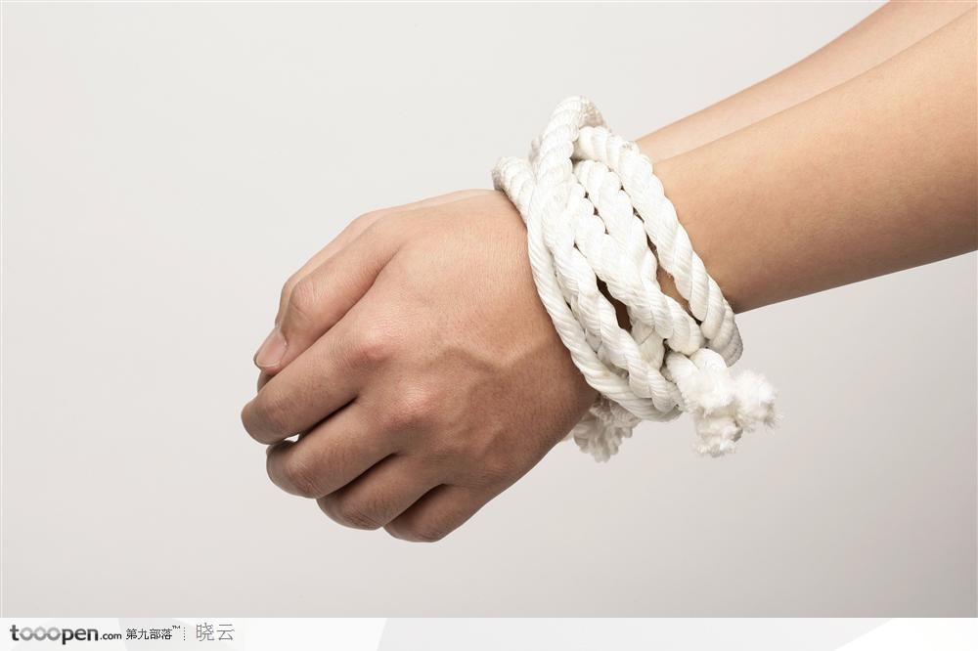
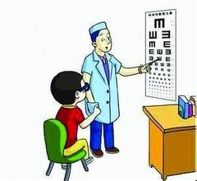
表示被动意义
The thief was taken out of the room with his hands tied.
His hands were tied.
The doctor wants to have his eyes examined.
His eyes are examined by the doctor.

Slide 4
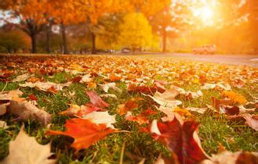
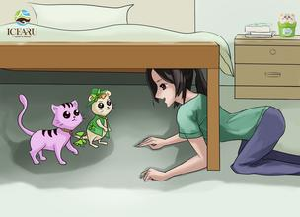
表示完成意义
I saw the leaves fallen this morning.
The leaves had fallen.
I found the cat hidden under the bed.
The cat had hidden under the bed.

Slide 5
总结：过去分词作宾语补足语
Past Participle as Object Complement
其结构形式为：主语+谓语动词+宾语+过去分词。（with + 名词/代词+过去分词）
作宾语补足语的过去分词一般来自及物动词，表示被动和完成意义，说明宾语所处的状态。
过去分词做宾补时，与宾语存在逻辑上的动宾关系。

Slide 6
Practice
I saw an old man (knock)down by a car.
With all the work (do), I feel very relaxed now.
knocked
done

Slide 7
Comparison
I saw her taken out of the classroom.
我看见她被人从教室带了出来。
I saw her coming into the classroom.
我看见她正进教室
被动关系
主动关系

Slide 8
自我总结
过去分词作宾语补足语
表被动意义
表完成意义
现在分词作宾语补足语
表主动意义
表现在进行意义

Slide 9
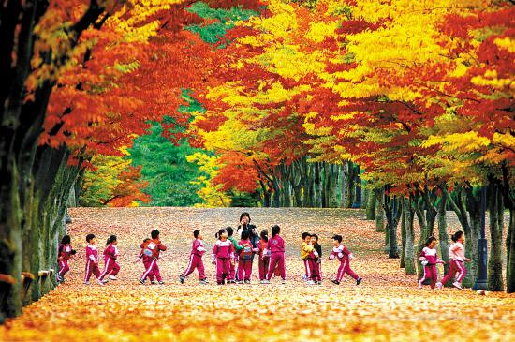
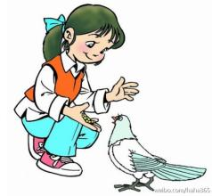

Practice: Use –ing or –ed participle to finish the following passage.
It was a sunny day. I went to a park. It was almost winter. I could see the leaves fallen (fall). I found some children running (run) around. Besides, I also see a girl feeding (feed)a pigeon with bread. At dusk, I found everyone gone (go) and only a bike parked (park) under the tree. I then realized it’s time to go home.

Slide 10
Homework
The other day, when I was having my hair (cut) in a barber’s, I had my bike (steal). I went to school (feel) very upset. My teacher noticed that. She told me to have my attention (focus) on my study, so I could relieve myself of worry.
cut
stolen
feeling
focused

Slide 11
Thank you!

