Slide 1

河源市河源中学 陈静
华南师范大学外国语言文华学院 徐嘉丽

Slide 2
BOOK 2 UNIT 1
cultural relics

Slide 3
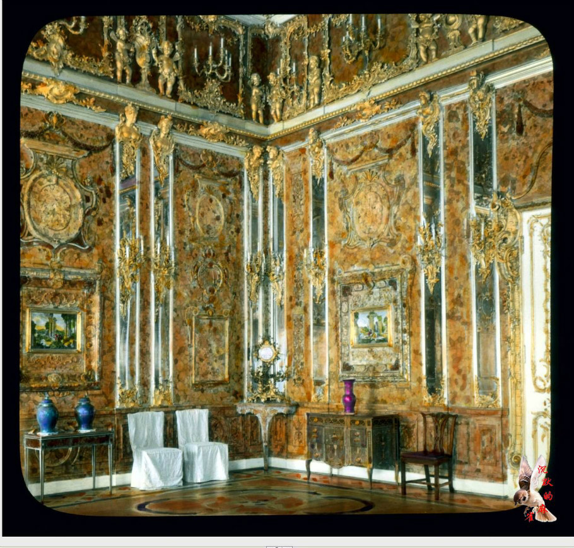
The Amber Room
The amber room, made of several tons of amber , is so wonderful that people around the world think highly of it. There is no doubt that it is considered to be one of the great wonders of the world. Although the amber room was stolen during the war, the new one has been built recently. It must be a place that is worth visiting.

Slide 4



think highly of
There is no doubt that...
be worth doing

Slide 5
think highly of
think highly of 对....评价高；看重，器重
think highly of + sth./ sb.

Slide 6
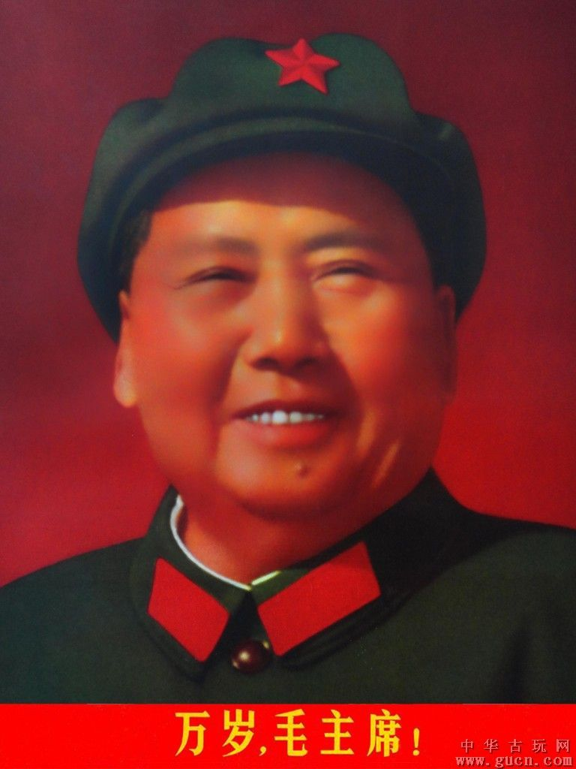
Chinese people think highly of President Mao.

Slide 7
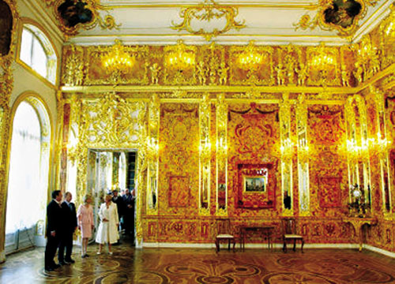
People all over the world think highly of the amber room.

Slide 8

speak highly of
think well/ much/ a lot/ the world… of对……评价很高
I think well of your suggestion.我觉得你的建议很好。

Slide 9
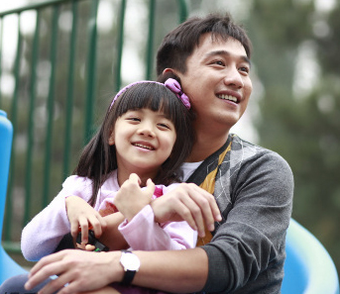
He thinks the world of his daughter. 他非常器重女儿。

Slide 10

He was highly thought of by the manager.经理对他非常赞赏。

Slide 11
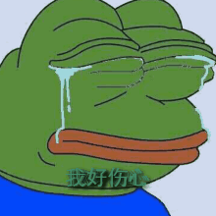
Think poorly/badly of
Those who think poorly of
themselves have a hard time finding solutions to problems.

Slide 12
there is no doubt that
毫无疑问
He always works so hard, there is no doubt that he will succeed.他总是如此努力地工作，毫无疑问，他会成功。
There is no doubt that China is one of the most powerful country in the world.毫无疑问，中国是世界上最强大的国家之一。

Slide 13
There is still some doubt ________ the autumn sports meet will be held in our school, but there is no doubt ________ it will be held soon after our National Day holiday.
A．that; that B．whether; whether
C．that; whether D．whether; that
D
There is some doubt whether“不确定，有疑问”
There is no doubt that “毫无疑问”。

Slide 14

Translate them:
毫无疑问，他在撒谎。
There is no doubt that he is telling a lie.
我们并不知道能否在最后期限之前找到他。
there is some doubt that/whether/if we can find him before the deadline.

Slide 15
be worth doing

Slide 16
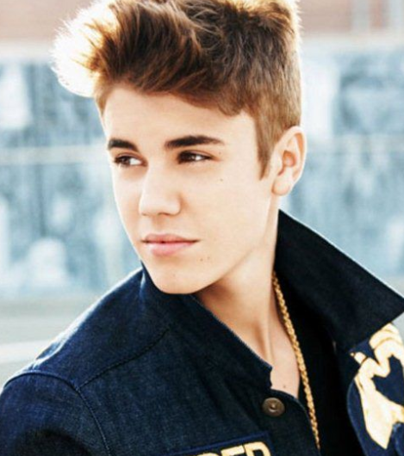
听歌填词。
God sent an angel to help you out
He gave you direction
Showed you how to read a map
With a long journey ahead
Said it ain't never over
Oh even in the midst of doubt
Life ,
Life , so live another day
is worth living
is worth living

Slide 17
be worth doing
……值得干某事
That film is worth seeing. 那部片子值得一看。
The report is worth listening to . 这报告值得听。
表“很值得”要用well worth. 如：
The film is well worth seeing .
这电影很值得一看。

Slide 18
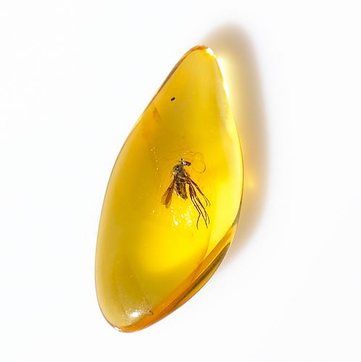
be worth +n
(表“值”“价值”) “……值(钱，等)”
This amber is worth ￡20,000.
这块琥珀值两万磅
It might be worth a lot of money.
它可能值很多钱

Slide 19
B
There are a few books .But only one of them is ( ).
A.worthy of reading
B worth reading
be worth doing （主动表被动）
=be worthy of being done/ be worthy to be done
某事值得被做....

Slide 20

Have a try!!
---The question is not worthy ___.
A.discussing
B.to be discussed
C.to discuss
D.be discussed
C
I don't believe that your T-shirt is（ ）.
A.worth of the price
B.worthy of the price
C.worth the price
D.worthy the price
is worth + n. 这里的worth是“值得的；等值的；有....价值的” 的意思。

Slide 21
The Amber Room
The amber room, made of several tons of amber , is so wonderful that people around the world think highly of it. There is no doubt that it is considered to be one of the great wonders of the world. Although the amber room was stolen during the war, the new one has been built recently. It must be a place that is worth visiting.

Slide 22
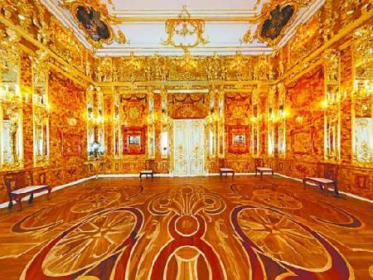


Slide 23
Thanks

