Slide 1
Book 4 Unit 2
Vocabulary
华南师范大学外国语言文化学院 徐夏敏 朱晓娜
河源市龙川一中 潘志明

Slide 2

A Short Story

Slide 3
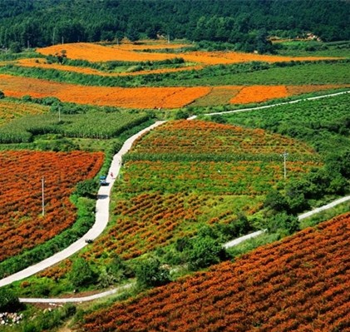
strain [streɪn] n. (植物的)品种，种类

Slide 4
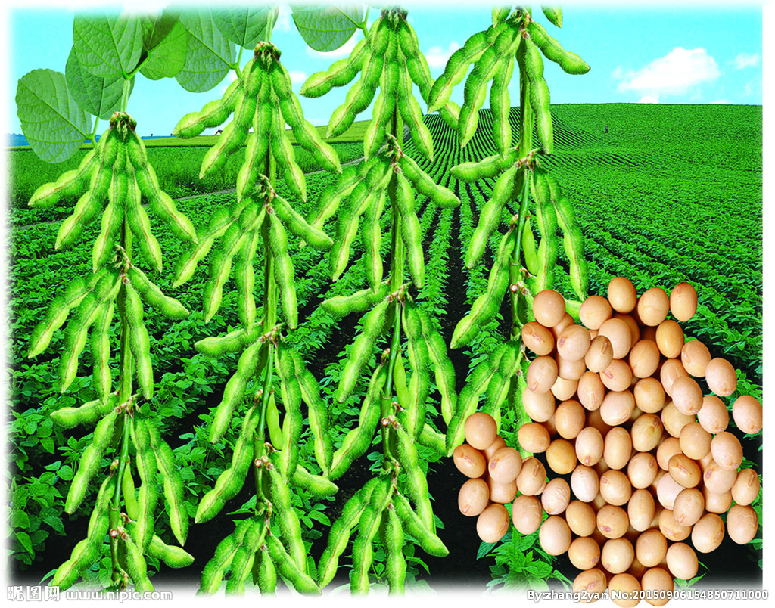
soybean ['sɒɪbiːn] n. 大豆

Slide 5
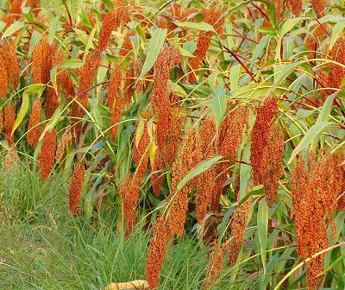
sorghum ['sɔːgəm] n. 高粱

Slide 6
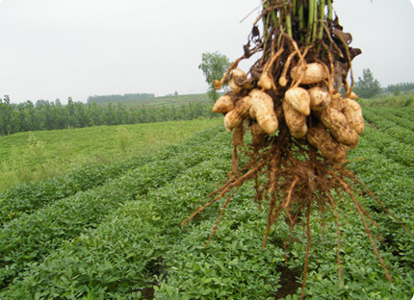
peanut ['piːnʌt] n. 花生

Slide 7

output ['aʊtpʊt] n. 产量，输出

Slide 8

hunger ['hʌŋgə] n. 饥饿；欲望

Slide 9

sunburnt ['sʌnbɜːnt] adj. 晒黑的

Slide 10
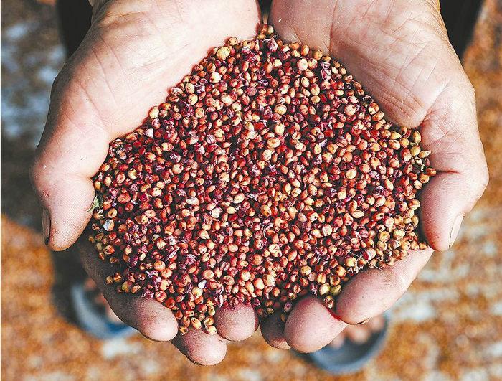
grain [greɪn] n. 谷物，粮食，颗粒

Slide 11
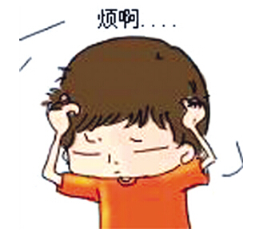
disturbing [dɪ'stɜːbɪŋ] adj. 引起烦恼的，令人不安的

Slide 12

pest [pest] n. 害虫，害兽，害鸟

Slide 13

﹖﹖
confuse [kən'fjuːz] vt. 使疑惑，使为难

Slide 14

chemical ['kemɪk(ə)l] adj. 化学的，关于化学的

Slide 15

struggle ['strʌg(ə)l] vt.&vi. 斗争，拼搏，努力

Slide 16
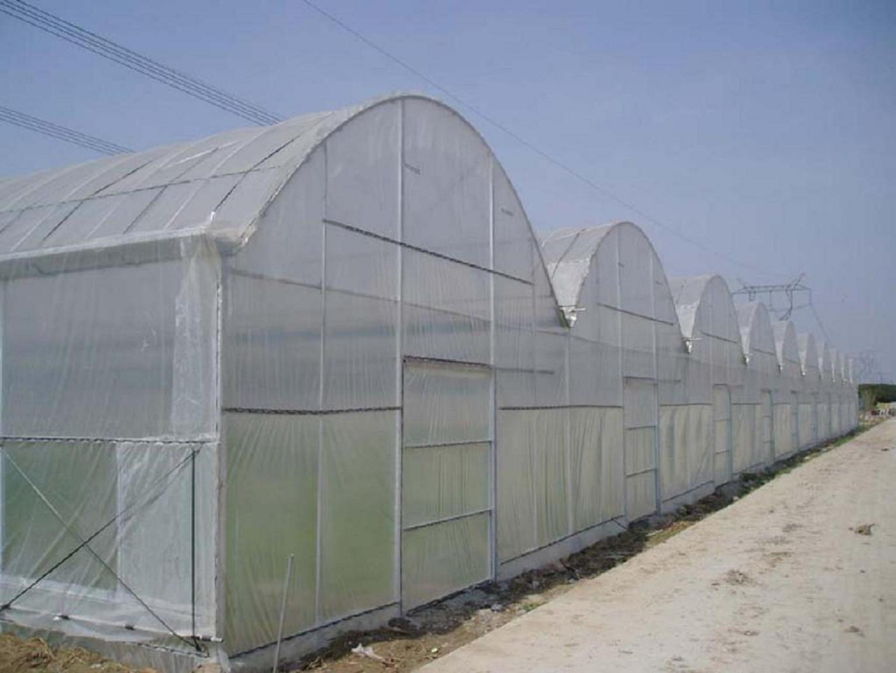
keep...free from/of 使...免受（影响、伤害），使...不含（有害物质）

Slide 17

bacteria [bæk'tɪərɪə] n.(pl bacterium) 细菌

Slide 18
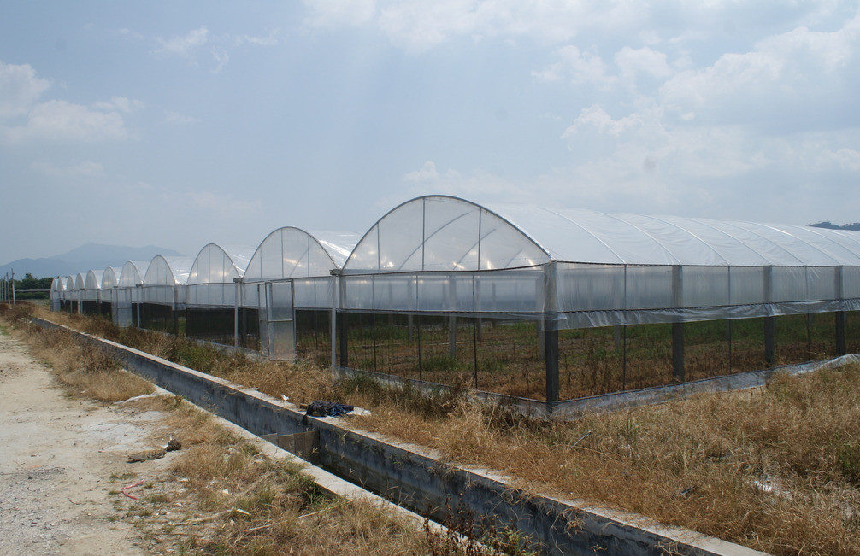
expand [ɪk'spænd; ek-] vt.& vi. 使变大，伸展

Slide 19

organic [ɔː'gænɪk] adj. 有机的，器官的，组织的

Slide 20

fertile ['fɜːtaɪl] adj. 肥沃的，富饶的

Slide 21

be satisfied with ['sætɪsfaɪd] 对...感到满意

Slide 22
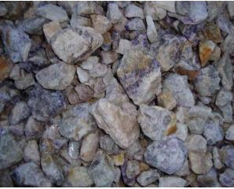
mineral ['mɪn(ə)r(ə)l] n. 矿物，矿石

Slide 23

focus ['fəʊkəs] n. 焦点，中心点 vt. 集中，聚焦
focus on 集中于...

Slide 24
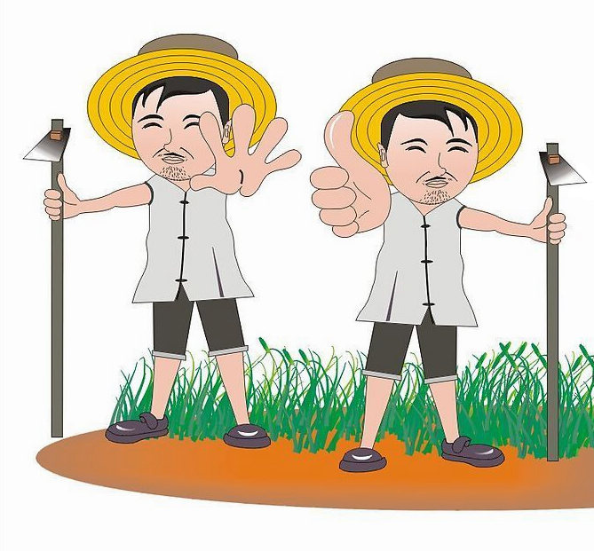
comment ['kɒment] n. / vt.& vi. 评论，议论

Slide 25

Key Words

Slide 26
therefore
adv.
因此，所以，因而
e.g We therefore can use the advanced technology.
Use it in writing to alternate "so" to improve our articles;
It should be paid attention to when it appears in reading material.
When it is used...
to begin a whole sentence, we usually put a comma after it.
e.g Therefore, we must obey the rules.
He was busy, therefore, he couldn't come.
2. to connect two whole sentences, we usually use "and therefore" or "; therefore"
e.g It's raining and therefore we can not go hiking.
We can learn lots of new things from books; therefore we should read more.

Slide 27
would rather
would rather do .../ would rather not do...
宁愿，宁可
e.g I would rather stay at home.
Pattern （句型）
"would rather...than..." or "would...rather than..." 与其...不如...
e.g 我宁愿吃米饭也不吃汉堡包。
I would rather have rice than hamburger.
I would have rice rather than hamburger.
2. "would rather have done..." 宁愿（要是），本想做...
e.g 我宁愿去了那场演唱会/我要是去了那场演唱会就好了
I would rather have gone to the show.
3. "would rather + clause(从句)" subjunctive mood (虚拟语气)

Slide 28

Other Words

Slide 29
skim [skɪm] vt. 浏览；略读
Vietnam [ˌvjet'næm] 越南
statistic [stə'tɪstɪk] n. (pl statistics) 统计，统计数字；统计资料
nationality [næʃə'nælɪtɪ] n. 国籍
personality [pɜːsə'nælɪtɪ] n. 性格；个性；人格
skim the statistic
浏览统计资料
under 在...下面
circulate ['sɜːkjʊleɪt] vt.& vi. 循环，流传
equip [ɪ'kwɪp] vt.& vi. 配备，装备
export [ˈekspɔːt；ɪkˈ-] vt.& vi. 输出，出口
line 线条
underline [ʌndə'laɪn] v. 划线标出；强调
occupation [ɒkjʊ'peɪʃ(ə)n] n. 工作；职业；占领
nutrition [njʊ'trɪʃ(ə)n] n. 营养；滋养；食物
rid...of 摆脱，除去
lead to 导致，造成（后果）

Slide 30
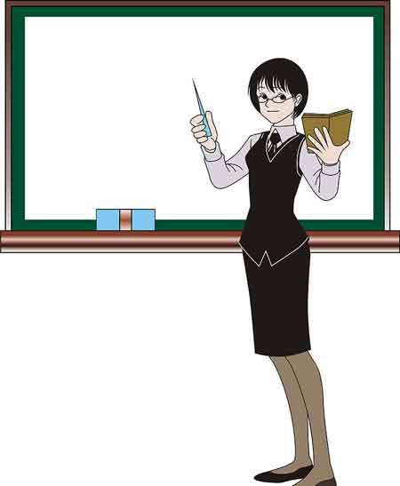
Do you know how to remember those new words now?
Try to make up your own story with them.

Slide 31

END

