Slide 1
Book5 Unit1 Great Scientists
vocabulary
制作者：华南师范大学吴丽纯
河源市龙川县隆师中学何文青
华南师范大学陈嬿儿

Slide 2
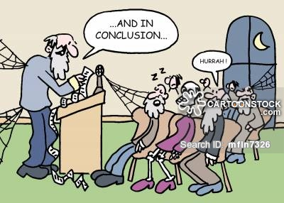

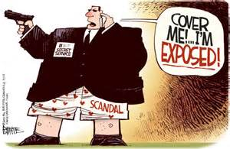
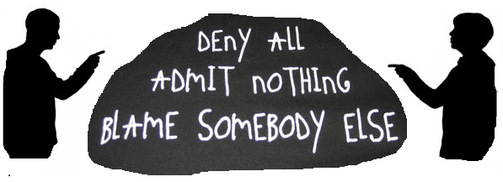
He concluded his speech with a slogan.

Slide 3

Conclude
vt.&vi. 结束，推断出
eg. 1.He concluded his speech with a slogan.
他用一句标语结束了演说。
2.It is hard to conclude.
这很难断定。
conclusion n.结束，结论
make
draw
reach
come to
arrive at
(a) conclusion(s) 下结论；得出结论
in conclusion 作为结论，最后

Slide 4

Have a try!
1.我们推断他们无法抵达目的地。
We concluded that they could not reach the destination.
2.我们认定他并没有告诉我们实情。
We concluded that he didn't tell us the truth.

Slide 5

He did not attend the meeting.

Slide 6
attend
vt. 照顾；护理；出席；参加
attendance n.出席，出席人数
eg. 1.He did not attend the meeting.
他没有参加会议。
2.Which doctor is attending you?
哪一个医生为你看病？
attend school 上学
attend a lecture/meeting 听讲座/出席会议
attend a wedding/ceremony 出席婚礼/参加典礼

Slide 7
Have a try!
1.上这个学校的几乎全是当地的孩子。
was attended
The school (attend) almost entirely by local children.
2.他在这个领域很出名，今晚会有成千上万的敬仰者
参加他的讲座。
He is famous in this field, and tens of thousands of fans (attend) his lecture this evening.
will attend

Slide 8
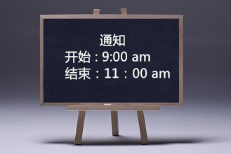
The plot was exposed in time.

Slide 9
expose
vt. 暴露;揭露;使曝光
eg.1. The plot was exposed in time.
那阴谋已被及时揭露。
2.This film has been exposed.
这片子已经感光。
3.As the journalist in the war,
she was exposed to many dangers.
作为战地记者，她置身于多种危险。
be exposed to…
置身于……；暴露于……

Slide 10
They blamed the driver for the accident.

Slide 11

blame
n. 过失；责备；责怪；（过失，过错等）责任
v. 责备，谴责
eg.1. They blamed the driver for (causing) the accident.
他们将这起事故归咎于司机。
2.We are all partly to blame.
我们都负有一部分的责任。
blame sb. for(doing) sth.
因(做)某事而责备某人
blame sth. on sb. 因某事而指责某人
sb. be to blame for(doing) sth.
因(做)某事某人应该受到谴责
be to blame 应负责(无被动式)

Slide 12
Have a try!
1.看来这次要归罪于饮用水了。
It seemed that the water is to blame.
2.他指责你玩忽职守。
He blames you for neglect of duty.

Slide 13
He lives on contributing to some local magazines.

Slide 14
Contribute
vt.& vi.贡献; 捐赠, 捐助（款项）; 投稿（给杂志等）
[n] contribution
eg: 1. He lives on contributing to some local magazines.
（他靠给一些地方杂志撰稿为生。）
2.He decided to contribute most of his personal assets to
the society.
（他决定将大部分的个人资产捐赠给社会。）
contribute to可表示“促成；有助于”
contribute to + doing sth.

Slide 15
Have a try!
T/F
We believe that this meeting will contribute to combat
global warming.
（我们坚信这次会议将为抵制全球变暖做出贡献。）
F
combating

Slide 16
He was instructed when to start through the blackboard.

Slide 17
instruct
vt. 通知; 指示；命令; 教导（指导）
eg：1.He was instructed when to start through the
blackboard.
他从黑板那儿得到开始时间的通知。
2. He instructed us in math last year.
他去年教我们数学。
Instruction n.
instruct sb. (in sth.) 教导，传授技能
instruct sb.to do sth. / instruct wh- 命令，指示
instruct that-clause 通知

Slide 18

Have a try!
instructed
He was (instruct) to sail for New York.
他奉命前往纽约。

Slide 19
blame
vt.& vi.贡献; 捐赠, 捐助
（款项）;
投稿（给杂志等）
Conclude
vt.&vi. 结束，推断出
attend
vt. 通知; 指示；
命令; 教导（指导）
vt. 暴露;揭露;使曝光
contribute
instruct
n. 过失；责备；责怪；
（过失，过错等）责任
v. 责备，谴责
expose
vt. 照顾；护理；
出席；参加

Slide 20
Thank you！

