Slide 1

The Lake of Heaven
--Using Language
录制者：华南师范大学外国语言文化学院 吴夏楠
合作者：华南师范大学外国语言文化学院 黎璐华
河源市龙川一中 黄桂梅

Slide 2
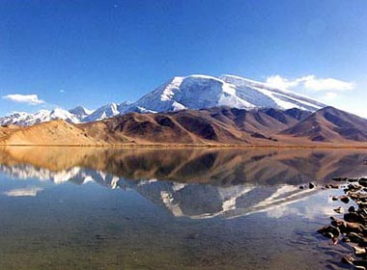
Changbaishan is kept in its natural state
for the people of China and visitors
from all over the world to enjoy.

Slide 3
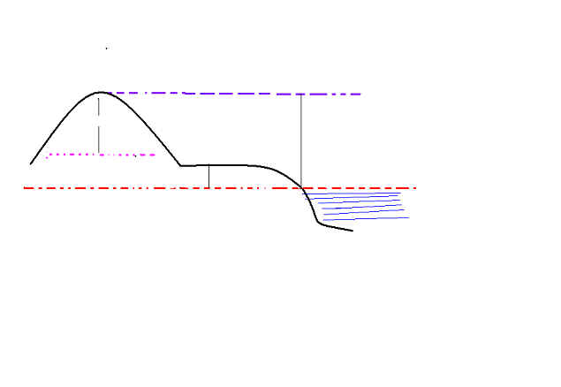
The land varies in height from 700 meters above sea level to over 2,000 meters.

Slide 4
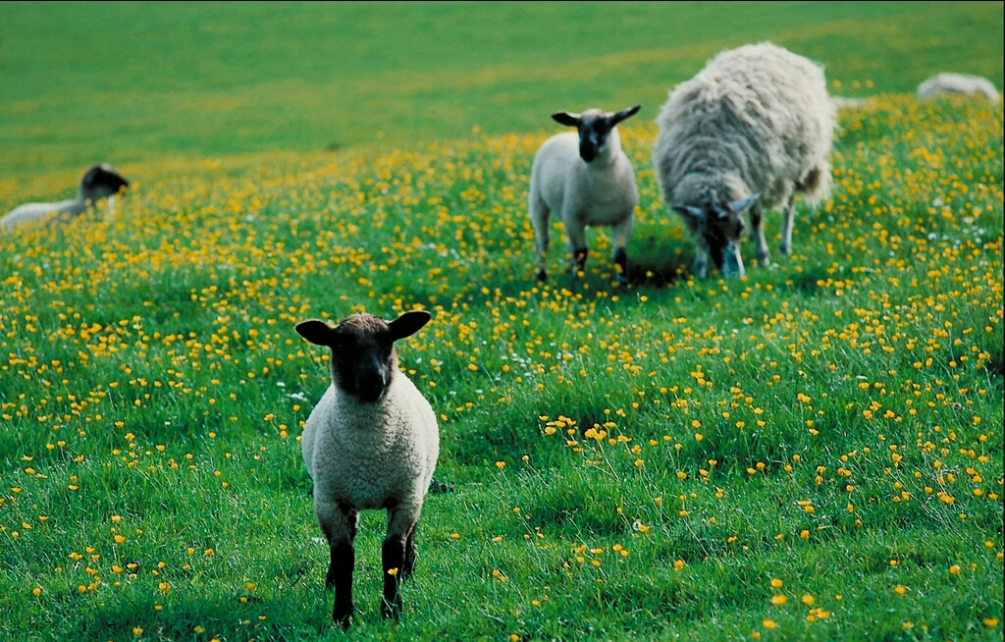
The land is home to a great diversity of rare plants and animals .

Slide 5
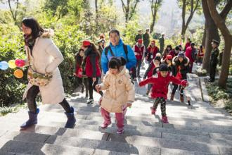
It takes about an hour to climb from the end of the road to the top of the mountain.

Slide 6
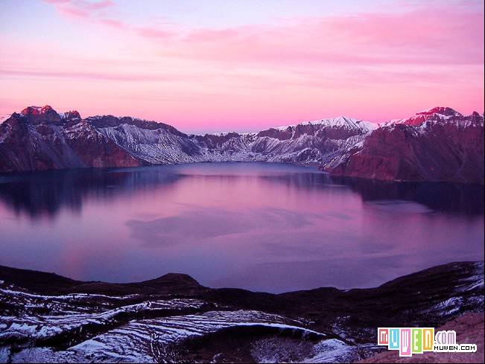
When you arrive you are rewarded not only
with the sight of its clear waters, but also by the view of
the other sixteen mountain peaks that surround Tianchi.

Slide 7

Having swallowed the fruit, the girl became pregnant
and later gave birth to a handsome boy.

Slide 8
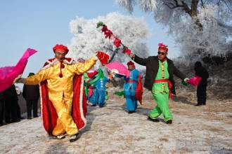
It is said that this boy, who had a great gift for
languages and persuasion, is the father of
the Manchu people.

Slide 9
Using Language
kept
in
a natural state
be
home
to
...
Tianchi is kept in a natural state for the people of China to enjoy.
The wetlands are home to a large variety of wildlife.

Slide 10
rewarded
be
rewarded
with
sth.
rewarded
by
sth./sb.
If our answer is right, we should be rewarded.
A good person will be rewarded with good luck.
Your hardworking will be rewarded by god one day.

Slide 11
vary
from...
to
...
a
variety
of
...
a
diversity
of
...
Office hours vary from company to company and country to country.
His lecture ranged over a great variety of topics.
a great diversity of

Slide 12
give
birth
to
...
have
a
gift
for
...
It
takes
sb.
sometime
to do sth.
Nancy gave birth to a baby boy last night.
He has a gift for foreign languages.
It takes me quite a long time to understand the meaning of the painting。

Slide 13
Complete the short passage using the lexical chunks that have just been learnt.
Lushan lies on the Fuchun River in Fuyang. Much of the beautiful hill is thick forest, which is a nature reserve in Fuyang（富阳的自然保护区）and is kept in a natural state（保持着它的原始状态）. This hill varies in height from 80 metres to 200 metres（这座山的高度从海拔80米到200米不等）and it is home to a great diversity of plants and animals（是多种多样动植物的生长地）. Many people come to Lushan to take exercise and appreciate the beautiful Fuchun River. However, the most popular attraction in it is Dongwu Park, where you can absolutely enjoy yourself .

Slide 14
Bye Bye!

