Slide 1

Under the sea
华南师范大学 吴小雯
华南师范大学 袁健敏
河源市和平县阳明中学 梁剑锋老师

Slide 2
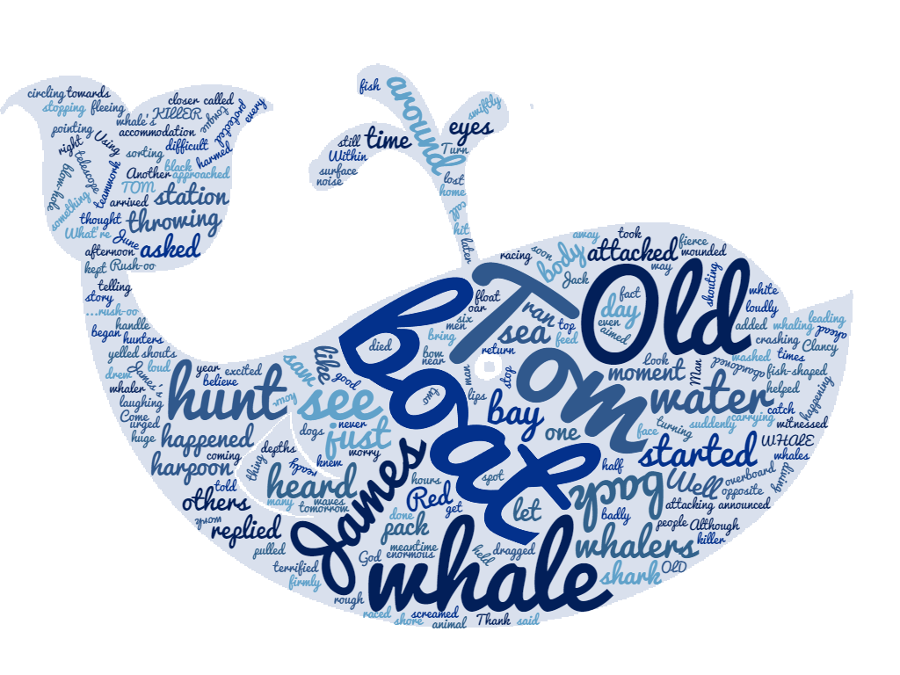

Slide 3
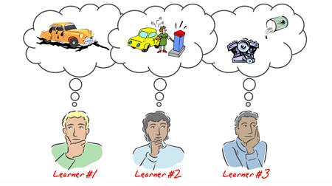
1. aware
(P24 L6) The first thing I become aware of was all he vivid colors surrounding me - purples, reds, oranges, yellows, blues and greens.
adj. (sometimes followed by of) having or showing realization or perception
意识到的；知道的（通常不用作定语）

Slide 4
Language Point
（1）常见搭配：
① be aware of sth.
② be aware + that-从句
e.g. He wasn't aware of the danger.
I became aware how she might feel.
（2）词形变化：
① 否定形式：unware a. 未认识到的；不知道的
② 名词形式：awareness n. 知道，晓得

Slide 5
高考真题：
（全国卷 2013）I went to a group activity ―Sensitivity Sunday, which was to make us more the problems faced by disabled people. We were asked to adopt a disability for several hours one Sunday.
A. curious about B. interested in C. aware of D. careful with
答案：C. 这是一道完形填空题，由上下文的语境可以看出，这里应该选择C，意为我们越来越意识到残疾人面临的问题。
aware of

Slide 6

2. scare
（P24 L28）I told myself they weren't dangerous but that didn't stop me from feeling scared to death for a moment.
（1）vt. to frighten sb. 恐吓，惊吓
e.g. You scared me. 你吓了我一跳。
（2）vi. to become frightened 受惊吓，害怕
e.g. He doesn't scare easily. 他不轻易害怕。

Slide 7
Language Point
1）常见搭配：
① be scared of… (=be afraid of) 遇到…(某种事物或行为)而害怕
② be scared to do (=be afraid to do) 不敢做……
③ be scared to death 吓死了
e.g. The thief was scared to death when hearing the gunshot.
听到枪声，那个贼吓得要死。
Most girls are scared to light the firework.
大多女孩不敢放烟花。
（2）词形变化：
形容词形式： scaring adj．令人害怕的；吓人的
scared adj． 受惊吓的；感到害怕的

Slide 8

3. depth
Within a moment or two, its body was dragged swiftly by the killers down into the depths of the sea.
N-PLURAL--The depths are places that are a long way below the surface of the sea or earth.
(海洋或陆地的)深处,深渊
Definition---(n.)The depth of something such as a river or hole is the distance downwards from its top surface, or between its upper and lower surfaces. 深度
E.g. What’s the depth of the lake?

Slide 9

3. depth
In depth
描述深度
E.g. The smaller lake ranges from five to fourteen feet in depth.
深入地，全面地
E.g. We will discuss these three areas in depth.
deep & deeply

Slide 10



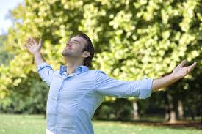
3. depth
deep
deeply
(Adv.)
描述具体动作时，两者都可以指“深深地”
E.g. The doctor asked me to breathe deep/deeply.
修饰抽象的、带有感情色彩的动词，(如 hate, dislike, love, admire, hurt, regret 等)，修饰其程度，通常要用 deeply
E.g. I was deeply moved by the movie.
表示深入地，在…的深处，通常要用 deep
E.g. We went deep into the woods.

Slide 11


4. urge
"Man overboard! Turn the boat around!" urged George, shouting loudly.
U R G E
to advise or try hard to persuade sb. to do sth.
敦促；催促；力劝
Collocations
Urge sb. To do sth.
E.g. She urged him to stay.
Urge that… (用于虚拟语气)
E.g. The report urged that all children be taught to swim.
Urge sth. on/upon sb
urgent

Slide 12
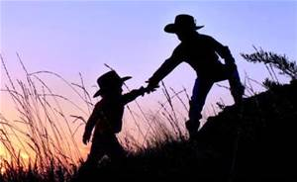
5. help... out
（P21）What evidence was there that Old Tom was helping the whalers out?
-to help sb, especially in a difficult situation 帮助某人（拜托困难或危险）
e.g. He's always willing to help out.
他总是急人之难。

Slide 13
Other expressions about help
help sb. do sth. 帮助某人做某事
with the help of sb. 在某人的帮助下
can't help doing sth. 忍不住做某事
can't help but do sth只得；不得不
help oneself to sth. 请随便自己动手(夹菜吃、用……等)

Slide 14


6. Upside down
The yellow and green parrotfish was hanging upside down.
in or into a position in which the top of sth. is where the bottom is normally found and the bottom is where the top is normally found
颠倒；倒转；翻转
Antonym： right side up

Slide 15

guess the meaning according to context
Part of speech
when it comes to new words...
Affix
synonym
...

Slide 16
Exercise
1. 词类转换。
（1）The lake is over 20 meters in ________ so we were all moved ________ by the man who dived ________ into the lake to save the little boy. (deep)
（2）Though the soup is _______, I’ve lost my sense of ______ and it ____just like ______water.(taste)
（3）Anyone who launches a war is_________ and is _______ by people who love peace all around the world. (awe)
（4）The ____________ of energy will help us research the way to save and _______ the energy. (conserve)
depth
deeply
deep
tasty
taste
taste
tastless
awesome
awed
conservation
conserve

Slide 17

