Slide 1
过去分词作宾语补足语
Past Participle as Object Complement
制作者: 华南师范大学外国语言文化学院 梁诗汝
熊景瑶
河源市龙川县隆师中学 魏素君

Slide 2
I. Can you find out the same grammatical structure?
主语+谓语动词+宾语+过去分词
过去分词作宾语补足语
Now when people refer to England you find Wales included as well.
We’d love to see the problems solved within seven days.

Slide 3
Characteristic
其结构形式为：主语+谓语动词+宾语+过去分词。（with + 名词/代词+过去分词）
作宾语补足语的过去分词一般来自及物动词，表示被动和完成意义，说明宾语所处的状态。
过去分词做宾补时，与宾语存在逻辑上的动宾关系。

Slide 4

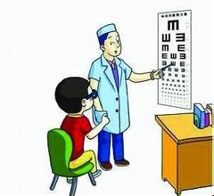
表示被动意义
The thief was taken out of the room with his hands tied.
His hands were tied.
The doctor wants to have his eyes examined.
His eyes are examined by the doctor.

Slide 5
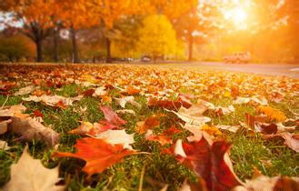
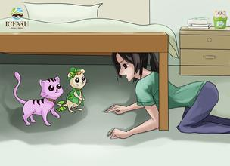
表示完成意义
I saw the leaves fallen this morning.
The leaves had fallen.
I found the cat hidden under the bed.
The cat had hidden under the bed.

Slide 6
Practice
I saw an old man (knock)down by a car.
With all the work (do), I feel very relaxed now.
knocked
done

Slide 7
Comparison
过去分词作宾语补足语
现在分词作宾语补足语
易混点
常考点

Slide 8
I saw her taken out of the classroom.
我看见她被人从教室带了出来。
I saw her coming into the classroom.
我看见她正进教室。
被动关系
She was taken out of the classroom.
主动关系
进行意义
She was coming into the classroom.

Slide 9
Conclusion
过去分词作宾语补足语
表被动意义
表完成意义
现在分词作宾语补足语
表主动意义
表进行意义

Slide 10
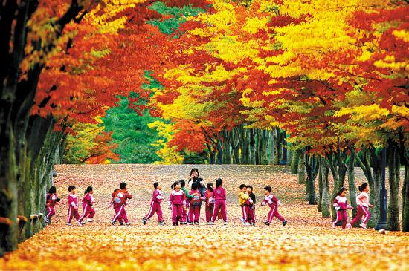
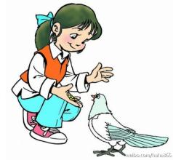

Practice: Use –ing or –ed participle to finish the following passage.
It was a sunny day. I went to a park. It was almost winter. I could see the leaves fallen (fall). I found some children running (run) around. Besides, I also see a girl feeding (feed)a pigeon with bread. At dusk, I found everyone gone (go) and only a bike parked (park) under the tree. I then realized it’s time to go home.

Slide 11


