Slide 1

Book3 Unit4
Astronomy: the science of the stars
How life began on the earth?
--词块学习
华南师范大学 凌伶
Notes:
本模板来源于网络，由第一课件网整理发布，免费分享给大家使用。
第一课件网是国内最专业的PPT模板分享网站，所有模板均经严格测试，保证100%下载，100%精彩！
更多精彩PPT模板，敬请访问http://www.1kejian.com
使用时删除此备注即可。
配色方案修改：
配色方案在【格式】-->【幻灯片设计】-->【配色方案】-->【编辑配色方案】下调整。
LOGO的添加：
Logo添加修改在【视图】-->【母版】-->【幻灯片母版】下调整。直接选择logo图片删除或修改。
字体格式的设置：
括标题和文本格式的设置在【视图】-->【母版】-->【幻灯片母版】下调整。

Slide 2

on the earth

Slide 3
On the earth
in the earth???
on earth ???

Slide 4

We live on the earth.

Slide 5
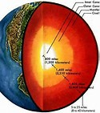
on the earth
There is a hole in the earth.
in the earth
地球内部 （为“在地下”之意）

Slide 6
What on earth is it？这到底是什么东西？
Why on earth did you tell a lie？你究竟为什么要说谎
“到底”，“究竟”，置于 what，when等疑问词之后，以加强问句的语气
on earth
“当今”或“世界上”，用于最高级之后，以加强语气
It's no use on earth．这一点儿也没有用。
Nothing on earth can change my mind．无论什么也不能改变我的主意。
用于否定词之后，作“一点儿也不”解，以加强否定的语气
I'm the happiest man on earth． 我是世界上最幸福的人。

Slide 7
matter

Slide 8
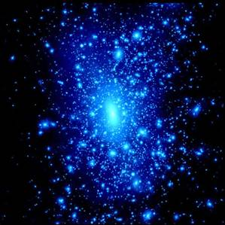
The universe began with a “big bang” that threw matter in all directions.

Slide 9
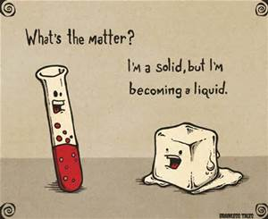


Slide 10

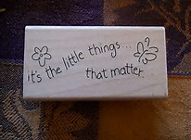


Slide 11
in all directions

Slide 12

The universe began with a “big bang” that threw matter in all directions.
They ran in all directions.

Slide 13

in all directions
in every direction

Slide 14
高考样题
in
He went back ___ the direction
________he came.
from which

Slide 15
be + to do

Slide 16
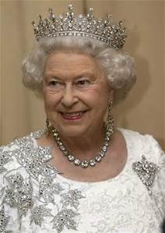
be +动词不定式（即be + to do sth.）
1.表示按计划或安排要做的事
The Queen is to visit Japan in a week’s time.

Slide 17
2.表示“应该”，相当于should, ought to
You are to report to the police.
3.表示“必须”，相当于must, have to
You are to do your homework before you watch TV.

Slide 18
be about to +不定式，意为马上做某事。
He is about to leave for Beijing.
Attention：be about to 不能与tomorrow, next week 等表示明确将来时的时间状语连用。

Slide 19
settle

Slide 20

settle problem
settle question
settle trouble
To tell the truth, it is not easy to settle this problem.

Slide 21
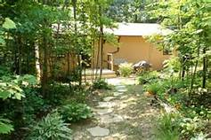
settle down
It was after serious consideration that they decided to leave their hometown and settle down in paris.

Slide 22

settle a bill
settle debts
You may also settle a large bill at that time.

Slide 23

See You

Slide 24
How life began on the earth?
No one know exactly how the earth began, as it happen so long ago. However, according to a widely accepted theory, the universe began with a “big bang” that threw matter in all directions. After that atoms began to from and combine to create stars and other bodies.
For several billion years after the "Big Bang", the earth was still just a cloud of dust. What it was to become was uncertain until between 4.5 and 3.8 billion years ago when the dust settled into a solid globe.

