Slide 1
Unit 5 Travelling abroad
Book 7
华南师范大学外国语言文化学院 刘玲、戴晓飞
河源市和平县福和高级中学 曾滢颖

Slide 2
Grammar
preposition + which
in attributive clause

Slide 3
The usage of prep. + which
1．语法作用：“介词＋关系代词”在从句中主要起关系副词的作用，即在定语从句中充当状语：
表示地点，时间和原因的“介词＋which”分别相当于 where，when，why。

Slide 4
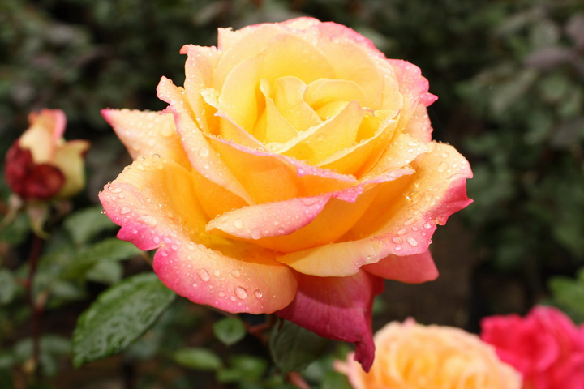
I know a wood in which you can find roses．
where

Slide 5
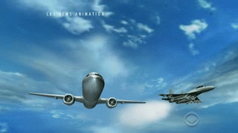
I'll never forget the day on which I travelled abroad．
when

Slide 6
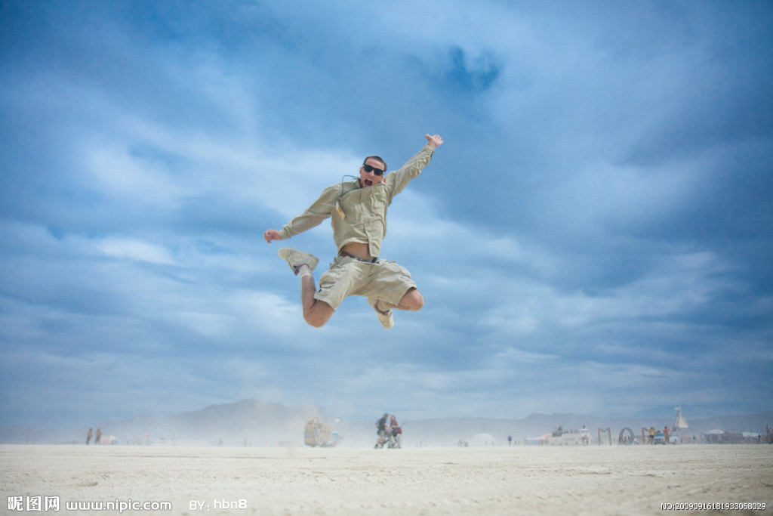
Is there any reason for which you should have a holiday？
why

Slide 7
2．“of ＋which”起形容词的作用，相当于whose（用来指物），其词序通常是“n．＋of which”。

Slide 8

He's written a book the name of which I've completely forgotten．
whose name

Slide 9
①This school is very famous.
② He once studied ____ this school.
in
×
This school which /that he once studied is very famous.
in

Slide 10
①Tommorrow I’ll bring here the magazine.
②You asked ____the magazine.
for
Tommorrow I'll bring here the magazine which / that you asked for.
×
for

Slide 11


prep.+which（指物）
prep.+whom (指人）
How to choose the right prepositions

Slide 12
1. Do you like the book____________ she spent $10?
2. Do you like the book_____________ she paid $10?
3. Do you like the book _____________ she learned a lot?
4. Do you like the book______________ she often talks?
on which
for which
from which
about which

Slide 13

Conclusion
根据定语从句中谓语动词的习惯搭配来决定。

Slide 14
This is the good car_______I spent all my money.
I can’t find my dictionary _______ I paid over $100 .
on which
spend money on the car
for which
pay… for the dictionary

Slide 15
I’ ll never forget the day ________ he made the speech. __ __ __ ___
on which
+ on the day
The moment ___which I made the decision is exciting.
___ the moment
at
at
in
The month _____which I left for vocation is July.
______ the month
in

Slide 16
2)根据先行词的搭配习惯来决定。

Slide 17
1. This is the knife __________ I usually cut my pencil.
2. We can’t live without the sun____________ we get heat and light.
with which
from which

Slide 18

1.The house ______ there is a big tree was built more than 1000 years ago.
A. which
B. in front of which
C. that
D. in the front of which

Slide 19
which
2.The house I grew up ____ has been taken down and replaced by an office building.
（2009江西，26）
A.in it B.in C.in that D.in which

Slide 20
3)根据定语从句所表达的意义来确定

Slide 21
without
Air, ________ which man can’t live, is really important.
The pen _____which he is writing now was bought yesterday.
with

Slide 22
下面两句中的介词能提前吗?
Is this the watch that you are looking for?
The old man whom I am looking after is better .
在固定短语中介词不能提前

Slide 23
固定搭配的动词短语中的介词一般不能提前.
常见的这类动词短语有:
look for/after/forward to,
care for(照顾，喜欢）
hear of/about/from, take care of等.
This is the right place I’m looking for.
The girl whom he is looking after is his sister.

Slide 24
Fill in the blanks with “preposition + which”:
of
which
China is a beautiful country, ____ _____ we are proud.
Do you remember the day ___ ______ you joined our club?
This is the house ____ _______ I lived two years ago.
In his room, we saw a big table ___ ______ there were 3 magazines.
on which
in which
which
on

Slide 25
without which
5.Glasses, _______ _________I can’t see clearly, are really important for me.
6. The pen ___ _______ I write every day is broken.
7.Can you give me some paper ___ ______ I can write a note?
with which
on
which

Slide 26
常见结构拓展

Slide 27
1.名词+介词+关系代词
Recently I bought an ancient Chinese vase（花瓶）, ______ was very reasonable（合理的）.
A. which price
B. the price of which
C. its price
D. the price of whose

Slide 28
2.数词+介词+关系代词(数词含基数词，序数词，分数和百分数）
The factory produces half a million pairs of shoes every year, 80% __ are sold abroad.
A. of which
B. which of
C. of them
D. of that

Slide 29
3. 代词+介词+关系代词（代词有all, both, none, neither, either, some, any等）
Last week, two persons came to see the house, _________ wanted to buy it.
A. both of they
B. neither of whom
C. both of them
D. all of whom

Slide 30
4. 形容词最高级+介词+关系代词
China has thousands of islands, _____________ is Taiwan Island.（其中最大的）
the largest of which

Slide 31
There are two buildings, ___ stands nearly a hundred feet high.
A. the larger
B. the larger of them
C. the larger one that
D. the larger of which

Slide 32
5.介词+关系代词+名词
He spent four years in college, ___________ he studied medicine.（在那段时间内）
during which time

Slide 33
In the office, I never seem to have time until after 5:30 p.m., _______ time many people have gone home.
A. whose
B. that
C. on which
D. by which

Slide 34
Exercises:
1.The newly-built cafe , the walls of___are painted light green,is really a peaceful place for us,especially after hard work.(2010江苏，32)
A.that B.it C.what D.which
Tip:the walls of the newly-built cafe

Slide 35
Exercises:
2.The settlement is home to nearly 1,000 people, many of_____left their village homes for a better life in the city. （2010浙江，3）
A.whom B.which C.them D.those
Tip:many of people

Slide 36
Exercises:
3.She brought with her three friends,none of___I had ever met before. (2009宁夏，28)
A.them B.who
C.whom D.these
Tip:none of her three friends

Slide 37
Exercises:
4. By nine o’clock, all the Olympic torch bearers had reached the top of Mount Qomolangma, ________ appeared rare rainbow soon. （2008福建,31）
A. of which B. on which
C. from which D. above which
Tip: The rainbow appeared above the top of the mountain.

Slide 38
Exercises:
5. The man pulled out a gold watch, ______ were made of small diamonds. (2008陕西,13)
A. the hands of whom
B. whom the hands of
C. which the hands of
D. the hands of which
Tip: the hands of the gold watch

Slide 39


Thank you!

