Slide 1
高中英语必修1 Unit 4 Earthquake
华南师范大学外国语言文化学院 麦群兴
华南师范大学外国语言文化学院 黄晓旋
河源市河源中学 赵聪娥

Slide 2
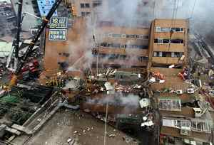

Slide 3
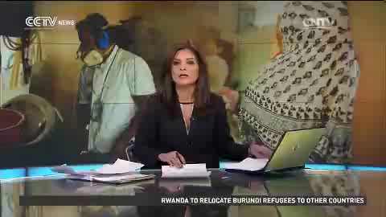

Slide 4
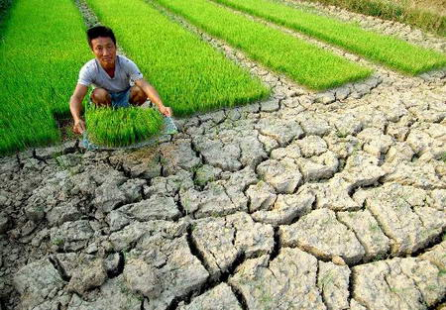
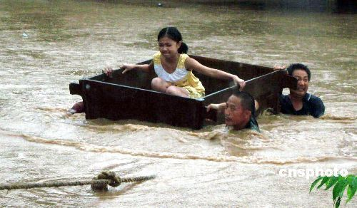
Step 1-Vocabulary storage
drought
旱灾
flood
[flʌd]
洪灾

Slide 5
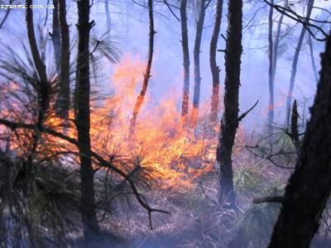
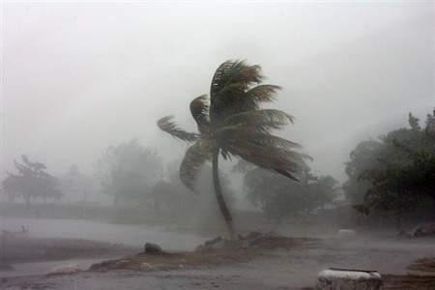
fire
火灾
typhoon
台风

Slide 6
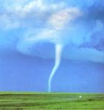
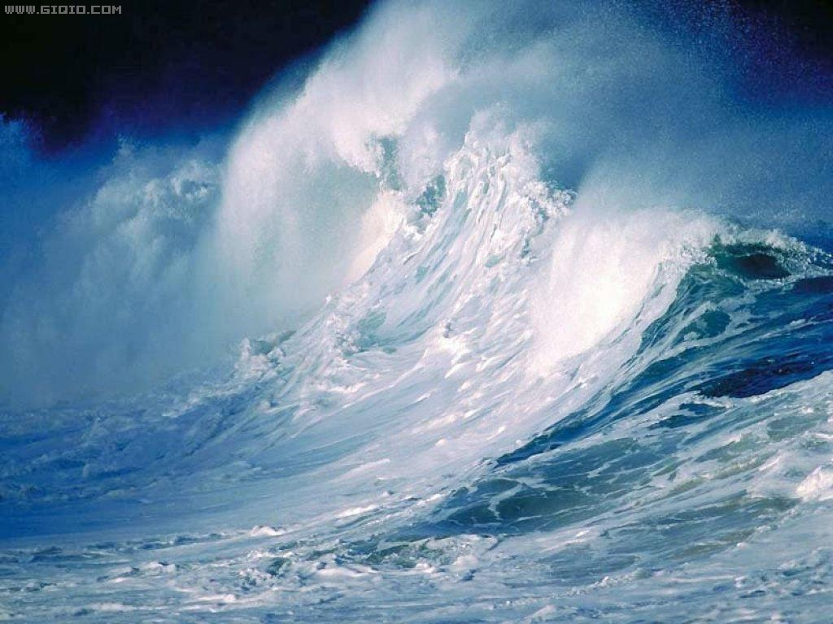
tornado
[tɔ:neidəu]
龙卷风
tsunami
[tsu:'nɑ:mi]
海啸

Slide 7
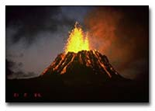
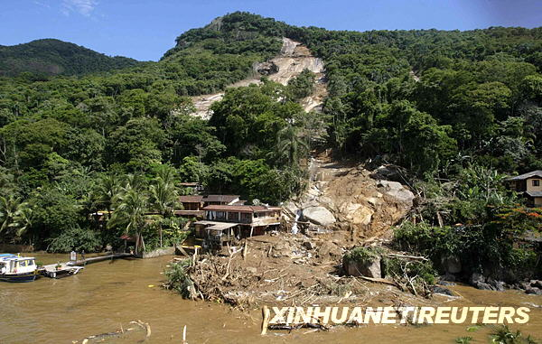
volcano
mud flow
[vɔlkeinəu]
(泥石流)
(火山)

Slide 8
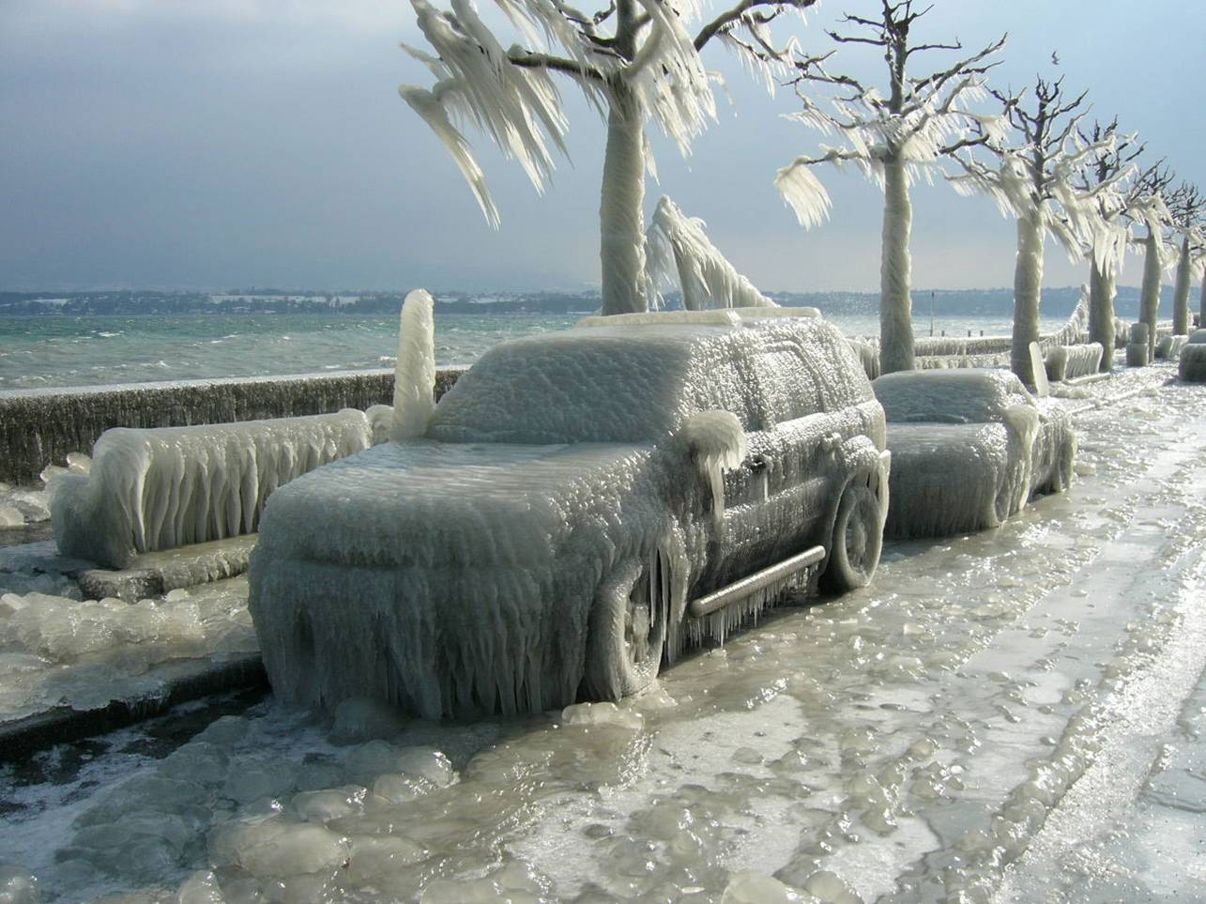
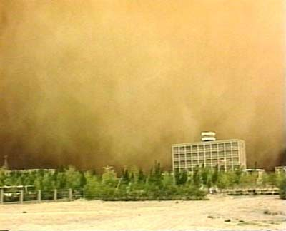
snowstorm
sandstorm
(沙尘暴)
(雪灾，雪暴)

Slide 9


Step 2-Discussion
What may be included in the
report ?

Slide 10
Chunks About Disasters
1. Time and place
2. Degree (程度)
3. Deaths and casualty（死伤情况）
4. Economic losses
5.The rescue work

Slide 11
1. Time and place
河北省东北部的农村
in the countryside of northeast Hebei
在可怕的15秒钟内
in fifteen terrible seconds
在……的北部
to the north of …

Slide 12
2. Degree
升升降降、起起伏伏
rise and fall
井壁上有深深的裂缝.
The well walls have deep cracks in them.
爆裂
crack and burst
世界似乎到了末日.
It seemed as if the world was at an end.
横穿房舍、马路和渠道
cut across houses, roads and canals
沉沦在一片废墟之中
lie in ruins

Slide 13
3. Deaths and casualty
死或受伤
die or be injured
许多孩子变成了孤儿.
Many children were left without parents.
死伤人数达到……
The number of people who were killed or seriously injured reached …
消失
be gone
刮走
blow … away

Slide 14
4. Economic losses
造成经济损失
cause economic losses
.……很难弄到
… be hard to get

Slide 15
5. The rescue work
救援人员
the rescue workers
挖
dig out
bury
埋葬
得救
be rescued from
为幸存者盖起了避难所
build shelters for survivors
开始出现生机
begin to breathe again

Slide 16
Application of lexical chunks :
Step 3: Application of lexical chunks
一. Sentence.
1. 在台南，两个人已经从倒塌了的17层公寓获救出来。
Two people have been rescued from a collapsed 17-story apartment building in Tainan.
2. 在2月6号的台湾地震中，已经有112人遇难。
In the February 6th earthquake in Taiwan, the number of people who were killed have been reached 112.
3. 估计造成经济损失达97个亿。
It is estimated that the economic losses were more than 9.7 billion yuan.

Slide 17
Application of lexical chunks ----- Writing
假如你是河源中学的记者，茂名市在2010年9月21日遭受特大洪灾，请写一篇英语短文向外国朋友报道灾情。
[写作内容]
1.发生的时间地点。
2.灾情： 
（１）死伤人数达到400多人，成千上万的房屋被毁， 几十万人无家归；  （２）水、食物和电都很难得到； 
（３）有史以来最大的洪灾。
3.救援工作： 
（１）灾后不久，部队派了大量的战士去灾区协助救援人员。
（２）他们为那些家园被毁的幸存者盖起了避难所，用火车、
卡车运来了水和食物。
● （３）慢慢地，这座城市又恢复了生机。
[写作要求]
１.词数100左右；
２.可适当增加细节，以使行文连贯。

Slide 18

A terrible flood occurred in Maoming on September 21, 2010, the greatest flood in the history of the city. As was reported, the number of people who were killed or injured reached more than 400. In addition, thousands of houses were destroyed, making tens of thousands of people homeless. Worse still, water, food and electricity were hard to get. Much to our delight and satisfaction, soon after the flood, the army sent a great number of soldiers to the disaster-stricken area to give a hand to the rescue workers, where they built shelters for survivors whose homes had been destroyed. More importantly, water and food were also sent to the city by train and truck, which made the city gradually come back to life.
Thanks for your attending!

