Slide 1
人教版新课标人教版 Book2 Unit5
Music
devote…to
&
be devoted to
华南师范大学外国语言文化学院 区铭诗
陈斯娴
河源市河源中学 刘素芬

Slide 2
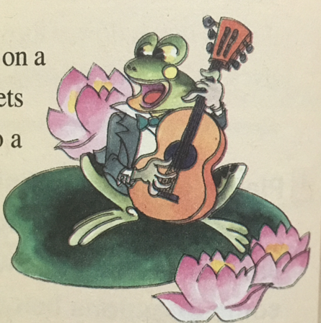

Freddy the Frog
Para 1 sentence 2
Fans showed their devotion by waiting for hours to get tickets for their concerts.
粉丝们花费几个小时排队购买他们的音乐会门票，以此来展示他们的热情。

Slide 3
devotion (n.)
devote (v.)
Great love or loyalty 深爱；挚爱；忠诚
The act of spending a lot of time and energy on something 奉献，；献身
Great loyalty to a religion 对（宗教的）虔诚
To use time, effort etc. in order to do something or help something be successful 为…付出时间/努力/金钱等
To do everything you can to achieve something or help someone 献身于…；专心致志于…

Slide 4
Chunks
1. devote sth. to (doing) sth.
2. devote oneself to (doing) sth.
3. be devoted to sb./ (doing) sth.

Slide 5
1
devote
to
sth. (doing) sth.
PPT模板下载：www.1ppt.com/moban/ 行业PPT模板：www.1ppt.com/hangye/
节日PPT模板：www.1ppt.com/jieri/ PPT素材下载：www.1ppt.com/sucai/
PPT背景图片：www.1ppt.com/beijing/ PPT图表下载：www.1ppt.com/tubiao/
优秀PPT下载：www.1ppt.com/xiazai/ PPT教程： www.1ppt.com/powerpoint/
Word教程： www.1ppt.com/word/ Excel教程：www.1ppt.com/excel/
资料下载：www.1ppt.com/ziliao/ PPT课件下载：www.1ppt.com/kejian/
范文下载：www.1ppt.com/fanwen/ 试卷下载：www.1ppt.com/shiti/
教案下载：www.1ppt.com/jiaoan/ PPT论坛：www.1ppt.cn

Slide 6
devote
sth.
to
(doing) sth.
把时间(钱，精力等)献给...
Attention
1). Sth. could be time, effort, money etc.
2). To, here is a preposition so the following verb should be V.+ing.

Slide 7
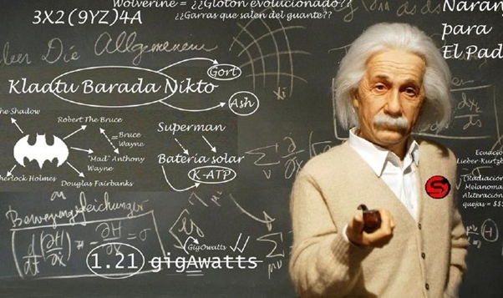
devote
sth.
to
(doing) sth.
1). He decided to devote the rest of his life to scientific investigation.
他决定把余生奉献给科学研究。

Slide 8
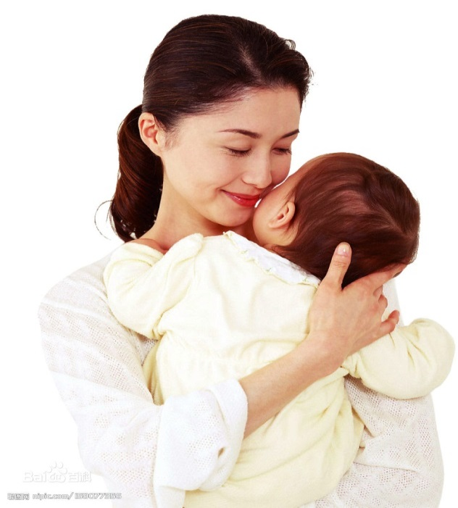
devote
sth.
to
(doing) sth.
2). I’m devoting all my time and energy to being a mom right now.
目前我把所有时间和精力都放在当妈妈这件事上。

Slide 9
2
devote
oneself
to
(doing) sth.

Slide 10
devote
oneself
to
(doing) sth.
献身于或致力于(做)某事。
热衷于，热爱。
专注于。
Attention
To, here is also a preposition so the following verb should be V.+ing.

Slide 11
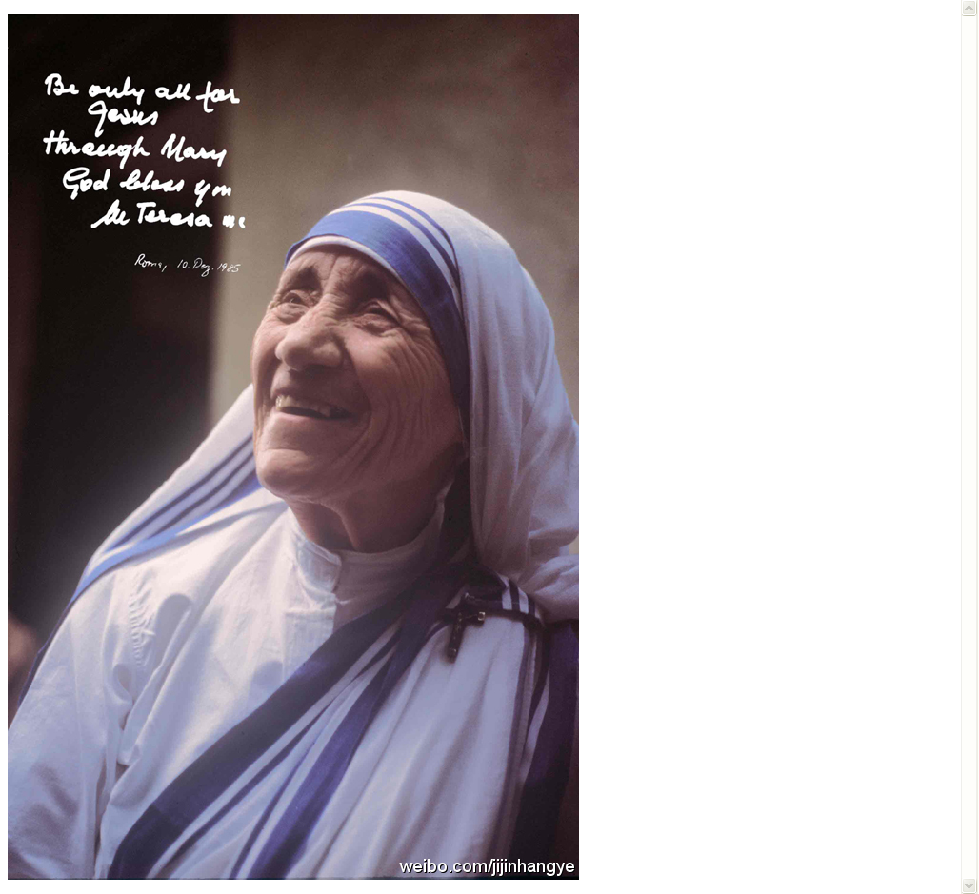
devote
oneself
to
(doing) sth.
1). 献身于…；致力于…
Mother Teresa has devoted herself to caring for the poor.
特蕾莎修女把自己的全部身心都倾注在照顾穷苦人之上。

Slide 12
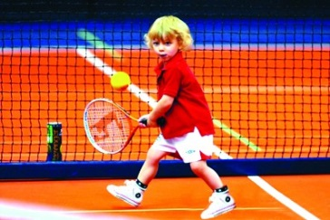
devote
oneself
to
(doing) sth.
2). 热爱，热衷于…
He devoted himself to tennis when he was young.
当他年轻的时候，他十分热爱网球。

Slide 13

devote
oneself
to
(doing) sth.
3). 专心致志于…；专注于…
She devoted herself to learning English.
她专心致志于学习英语。

Slide 14
3
be devoted to
sb. / (doing) sth.

Slide 15
be devoted to
sb. / (doing) sth.
热爱。
致力于，献身于。
专用于。
Attention
“devoted” here is an adjective.
It means “ 献身的；忠诚的”

Slide 16

be devoted to
sb. / (doing) sth.
1). Showing great love and loyalty for someone or something. 热爱…
Alice is devoted to his music.
爱丽丝热爱他的音乐。

Slide 17
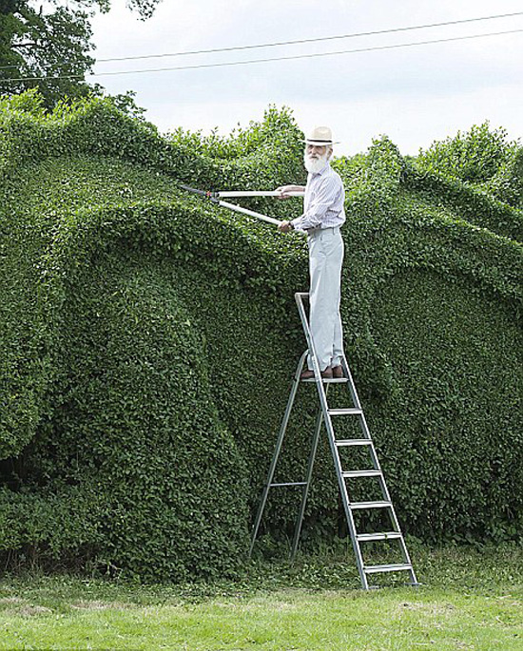
be devoted to
sb. / (doing) sth.
2). care about it a lot and be very enthusiastic about it 热衷于；致力于
Horace is so devoted to his garden that he hasn't been away for 10 years...
霍勒斯对他的花园太过上心，都有10年没出过远门了。

Slide 18
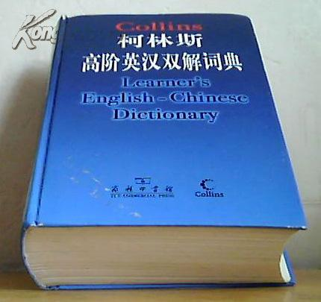
be devoted to
sb. / (doing) sth.
3). Something that is devoted to a particular thing deals only with that thing or contains only that thing. 专用于…
This dictionary is devoted to explaining word usage. 这本词典是解释词的用法的

Slide 19
4
Attention & Tips

Slide 20
1. 在以“devote…to”为根的词组中，to为介词，因此接续的动词要使用-ing形式。
2.两个词块（devote…to… & be devoted to）的区别往往体现在其非谓语形式的考查中
3. 写作时，可以灵活运用“devote…to”：
（1）give all one’s effort to devote oneself to
（2）concentrate on devote oneself to
（3）like; be interested in be devoted to

Slide 21
Practice now

Slide 22
应用devote相关词块翻译下列句子：
她一生都奉献给中国妇女与儿童的医疗事业。
2. 里德先生决心倾其所有为贫苦孩子建立一些学校。
3.毕业之后他继续致力于研究工作。
4. 学生们专心于学习。
She devoted all her life to medical work for Chinese women and children.
Mr. Reed made up his mind to devote all he had to setting up some schools for poor children.
After he graduated he continued to devote himself to research.
The students are devoted to their studies.

Slide 23
高考重难点：
1.Mr.wang made up his mind to devote all he could ____his oral English before going abroad.
A. improve B. to improve
C. improving D. to improving
D
Because he was devoted to his work, Jack paid no attention to other things.
Because she devotes all her efforts to her work, she makes a lot of achievements.
原因状语
be devoted to
2. a) ______to his work, Jack paid no attention to other things.
A. Devoted B. To devote
C. Having devoted D. Devoting
A
原因状语
D
b)_______all her efforts to her work, she makes a lot of achievements.

Slide 24
Summary
sth. (doing) sth.
1.
devote
to
把时间(钱，精力等)献给...
devote
oneself
to
(doing) sth.
2.
献身于或致力于(做)某事。
热衷于，热爱。
专注于。

Slide 25
Summary
3.
be devoted to
sb. / (doing) sth.
热爱。
致力于，献身于。
专用于。
devoted here is an adjective!!!
4.
Key & Difficult Point
the Non-Finite Verb
be devoted to
devote…to

Slide 26
THANK
YOU
BYE

