Slide 1
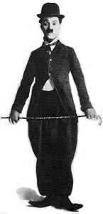
M4U3 READING --- A MASTER OF NONVERBAL HUMOUR
HUMOUR
Phrases and Sentence Patterns
华南师范大学外国语言文化学院 叶丽敏 胡晓敏
河源市东源中学 欧阳筱莉
Pick out/ spend (in) doing/ feel content with/ badly off

Slide 2
Prases and Sentence Patterns
From reading
Spend (in) doing
Pick
out
Feel content with
Badly off
Pick out/ spend (in) doing/ feel content with/ badly off

Slide 3
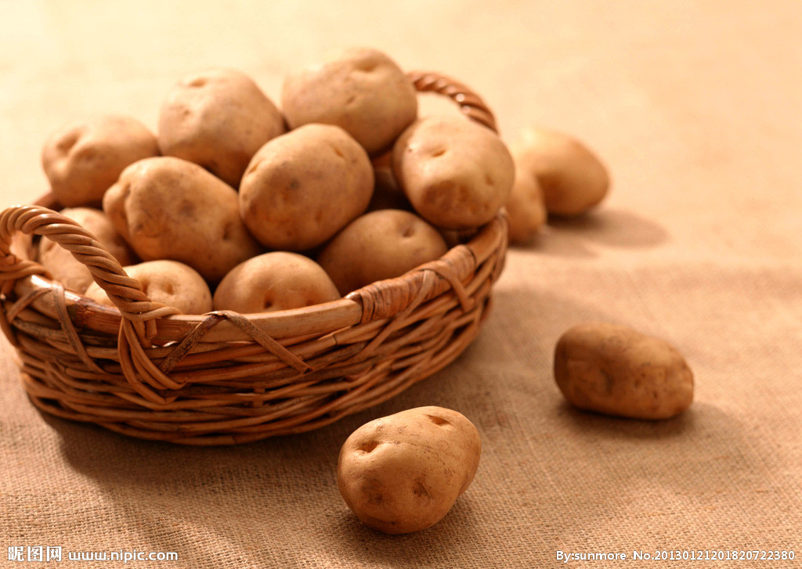
Pick out
(从同类当中）选出;选择
Chaplin picked out the bad potatoes from the basket.
卓别林把坏掉的土豆从篮子里挑出来。
Pick out/ spend (in) doing/ feel content with/ badly off

Slide 4
Pick out
2. (在许多人当中）看出；辨认出…
It’s easy to pick out Chaplin because he always wore large trousers and a small round black hat.
很容易就能辨认出卓别林，因为他经常穿着肥大的裤子和一顶小圆黑礼帽。
Pick out/ spend (in) doing/ feel content with/ badly off

Slide 5
Pick out
3.了解; 领会
Chaplin picked out the meaning of the film script quickly.
卓别林很快理解了电影剧本。
Pick out/ spend (in) doing/ feel content with/ badly off

Slide 6
拓展&练习 Pick up
He promised to pick me up
at the school gate.
拾起；拿起
（非正式地）获得；学得
Please pick up all your toys when you've finished playing.
（车、船）接载某人
Kathy picked up a lot of Spanish by playing with the native boys and girls.
接收（信号，广播、电视节目)
I managed to pick up an American news broadcast.
Pick out/ spend (in) doing/ feel content with/ badly off

Slide 7
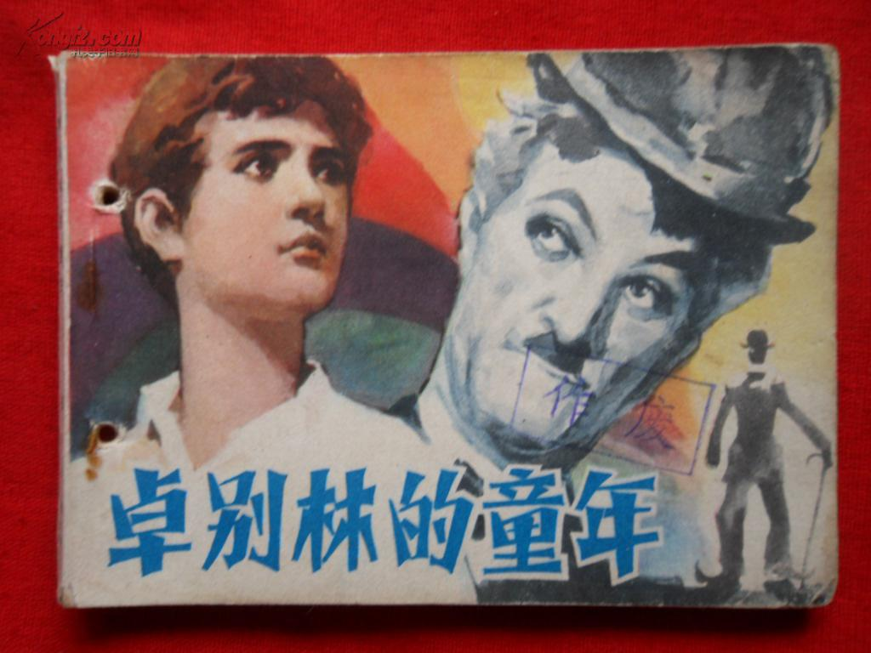
Spend (in) doing..
花费（时间、金钱）做某事
Charlie spent his childhood looking after his sick mother and his brother.
卓别林童年时都在照顾他生病的母亲和他的弟弟。
注意：spend, spent, spent
Pick out/ spend (in) doing/ feel content with/ badly off

Slide 8
Spend 拓展
辨析spend, cost, take, pay
1.spend some time/money (in) doing sth./on sth. 花费时间或金钱做某事，主语一般为人
2.sth.cost(s) sb…某物花费某人…，一般用物做主语
3.It takes sb. some time/money to do sth.花费某人时间或金钱做某事。It为形式主语，to do不定式是真正主语
4.sb.pays some money to do sth.
Pick out/ spend (in) doing/ feel content with/ badly off

Slide 9
Spend 拓展
辨析spend, cost, take, pay
①Chaplin ______a lot of time in making films.
②I know it ____Chaplin much time to act the fool doing ordinary everyday tasks.
③Making films _____Chaplin a lot of time.
④ Chaplin ________ much money to make films.
注意：pay后一般只加金钱,不加时间。
spent
took
cost
paid

Slide 10
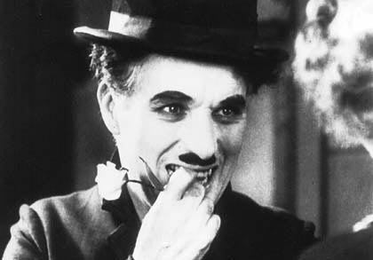
Feel/be content with
adj. 满足的; 满意的; 知足的
对…感到满足
Chaplin made people feel more content with life during two world wars.
在两次世界大战时期，卓别林使人们对生活更满意一些。
Pick out/ spend (in) doing/ feel content with/ badly off

Slide 11
Content 拓展
Be content to do sth. 做…很满足
v.使满足；
content sb. or oneself with sth. 使…满足于…
n.内容
Chaplin was content to make films to
entertain people.
Chaplin usually contented people with his
unusual dressing and funny action.
Pick out/ spend (in) doing/ feel content with/ badly off

Slide 12
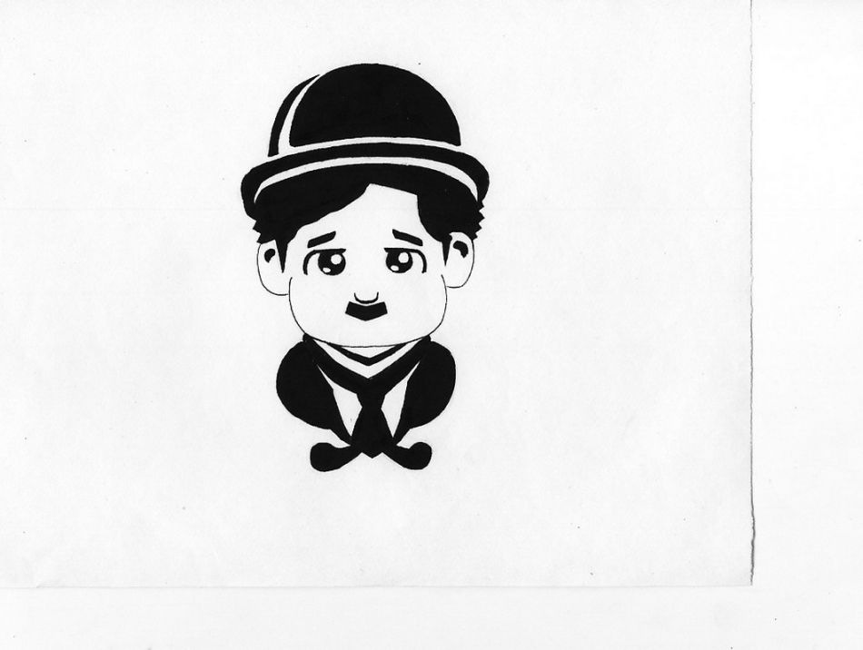
Badly off
穷困；潦倒
When Chaplin was young, his family was badly off.
当卓别林小的时候，他们家穷困潦倒。
Pick out/ spend (in) doing/ feel content with/ badly off

Slide 13
Badly off 拓展
比较级： worse off 恶化
最高级： worst off
反义词： well off 富裕的
比较级： better off 转好
最高级：best off
Pick out/ spend (in) doing/ feel content with/ badly off

Slide 15
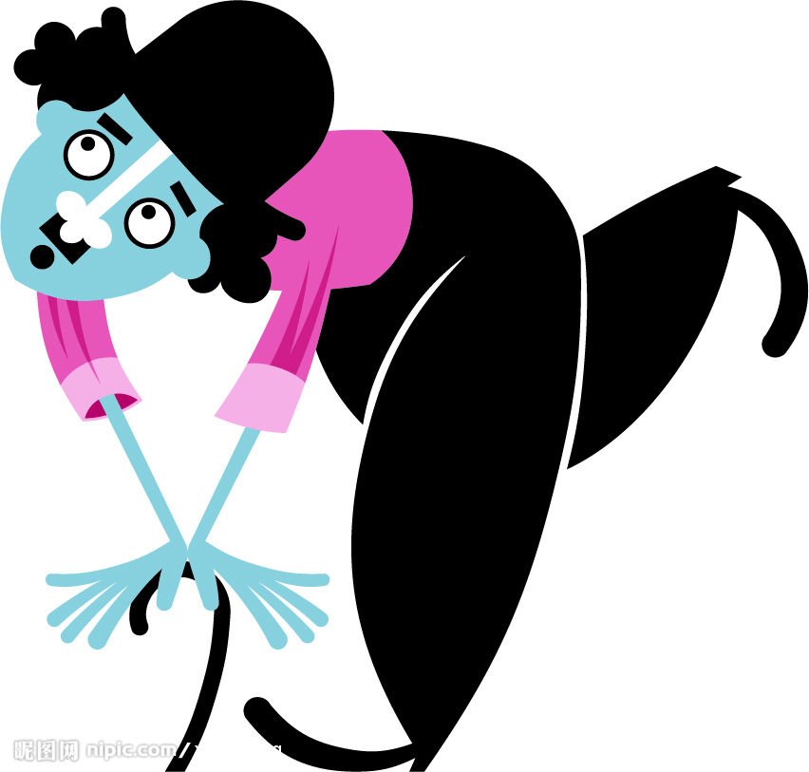
Pick out/spend doing/
(feel) content with/badly off
Exercise
Charlie was born in a poor family in 1889. His family was ________ and he ______ his childhood ________(look) after his sick mother as well as little brother. Between two world wars, people in America and British ______ not ____________ their life at all. However, as an excellent actor, Charlie _______ people ______ his nonverbal humour and comforted them a bit. He grew more and more popular as his charming character, a little tramp. In his most famous film, the Gold Rush, the little tramp was so hungry that he ___________ the laces of his shoe and ate them as if they were spaghetti.
badly off
spent
looking
felt
content with
contented
with
picked out
Notes:
15

Slide 16
Thanks for your attention!

