Slide 1
Lexical Chunks
人教版高中英语B2U4
Wildlife Protection
华南师范大学外国语言文化学院 招宇琦
丁金丽
河源市河源中学 黄秀添

Slide 2
Unit 4 Wildlife protection

Slide 3
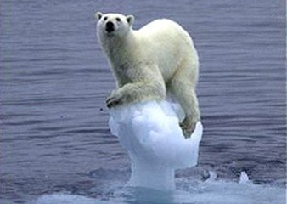
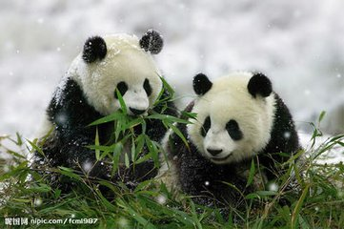

Slide 4
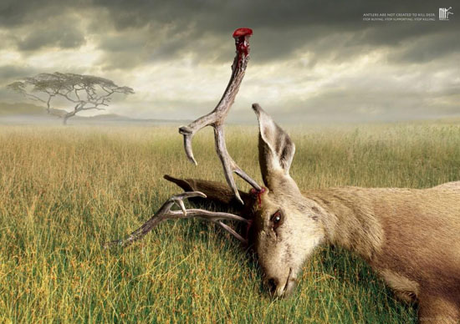
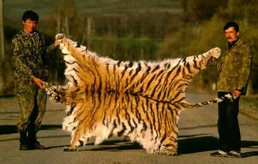

Slide 5
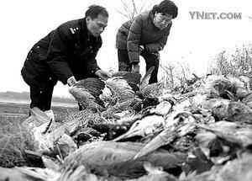
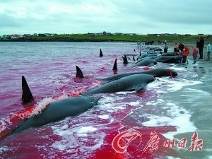

Slide 6
Let's learn some chunks in arising people's awareness in wildlife protection

Slide 7
TASK 1:
Some important and useful chunks.

Slide 8
1. appreciate
2) be thankful/grateful to
1) realize
3) recognize the good qualities of 欣赏
1) She never really appreciated the depth and bitterness of the family's conflict.
2) Peter stood by me when I most needed it. I'll always appreciate that.
3) Anyone can appreciate our music.
句型
I would appreciate it if you did sth.
Nothing is strong enough to convey my appreciation of sth./ sb.
语篇运用：
_________________________________________________________ 我将会很感激，如果我的申请得到了您的批准。（2011,重庆）
I would appreciate it if my application could get your approval.

Slide 9
from against
2. protect …______/_______ … 保护……不受……
语篇运用：
1. Pandas are not only_________________but also our friends and ______________________________________.
熊猫不仅是大自然的珍宝也是我们的朋友。保护他们就是保护我们自己。（2011，重庆）
2. It is our duty __________________________________.
保护动物免受伤害是我们的责任。
treasure of nature
protecting them is protecting ourselves
to protect animals from being hurt

Slide 10
( much)
( little )
( no )
doing
3. pay attention to (______)sth.
attach
语篇运用：
____________________________________________
______________________________________________
我们要注意动物的感受，禁止游客和动物拍照。(2009广东)
We should pay attention to animals’ feelings and ban
tourists from taking photos with them.
I have been paying attention to animals since I was a child and I care for animals very much.
___________________________________________________________________________________________自儿时开始，我就一直关注动物并喜欢他们。(2011重庆)

Slide 11
4.die out （动，植物物种）灭绝
e.g. This kind of species died out many years ago.
这个物种很多年前就灭绝了。
5.in peace 平静的（地）；安静的（地）
in silence/ in quiet/in surprise/in a hurry
e.g. She began to live in peace and content.
她开始平静而满意地生活了。
6.be in danger of 有… 危险
be out of danger脱离危险
endangered adj. 濒危的 dangerous 危险的
e.g. The group was in danger of breaking up.
这个团队处于解散的危机之中。

Slide 12
TASK 2:
Practice.

Slide 13
翻译句子：
1. 一些动物濒临灭绝的危险。
_________________________________________________________
2. 如果它们不被猎杀，就能够平静地生活。
_________________________________________________________
3.我们人类不应该危害动物。
_________________________________________________________
Some animals are in danger of dying out.
If they were not hunted or killed, they would live in peace.
We human beings shouldn't do harm to animals.

Slide 14
翻译句子：
4.政府应采取措施禁止捕杀野生动物。
_______________________________________________________
_______________________________________________________
5.作为学生，我们要提高保护野生动物的意识，保持良好的生态平衡。
_______________________________________________________
_______________________________________________________
____________________
The government ought to take measures to protect
wild animals from being hunted and killed.
As students, we ought to pay attention to increasing
the awareness of protecting wild animals and the
balance of nature.

Slide 15
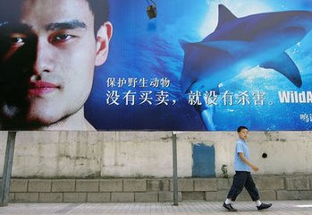
书面表达
某国际动物关爱协会面向全球中学生招募“动物代言人”，希望申请者选择一种自己喜欢的动物，为之代言（speak for）。假设你是李华，有意参与该活动，请你用英文写一封申请信。内容如下：
●表示有意参加
●说明自己富有爱心、关爱动物
●打算为何种动物代言，并说明理由
●希望申请成功
注意：
（1）词数100左右；
（2）申请信的开头、结尾已给出，不计入总词数。

Slide 16
Dear Sir or Madam,
_____________________________________________________________________________________________________________________________________________________________________________________________________________________________________________________________________________________________________________________________________________________________________________________________________________________________________________________________________________________________________________________________________________________________________________________________________________________________________________________________
I’m looking forward to you reply.
Yours Sincerely,
Li Hua

Slide 17
Dear Sir or Madam,
Knowing that you want some students to speak for the animals they like, I can hardly contain my inner excitement and would like to participate in the activity and speak for pandas. I have been paying attention to animals since I was a child and I care for animals very much. Not only are pandas lovely animals which are considered as the treasure of our country, but also they are rare animals in danger of dying out. So if I have the honor to have the chance to speak for a kind of animal, I would like to speak for pandas so that I can raise the public awareness of animal protection and appeal to people to protect them from extinction.
I'm firmly believed that I can do something for pandas. I would appreciate it if my application could get your approval. I’m looking forward to you reply.
Yours Sincerely,
Li Hua

Slide 18
Summary of some useful chunks :
1.contain
2.appreciate
3. protect ...from/against
4.pay more attention to
5.in danger
6.die out
7.speak for
8.care for
9.appeal to
10.treasure of nature
11. raise the public awareness of
12.live in harmony with
包含；容纳；控制
欣赏；理解；感激
保护……不受……
更加关注……
濒危
灭绝
为……代言
关心
吸引，号召
自然的财富
提高大众……意识
与……和谐相处

Slide 19
Thanks for your listening!

