Slide 1
Book 7, unit1
词汇•精讲
华南师范大学外国语言文化学院 卓琳
华南师范大学外国语言文化学院 苏双欣
河源市和平县福和高级中学 伍丽梅

Slide 2
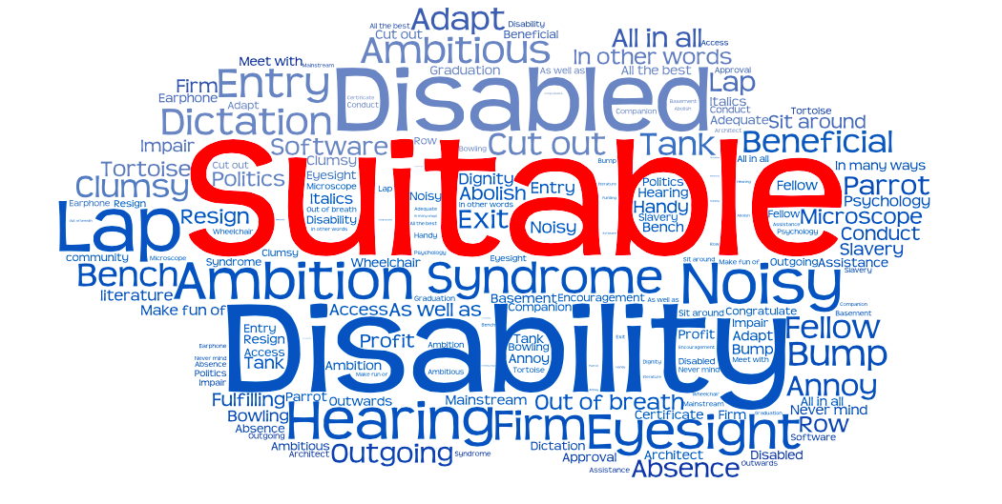
words review
word clouds made by tagul.com

Slide 3
(1)suitable•词义
ADJ-GRADED
合适的;适宜的;适当的
Someone or something that is suitable for a particular purpose or occasion is right or acceptable for it.
《柯林斯高阶英汉双解学习词典》
Collins Advanced Learner's Dictionary of English and Chinese

Slide 4
(2)suitable•词源
on the pattern of agreeable
late 16th century.
suitable
from the verb suit

Slide 5
suit, able, suitable
suitable
suit
able

Slide 6
拓展•词缀-able
-able是一个常见的形容词词缀。
以“-able”结尾的形容词一般分为两种情况：
1. v.+able→adj. 以这种方式构成的形容词其意义为“能…的”、“可以(被)…的”、“适合于…的”、“值得…的”等，即有被动含义。
如：reliable(可以依靠的)，drinkable(可以饮用的)，eatable(可食用的)等
2. n.+able→adj. 这种形容词意为“具有…特点的”
如：valuable(有价值的)，reasonable( 有道理的)，comfortable(舒适的)等

Slide 7


(3)suitable•用法
1.suitable+n.

Slide 8



How to use ‘suitable’ in a sentence?
句子搜索法
2.be suitable to do something

Slide 9
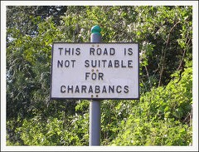
图片搜索法
3.be suitable for something
examples：
1.This area is particularly suitable for families.
2.The latter observational method is more suitable for global mapping.
3.What materials are suitable for tank decor?

Slide 10
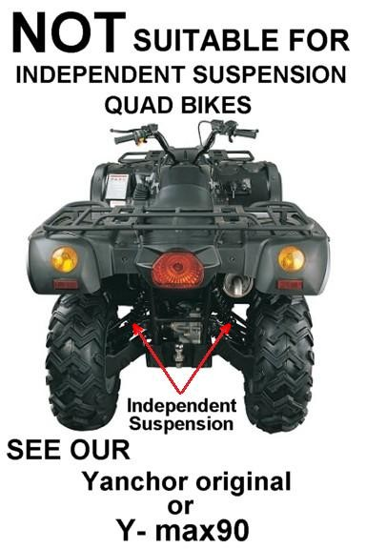
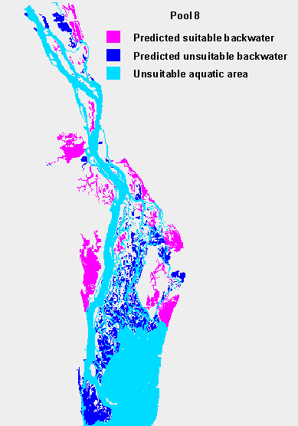
4.be not suitable for/unsuitable＋n.
suitable的否定用法

Slide 11
词汇学习•技巧总结
1.Make sure the definition of the word.(pay more attention on the different meanings of same word)
2.Try to find out the etymology of the word and learn its construction(affix&suffix) by heart.
3.Keep your eyes on how the word be used in sentences and our daily life.
4.Try to make some conclusions.

Slide 12


