Slide 1
Subjunctive Mood ---mixed conditionals
Jiaqi Han 韩嘉琪

Slide 2
We use subjunctive mood to describe unreal things for now, in the past, or in the future.
1) unreal things for now：
If + subject + … , subject + + V原
should/
would/
could/
might
was/
were/
V-ed

Slide 3
2) unreal things in the past：
If + subject + ... , subject +have v-ed
3) unreal things in the future ：
If + subject + … , subject +v原
should/
would/
could/
might
had (been) done
should/
would/
could/
might
should
were to

Slide 5
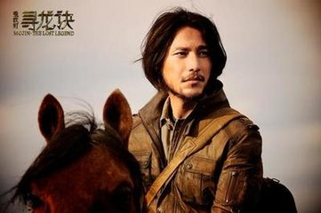
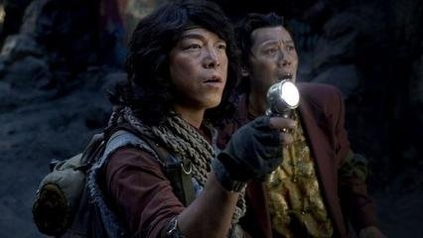
Bayi Hu’s team member——Kaixuan Wang accidentally found the news about Bayi Hu’s first love Xiao Ding who died 20 years ago. What’s more, the Equinox Flower(彼岸花) which bears in their minds constantly appeared again. So they decided to get into the ancient tomb again to find out the secret with Bayi Hu’s agent & girlfriend——Shirley.
Sitian Ding
Bayi Hu
Shirley
Kaixuan Wang

Slide 6
If there had been ifs THEN,
everything would be different NOW...
When the main clause and the if-clause are about different tenses,we use mixed conditionals.

Slide 7
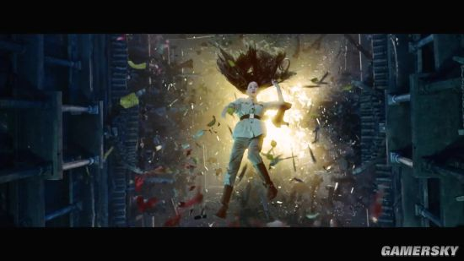
If Xiao Ding hadn’t sacrificed herself, her friends would not be alive now!

Slide 8
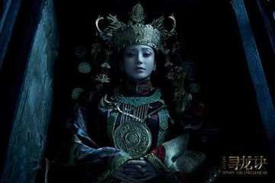
If Bayi Hu hadn’t decided to come back to the ancient tomb , he wouldn’t find out the secret of Equinox ['ikwɪnɑks] Flower (彼岸花).

Slide 9
If they hadn’t decided to find out the secret of Equinox ['ikwɪnɑks] Flower (彼岸花), they wouldn’t have to face the challenges.

Slide 10
If Hu and Shirley hadn’t experienced the adventure, they would not know how much they love each other.

Slide 11
If Xiao Ding hadn’t sacrified herself,
her friends would not be alive now!
Past:if-clause: had +V-ed
Now:main clause:
would+V

Slide 12
If Bayi Hu hadn’t decided to come back to the ancient tomb,
he wouldn’t find out the secret of Equinox Flower.
Past:if-clause: had +V-ed
Now:main clause:
would+V

Slide 13
If they hadn’t decided to find out the secret of Equinox Flower,
they wouldn’t have to face the challenges.
Past:if-clause: had +V-ed
Now:main clause:
would+V

Slide 14
If Hu and Shirley hadn’t experienced
the adventure, they would not know
how much they love each other.
Past:if-clause: had +V-ed
Now:main clause:
would+V

Slide 15
If you had come and attended the meeting yesterday, you would know what we are doing now.
If you had followed my advice, you would not be in trouble now.

Slide 16
If the weather had been finer, the crops would be growing still better.
If you had followed the teacher’s advice, you wouldn’t be in the hospital.

Slide 17
2. We use otherwise, or and phrases
beginning with with, without and but
for to replace an if-clause in implied
conditionals.
Without air , there would be no living things.
But for your help , I couldn’t have done it.
(If there were no air)
(If it hadn’t been for your help)

Slide 18
I was busy that day. Otherwise I would have gone there with them.
(If I hadn’t been busy that day, I would have gone there with them.)
I would have finished the work, but I have been ill.
(If I hadn’t been ill, I would have finished the work.)

Slide 19
Thanks for your listening~

