Slide 1
The Present Continuous Tense for Future Actions 现在进行时 表将来
Unit 3 Grammar
华南师范大学外国语言文化学院 胡清清

Slide 3
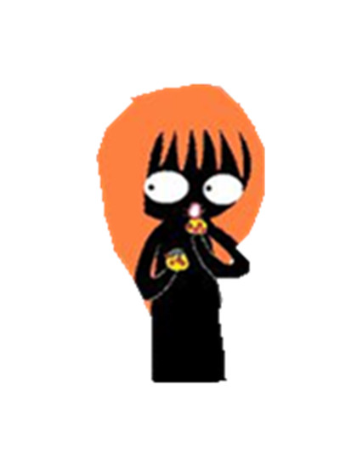
真相只有一个
I am eating your cake.
I am going to eat your cake.

Slide 4
现在进行时?
Be(am, is, are) +V.ing

Slide 5
现在进行时的一般用法：
（1）表示说话的时刻正在发生的动作，常与now, at the moment连用。
He is doing his homework at the moment.
他正在做作业。
We are waiting for you now.
我们在等你。

Slide 6
（2）表示现阶段正在发生的动作，常与today, these days, this week, this term, recently等词连用。
Our school are preparing for the sports meet this week.
本周我们学校正在为运动会做准备。
I am preparing for the mid-term exam recently.
我最近在为期中考而复习。

Slide 7
（3）当其与always，forever，continually，constantly 等副词连用时表示重复的动作，有着极大的感情色彩，表示说话人的不满或满意。
She is always changing her mind.
她老是改变主意。（不满）
The students are making progress constantly.
学生们在不断进步。 （满意）

Slide 8
现在进行时
表示现在
表示将来

Slide 9
Read the following sentences and underline the verbs that express future.
Warming up
Bob is always borrowing money from me but never pays back. Recently he is dating with a girl. He is coming to my office after work. I am driving home.

Slide 10
现在进行时可以表示将来，主要用于按计划或安排要发生的动作。通常带一个表将来的时间状语。

Slide 11
现在进行时表将来
（1）有此用法的动词多是位移动词，如：come, go, get, start, stay, arrive, leave, return, see off, take off 等。
I am leaving tomorrow.
我明天走。
I am seeing him off this afternoon.
我今天下午为他送行。
He is returning this weekend.
他这个周末回来。

Slide 12
（2）表示交通方式，行程安排的动词，例如fly, walk, ride, drive, take (a bus, a taxi)等现在进行时也常用于表示将来。
I am flying to Shanghai tomorrow.
我明天坐飞机去上海。
He is taking his son to the Central Park this Saturday.
他这个周六要带他儿子去中央公园。

Slide 13
（3）另外也可使用某些非位移动词，例如 do, buy, meet, have, play, spend等，此时句中一般要有表示将来的时间状语。
We are playing basketball tomorrow.
我们明天打篮球。
They are having party on Saturday.
他们星期六聚会。

Slide 14
homework
We are having a Christmas party
Where are you going?
When are you getting there?
What are you doing there?
Who are you inviting?
Where are you staying?
How much are you spending on it?
When are you coming back?

Slide 15
T h a n k s for listening

