Slide 1
Subjunctive Mood ---mixed conditionals
华南师范大学外国语言文化学院 胡紫梦
河源市连平中学 阮秀婷
华南师范大学外国语言文化学院 韩嘉琪

Slide 2
We use subjunctive mood to describe unreal things for now, in the past, or in the future.
1) unreal things for now：
If +O+ …, O+ + V原
was/were
/V-ed
should (would
could, might)

Slide 3
2) unreal things in the past：
If +O ... , O +have V-ed
3) unreal things in the future：
If +O …, O +V原
had been /V-ed
should (would
could, might)
should
were to
should (would
could, might)

Slide 4
But,
as often the case, many things undone earlier cause totally different result and regret to people later!
So,
lots of “ifs about the past” are being mentioned by people, just like what happened in this story...

Slide 5
In the early 1990s, Bayi Hu were going to gave up his old business but his team member——Kaixuan Wang accidentally found the news about Bayi Hu’s first love Xiao Ding who died 20 years ago. What’s more, the Equinox Flower which bears in their minds constantly appeared again. So they decided to get into the ancient tomb again to find out the secret with Bayi Hu’s agent & girlfriend——Shirley.

Slide 6
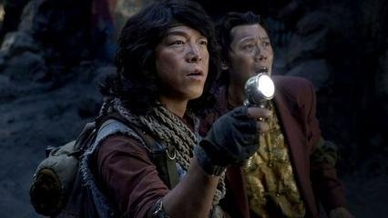
first love
Xiao Ding
agent & girlfriend
Bayi Hu
team member
Shirley
Kaixuan Wang

Slide 7
If Xiao Ding hadn’t sacrificed herself, her friends would not be alive now!

Slide 8
If Bayi Hu hadn’t decided to come back to the ancient tomb , he wouldn’t fine out the secret of Equinox Flower.

Slide 9
If Hu and Shirley hadn’t experienced the adventure, they would not know how much they love each other.

Slide 10
Use the correct verb form for if-clause and the main clause according to the different time the thing happens.
If Xiao Ding hadn’t sacrified herself,
her friends would not be alive now!
Past:if-clause: had +V-ed
Now:main clause:
would+V

Slide 11
Use the correct verb form for if-clause and the main clause according to the different time the thing happens.
If Bayi Hu hadn’t decided to come back to the ancient tomb,
he wouldn’t find out the secret of Equinox Flower.
Past:if-clause: had +V-ed
Now:main clause:
would+V

Slide 12
Use the correct verb form for if-clause and the main clause according to the different time the thing happens.
If Hu and Shirley hadn’t experienced the adventure,
they would not know how much they love each other.
Past:if-clause: had +V-ed
Now:main clause:
would+V

Slide 13
If you had come and attended the meeting yesterday, you would know what we are doing now.
If you had followed my advice, you would not be in trouble now.

Slide 14
If the weather had been finer, the crops would be growing still better.
If you had followed the teacher’s advice, you wouldn’t be in the hospital.

Slide 15
2. We use otherwise, or and phrases
beginning with with, without and but
for to replace an if-clause in implied
conditionals.
Without air , there would be no living things.
But for your help , I couldn’t have done it.
(If there were no air)
(If it hadn’t been for your help)

Slide 16
I was busy that day. Otherwise I would have gone there with them.
(If I hadn’t been busy that day, I would have gone there with them.)
I would have finished the work, but I have been ill.
(If I hadn’t been ill, I would have finished the work.)

