Slide 1
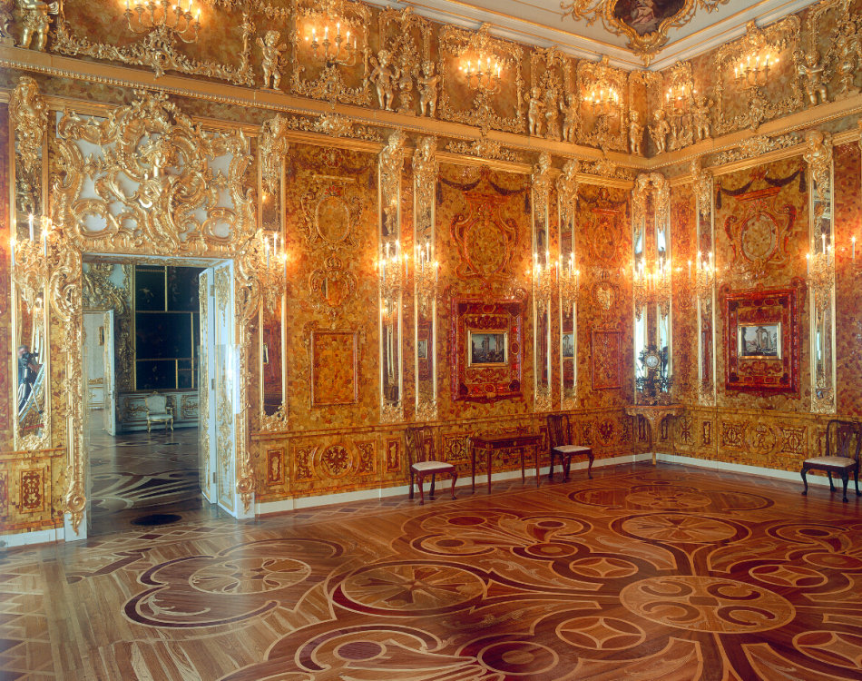
Book2 Unit1
Cultural Relics
华南师范大学外国语言文化学院 黄雪琪 徐嘉丽
河源市河源中学 陈静

Slide 3
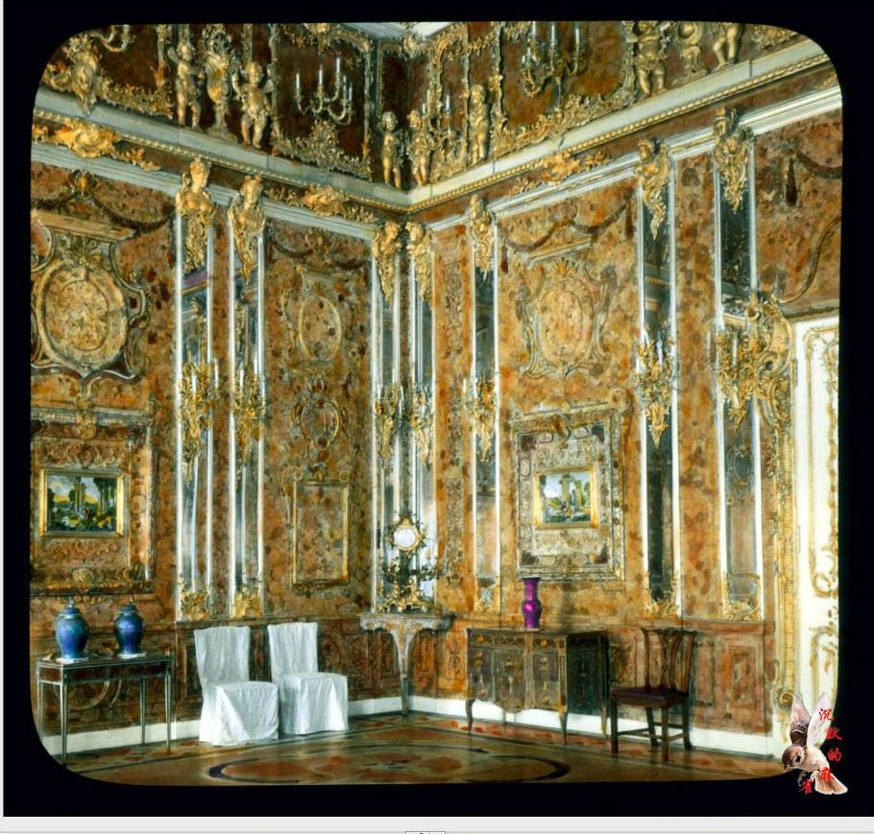
The Amber Room
The amber room, made of several tons of amber , is so wonderful that people around the world think highly of it. There is no doubt that it is considered to be one of the great wonders of the world. Although the amber room was stolen during the war, the new one has been built recently. It must be a place that is worth visiting.

Slide 4
think highly of
There is no doubt that...
be worth doing

Slide 5
think highly of
think highly of 对....评价高；看重，器重
think highly of + sth./ sb.

Slide 6
think highly of
1.We think highly of their research in the field.
对这一领域的评价高
2.The people think highly of the TV play.
对电视节目评价高
3. The boss seemed to think highly of you.
对你很看重/器重

Slide 7
There is still some doubt ________ the autumn sports meet will be held in our school, but there is no doubt ________ it will be held soon after our National Day holiday.
A．that; that B．whether; whether
C．that; whether D．whether; that
D
There is some doubt whether“不确定，有疑问”
There is no doubt that “毫无疑问”。

Slide 8
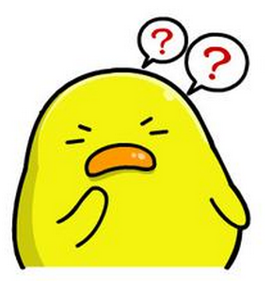
doubt+宾语从句
（1）在否定句和疑问句中,doubt后面接that引导的宾语从句.例如：
I don't doubt that he can finish the task on time.我相信他能按时完成任务.
Do you doubt that she will succeed?你怀疑她会成功吗?
（2）在肯定句中,doubt后面一般接whether或if引导的宾语从句.例如：
I doubt whether they can swim across the river.我怀疑他们能否游过河去.
He doubts if she will keep her word.他不敢肯定她是否会遵守诺言.
会不会有例外的用法呢？

Slide 9
Try to translate these two sentences.
I doubt if she will change her mind.
I doubt that she will change her mind.
我拿不准她是否会改变想法。
我不相信她会改变想法。
在肯定句中,doubt后面也可以接that引导的宾语从句,但表示疑虑较大或“不相信”

Slide 10
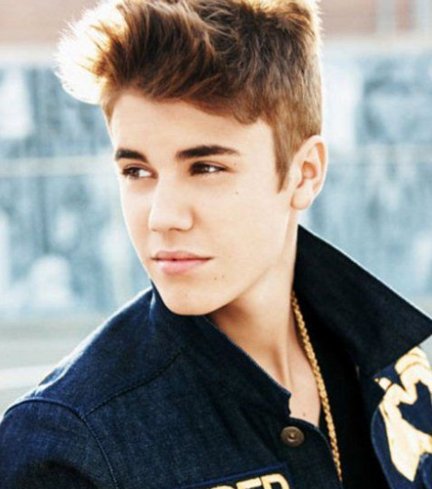
听歌填词。
God sent an angel to help you out
He gave you direction
Showed you how to read a map
With a long journey ahead
Said it ain't never over
Oh even in the midst of doubt
Life ,
Life , so live another day
is worth living
is worth living

Slide 11
B
There are a few books .But only one of them is ( ).
A.worthy of reading
B worth reading
be worth doing （主动表被动）
=be worthy of being done/ be worthy to be done
某事值得被做....

Slide 12
Have a try!!
---The question is not worthy ___.
A.discussing
B.to be discussed
C.to discuss
D.be discussed
C
I don't believe that your T-shirt is（ ）.
A.worth of the price
B.worthy of the price
C.worth the price
D.worthy the price
is worthy of 带有被动的含义，但该句没有表达被动的含义。
is worth + n. 这里的worth是“值得的；等值的；有....价值的” 的意思。

Slide 13
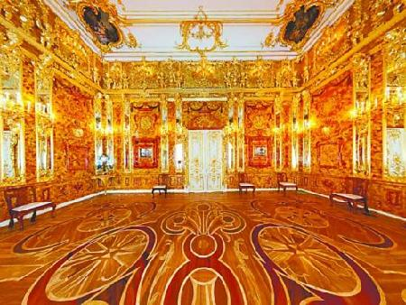
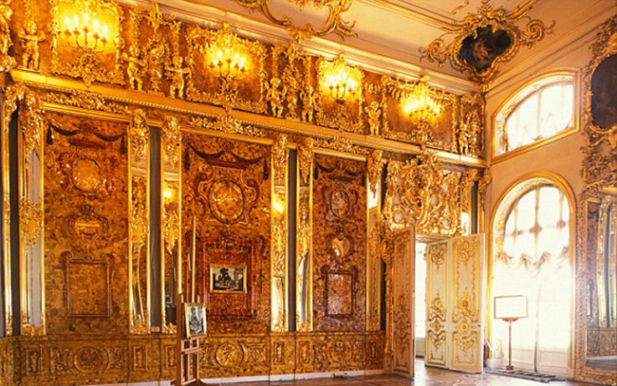
小结：
be worth + doing/ n./ pron.
be worthy + of + n./ pron. /doing
be worthy to do

Slide 14
The Amber Room
The amber room, made of several tons of amber , is so wonderful that people around the world think highly of it. There is no doubt that it is considered to be one of the great wonders of the world. Although the amber room was stolen during the war, the new one has been built recently. It must be a place that is worth visiting.

Slide 15
Thanks

