Slide 1
词块 Lexical Chunks
B3U2 Healthy Eating
河源市河源中学 张志栋
华南师范大学外国语言文化学院 李丽希
华南师范大学外国语言文化学院 刘颖虹

Slide 2
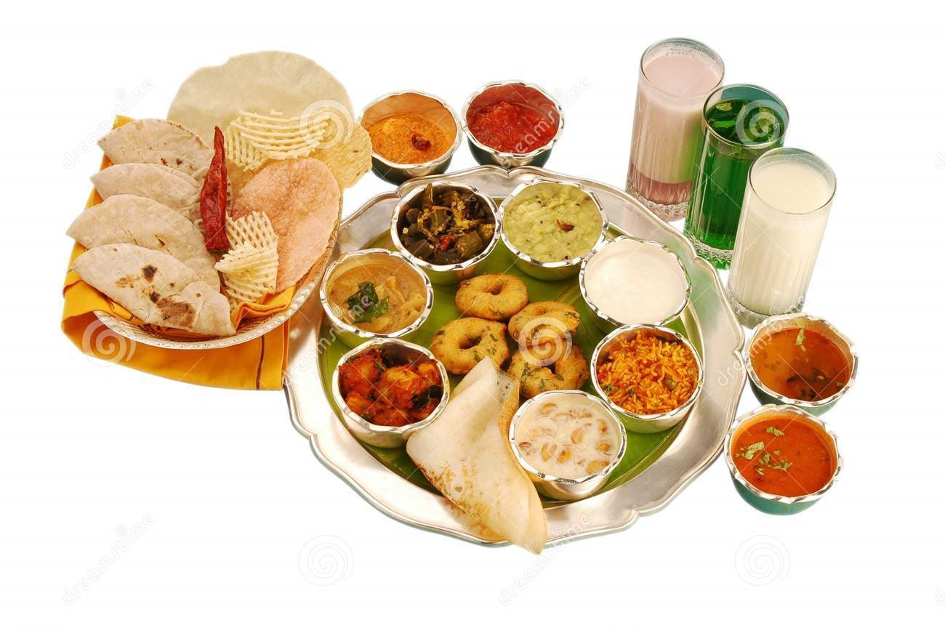
Mike earned his living by running a restaurant which was popular with the public beacuse of its heallthy diet.

Slide 3
Some ladies were so glad for the reason that they didn't have to go on a diet to lose weight anymore.

Slide 4
In order to benefit more from the customer, Mike began to cut down the amount of green food and combine them with some bad food.

Slide 5
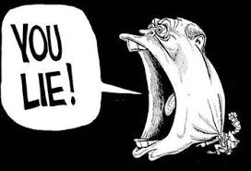
He told lies to his customers who spied on his movements. However, it was impossible for Mike to win them back.

Slide 6
Before long, Mike was in heavy debt because of the failing restaurant.

Slide 7
Nobody can get away with cheating.

Slide 8
Mike earned his living by running a restaurant which was popular with the public beacuse of its heallthy diet. Some ladies were so glad for the reason that they didn't have to go on a diet to lose weight anymore. In order to benefit more from the customer, Mike began to cut down the amount of green food. He told lies to his customers. However, it was impossible for Mike to win them back. Before long, Mike was in heavy debt because of the failing restaurant. Nobody can get away with cheating.
chunks

Slide 9
1、Mike earned his living by running a restaurant... earn a/one' s living 谋生 = make a/one' s living Perhaps he would be able to earn his living and not have to close his restaurant.

Slide 10
2、...they didn't have to go on a diet to lose weight anymore. be/go on a diet 节食 I' ve been on a diet for two months and I' ve lost 6 kilograms.
diet vi. 节食 (limit the amount and type of food so as to lose weight) n. 日常饮食；(the usual food and drink of a person) have/eat a healthy diet 健康饮食 have/eat a balanced diet 均衡饮食 keep a balanced diet 保持饮食平衡

Slide 11
3、...they didn't have to go on a diet to lose weight anymore. lose weight 减轻体重 It will make a great difference to your health if you lose weight.
反义：put on weight 增加体重

Slide 12
4、In order to benefit more from the customer ... benefit from 从……中受益 You will benefit from a holiday in the mountain.
归纳总结： benefit sb./sth.使某人/某物受益 benefit from 从……中受益 for the benefit of 为了……的利益 be of benefit to 对……有益；有好处 be beneficial to 对……有益

Slide 13
［灵活运用］一句多译: 新鲜空气有益于健康。
Fresh air is of great benefit to our health. Fresh air benefits our health. Our health benefits from fresh air. Fresh air is beneficial to our health. Fresh air does good to our health.

Slide 14
5、Mike began to cut down the amount of green food... cut down 削减；删节(reduce，shorten) They have to cut down the office staff.
If all the trees are cut down, the land will be ruined seriously.
砍倒(cause sth. to fall down by cutting it)
总结归纳 cut in 插嘴 cut off 切断 cut out 删掉；戒掉；裁剪 cut up 切碎

Slide 15
6、However, it was impossible for Mike to win them back. win...back 赢回，重新获得 We should get to the heart of this meeting, which is how to win customers back.

Slide 16
7、Before long, Mike was in heavy debt ... before long 不久以后 (soon) The dictionary will be published before long.
long before 很久之前 (long long ago)
I had heard of him long before I came here.
区分before long 和 long before 巧记：long前为前, long后为后

Slide 17
8、Mike was in heavy debt because of the failing restaurant. in debt 欠债 I' m afraid that I' ll be in debt all my life.
out of debt 不欠债
He was in debt when he was poor, but has been out of debt since he got rich.

Slide 18
9、Nobody can get away with cheating. get away with 被放过；(做坏事)不受惩罚 How did he get away with cheating in the exam？
The gangsters got away with more than ＄20.000.
get away with 带着……逃跑了

Slide 19
Thank You

