Slide 1
Senior High1 Book 1 Unit 2
English around the world
华南师范大学外国语言文化学院 李玉嫦、 区婉婷 河源市河源中学 邹辉渐

Slide 2

Conversation1: Chinese English
A: a high school student
B: A's foreign teacher

Slide 3
language point
each other （用作动词或介词的宾语） 互相，彼此
eg: Yes, they have different accents, but they can recognize each other.
each other vs one another?
one another √
(1)：We respect each other. 我们尊重对方
(2) : The sea and the sky seem to melt into one another.大海和蓝天似乎融为一体。
each other√
1. 一般认为 each other 指两者，one another指三者或三者以上。
但在实际运用中，这两个短语常可互换；
(3): They know each other's / one another's weak points. 他们都彼此了解对方的缺点
2. 两者均有所有格

Slide 4
(4): We helped each other. ＝We each helped the other. 我们互相帮助。
3. each other 可折开用 (each…the other)，而 one another则不能
(5): We each know what the other thinks. √
(6): We know what each other /one another thinks.×
4. 这两个短语均不能用作主语
正因为不能用作主语，所以用它们作宾语的句子不能改为被动语态。

Slide 5
the number of
&
a number of
e.g.
The number of our classmates is 45.
The number of students in my class is 56.
A number of our classmates love English.
A number of students are playing.
the number of 是指“......的数量”，后面的动词是单数形式, the number of 表示数目。后面的be动词一般为单数。
a number of 是指“大量的”,后面的动词是复数形式, a number of = a lot of =many .修饰可数名词。

Slide 6
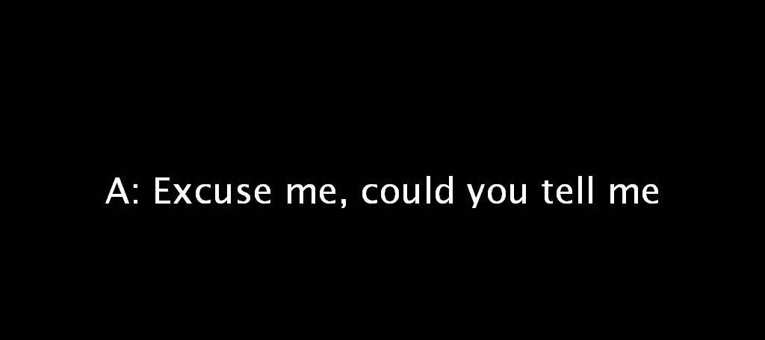
Conversation2: Asking the way
A: A foreigner
T: A Thai person in China
F: The foreigner's friend

Slide 7
because of
&
because
because of 是复合介词，其后可接名词或代词，动名词以及由关系代词型的所what 引导的从句等(但不能接that从句)。
because是连词，后加从句。
due to： 用于较庄重的书面语中，侧重"起因于"，在句中多作表语，有时作状语。
owing to： 可以和due to换用，但在句中多作状语，也可作表语。
because of： 着重某种原因的理由，在句中通常作状语。
thanks to： 突出一种感激之情，含"多亏"意味。
e.g.
·He lost his job because of his age.
·I said nothing about it, because of his wife's being there.
.He knew she was crying because of what he had said.
·I said nothing about it because his wife is here.
I didn’t buy it because it was too expensive.

Slide 8
base on
I recognized it because of your "kah" based on Thai language.
使建立在…基础上
e.g.
·Edison based his ideas on scientific experiment.
·What he said is based on fact.
base on “以……为根据”，用法应是 base A on B
be based on “以……为根据”; “根据……”;“基于……”用法是A be based on B
Exercise：1.你的意见都要以事实为根据。
____________________________
2.那故事是根据现实生活而写的。
____________________________
You should base your opinion on facts.
The story is based on real life.

Slide 9
But I still used to using "kah", "nah" at the end of what I say.
at the end of
在…结尾，在…末端
at the end of用于表示具体事物或场所的场合，也可表示比喻意(be at the end of sth=to have almost nothing left of sth)，后边可以跟时间和地点名词。在表时间时，at the end of 指过去或将来的时间上的一个点，往往与一个行为动作相关，常与一般过去式或一般将来时连用。
By the end of用于表示时间的场合，往往含有“不迟于”的意味。不指一个时间点，而是指某一时间点以前或到某一时间点为止，强调的是状态或结果，而不是行为，常与完成时连用
in the end的涵义是“终于”、“最后”，其义相当于 at last.
at the end of
端部的；结尾处
at the ends of
在两端

Slide 10
at the end of January
一月底（指一月份的最后一天）
by the end of January
一月底之前（指一月份结束前的几天）
e.g.
·That treaty expires at the end of this year.
·I noticed a chink of light at the end of the corridor.
·At the end of the interview I was dazed and exhausted.
Exercise：
1.They were _____________ their patience．
他们忍无可忍。
2.We are to complete the task ______________the year．
年底之前我们必须完成此项任务。
at the end of
by the end of

Slide 11
Thanks for your listening

