Slide 1
Book4 Unit 2 Working the Land
合作者: 华南师范大学 蔡文 薛莹
河源市东源中学 贺杜夷
Notes:
草原
（基本）
注意： 此模板针对 PowerPoint 2010进行了优化，使用视频背景。如果在 PowerPoint 2007 中使用，则视频元素将会播放，但所有内容在幻灯片放映模式下将被视频背景覆盖。如果在 PowerPoint 2003 中使用，则视频不会播放，但是视频的标牌框架将保持不变，就像静态图像一样。
视频：
在每次切换幻灯片后自动播放。
时长 30 秒。
无缝地无限循环播放。
若要添加幻灯片或更改版式，请执行下列操作：
若要添加新的幻灯片，请在“开始”选项卡上的“幻灯片”组中，单击“新建幻灯片”下方的箭头，在“动画背景主题”下方单击，然后选择所需版式。
若要更改现有幻灯片的版式，请在“开始”选项卡的“幻灯片”组中，单击“版式”，然后选择所需版式。
此模板使用“Pushpin”主题字体。 若要访问或更改主题字体，请执行下列操作：
在“视图”选项卡上的“母版视图”组中，选择“幻灯片母版”。
在“幻灯片母版”视图中，选择幻灯片 1（使用视频背景的母版版式的母版幻灯片）。
在“幻灯片母版”选项卡的“编辑主题”组中，单击“字体”，然后选择新的主题字体。
使用动画元素：
所有动画元素都将从切换幻灯片并且背景视频开始播放后开始。

Slide 2
1. one of ….
Although he is one of China's most famous scientists, Yuan....
The invention of super hybrid rice is one of the most significant events all over the world.
When Yuan successfully developed the hybrid rice, it must be one of Yuan's most excited moments.

Slide 3
one of +限定词+形容词最高级+名词复数
最...的之一
这个短语里的限定词常用的是the 或one's
eg.one of the most beautiful women
one of my most favorite songs
（不能同时两个限定词修饰同一个名词）

Slide 4
Exercise
the longest
The Changing River is one of
（最长的河流）in the world.
rivers
Mandy is one of in the class.
A. my best friends B.my the best students
C. my best student D.my better students

Slide 5
2. struggle for
Yuan struggled for the realization of his goal although he confronted many difficulties.
Poor people have to struggle for the living.
Many people struggle for woman's equality in many aspects all the time.

Slide 6
struggle for
为...而努力奋斗，苦苦挣扎 （带有艰难的感情色彩）
1.struggle with 与.....斗争
2.struggle against 为反对...而抗争，斗争
3.struggle to do sth. 努力做某事 (=make great efforts to do sth.)

Slide 7
Exercise
1.The black people insist on struggling ____ freedom and equality.
A.for B.against C. with D.in
2.It is a significant event to struggle ____ gender discrimination.
A.for B.with C.against D.in

Slide 8
3. thanks to
Thanks to his research, the UN has more tools in the battle to rid people of hunger.
Thanks to Yuan's cautious research, he finally developed the super hybrid rice successfully.
Thanks to Yuan's super hybrid rice, the high output of rice makes people no longer live in hunger.

Slide 9
thanks to
多亏，由于
thanks to VS thanks for
thanks to (是指感谢的对象,to后面接的名词或代词)
thanks for (指为何而感谢，for后面主要接名词或动名词)
thanks for =thank you for

Slide 10
Exercise
_____the new policy, we are now having a happy life.
A. Thanks to B. Because
C. For D. Thanks for
多亏了你的鼓励，我才能从失败中走出来。
Thanks to your encouragement, I could come out of the failure.

Slide 11
4. rid of
You must rid yourself of these old-fashioned ideas.
The whole family moved to another village to rid of the famine.
He wanted to rid himself of the burden of the secret.
Further measures will be taken to rid our streets of crime.

Slide 12
rid of
摆脱；免于
rid of VS get rid of
rid sb/sth of sth
(rid后跟的是要去除的对象,of后跟的是要去除的东西)
get rid of
(句子的主语就是对象)

Slide 13
Exercise
你能帮我去掉T-shirt上的污渍吗（stains）?
Can you help me rid the ____ of _____?
如果我是世界总统，我要让这个世界永远摆脱战争。
If I were the world president,I would rid the world of war forever.
T-shirt
stains

Slide 14
5. would rather
She’d rather die than give a speech.
He would rather work in the countryside.

Slide 15
would rather do sth.
宁愿、更喜欢
P.S
1. would rather not do sth
(否定形式)
2. would rather没有人称和数的变化，所有的人称一律用would rather。

Slide 16
Exercise
他宁愿一枪打死自己也不愿违背自己的原则。
He ___＿ ＿＿＿ shoot himself ＿＿ break his principle.
我个人更愿意烤整只鸡.
I personally would rather roast the whole chicken.
would
rather
than

Slide 17
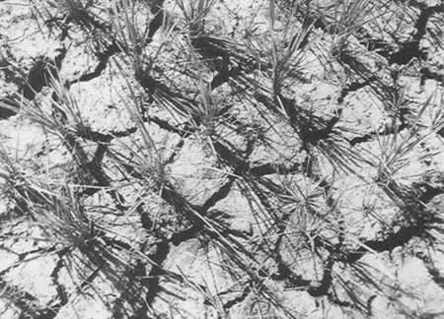
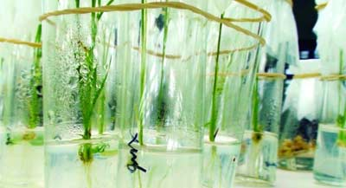
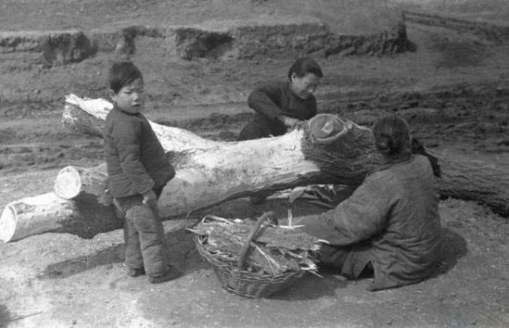
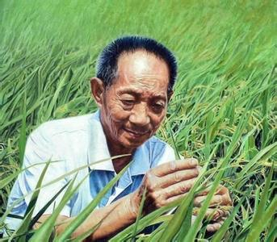
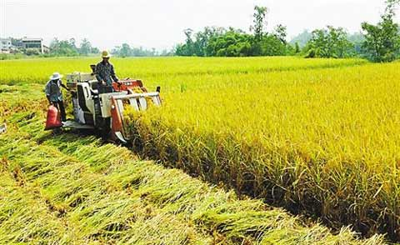
Retell the story of Yuan

Slide 18
Thank you!

