Slide 1
Unit 2 Poems
Reading A Few Simple Forms of English Poems the first paragraph
制作人
人教版高中英语B6U2 Poems
河源市龙川一中 邱丽英老师
华南师范大学外国语言文化学院 陈淑娴杜紫清

Slide 2
阅读文章第一段并找出文中词块
35
There are various reasons why people write poetry. Some poems tell a story or describe something in a way that will give the reader a strong impression. Others try to convey certain emotions. Poets use many different forms of poetry to express themselves. In this text, however, we will look at a few of the simple forms.

Slide 3
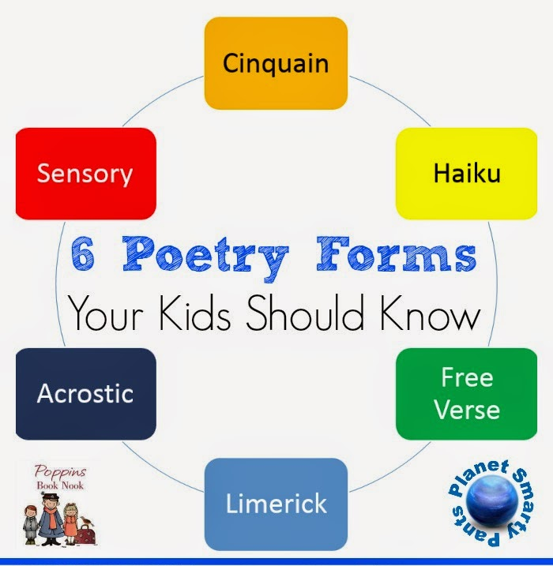
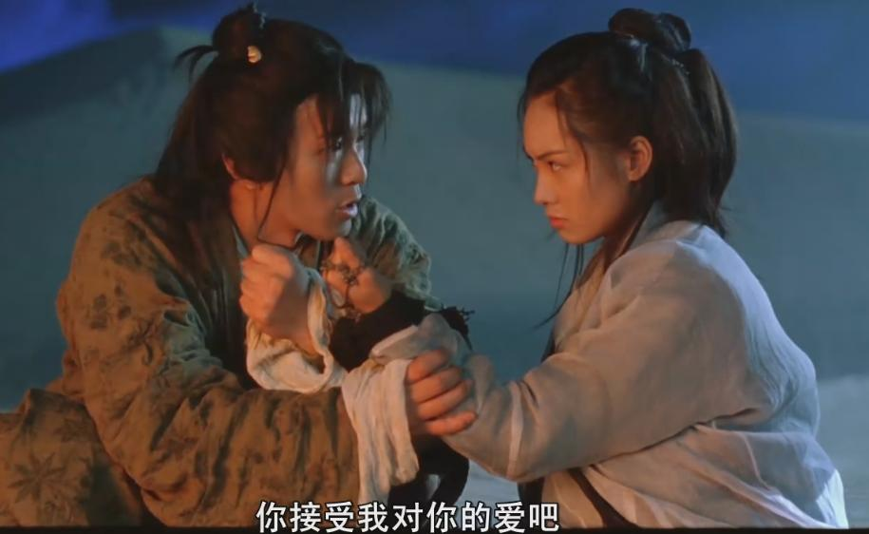
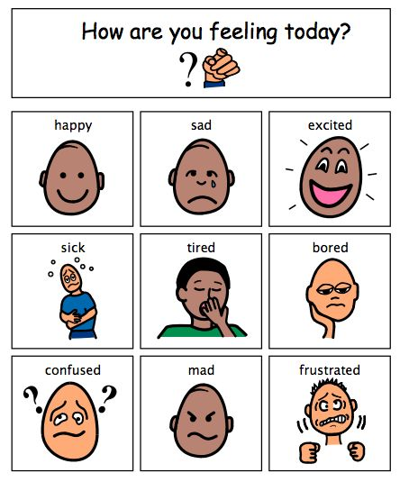



Lexical Chunks
There are various reasons why
有各种各样的.......理由
in a way that
以......的方式
a strong impression
强烈印象
convey certain emotions
传达某种感情
many different forms of poetry
许多不同格式的诗
express oneself
表达自己的情感

Slide 4
Reading and find out the
20
There are various reasons why people write poetry. Some poems tell a story or describe something in a way that will give the reader a strong impression. Others try to convey certain emotions. Poets use many different forms of poetry to express themselves. In this text, however, we will look at a few of the simple forms.
有各种各样的理由
以..的方式
强烈印象
传达某种感情
许多不同
格式的诗
表达自己的情感

Slide 5
Key Lexical Chunks
传达某种感情
convey certain emotions
根据汉语提示完成句子。
我的情感难以言表。
I can't___________________________.
2)他向他的老师表达了他的谢意。
He ____________________________.
convey my feelings in words
express
conveyed his thanks to his teacher

Slide 6
3)我们应该立即把必需品从城里运送到地震灾区。
We should
____________________________________
the earthquake-hit areas immediately.
4.我们希望旅客们被安全送往机场。
We hope that
_____________________________________________.
convey the necessities from the city to
transport
passengers will be conveyed to the airport safely

Slide 7
归纳总结
convey
convey sth. (to sb)
convey sth. (from ... to...)
把...从...传送到...
向某人表达…

Slide 8
写作句型仿写
1. There are various reasons why..有各种原因
原句 There are various reasons why people write poetry. 人们写诗是有各种原因的。
例句 青少年喜欢流行音乐是有各种原因的。
There are various reasons why teenagers like pop music.

Slide 9
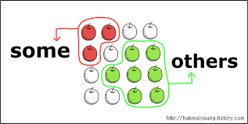
写作句型仿写
2. Some...; others... 有些……; 有些……
原句 Some poems tell a story or describe something in a way that will give the reader a strong impression. Others try to convey certain emotions.
有些诗歌以一种令读者印象深刻的方式讲述故事或描述事件, 其它的就试图传达某些感情。

Slide 10

写作句型仿写
2. Some...; others... 有些……; 有些……
例句 国庆节期间, 一些人出行旅游, 另一些人则呆在家里。
During the National Day, _________________________; _________ prefer to ______________.
some go on a journey
others
stay at home

Slide 11
Thank you.

