Slide 1
Unit 3 A taste of English humour (grammar)
V-ing form being used as attribute, predicative and object complement
动词ing形式做定语，表语和宾补
华南师范大学外国语言文化学院 陈媛
龙川县田家炳中学 黄少平

Slide 2
introduction
attribute
V-ing form predicative
being used as
object complement
Three parts include two sections: Gerund (动名词) and Present particle （现在分词）

Slide 3
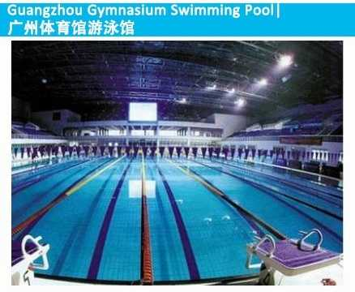
I want to go to the reading room to study . What about you?
I want to go the swimming pool.

Slide 4
QUESTION
Is function of “swimming” “reading” the same as representing the present continuous tense （现在进行时） we have learned before?
Like:
I am reading the book.
I am swimming in the pool.

Slide 5
Let’s look at some more examples.
Gerund (动名词)
a waiting room(= a room for waiting)候车室
a walking stick( =a stick for walking)手杖
Gerund describes the functions（功能） of the following nouns and the relevant actions （相关的动作） of the following nouns(but not the actions of themselves)（本身的动作）

Slide 6
Present particle （现在分词）
a sleeping child (= a child who is sleeping ) 正在睡觉的孩子
a waiting man (=a man who is waiting)正在等待的男人
Present particle describe what is the described noun doing.
The relationship of Present particle and the described noun
The relationship of subject（主语 ）and predicate（谓语）

Slide 7
Let’s have a try!
我们必须改进工作方法。
We must improve our (work) method. (Gerund)
他们将手术台架设在一座小庙里。
They set up an (operate) table in a small temple. (Gerund)
中国是发展中国家。
China is a (develop)country. (Present particle )
正在做实验的那个学生是我们的班长。
The student (make)the experiment is our monitor. (Present particle )
working
operating
developing
making

Slide 8
What’s your homework ?
My homework is reading books.
be + V-ing
be + predicative
（表语）
V-ing is used as predicative

Slide 9
Let’s look at some more examples.
Gerund (动名词)
Our greatest happiness is serving the people.
Gerund being predicative（表语） expresses abstract and general behaviors (抽象或一般的动作). The positions of gerund and predicative can be exchanged.
Its full time job is laying eggs.
Laying eggs is its full time job.
他的专职工作是产卵。 (Gerund)
Playing all kinds of music is our job.
Our job is playing all kinds of music .
演奏各种音乐是我们的工作。 (Gerund)

Slide 10
Present particle （现在分词）
His words are encouraging.
Present particle being predicative（表语） expresses the features, characters and status of the nouns (名词的特点，性质 和状态). The position of Present particle and predicative can not be exchanged.
The music they are playing sounds exciting.
他们演奏的音乐是如此令人兴奋。 (Present particle )

Slide 11
I saw you swimming very well last week.
Thank you!
saw you swimming
see sb. doing sth.
be used as the object complement（宾补）

Slide 12
ATTENTION
Gerund can not be used as the object complement.
(宾补)
Present particle can be used as the object complement, indicating what is happening.
Two types of verbs followed by V-ing being used as the object complement
⑴Some verbs about sensations, like see, hear, feel, smell, watch, find, notice and so on.
⑵ Some verbs about commands, like have, set, keep, get, catch, leave and so on.

Slide 13
Let’s look at some more examples.
我看见他正在上楼。
I saw him going upstairs.
我们看着她在过大街。
We watched her crossing the street.
我们听见她在房间里唱歌。
We heard her singing in her room。

Slide 14
SUMMARY
V-ing form is used as attribute, predicative and object complement.
Attribute: V-ing + noun
Predicative: be + V-ing
object complement: v. + sb. + doing sth.
Gerund and present particle have different meanings.

Slide 15
TAHNK YOU !

