Slide 1
Welocome to our English class
-- Book2 Unit2
华南师范大学外国语言文化学院 邓小艳

Slide 2
Learning tasks
take part in
one after another
as well

Slide 3
take part in
Page 9 Warming Up Q3: Who could not take part in the ancient Olympic Games?
take part in: 参加，参与
join: 加入，参加

Slide 4
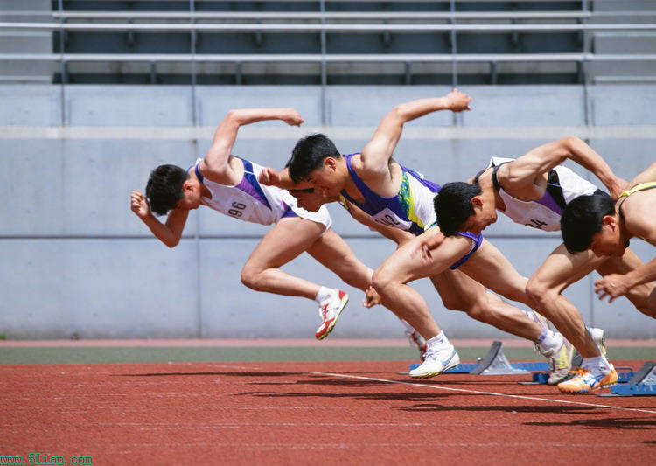
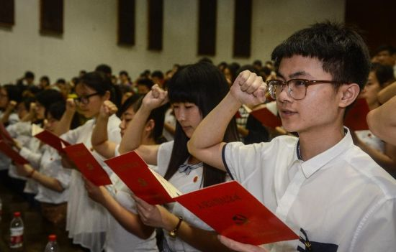
take part in
Do you want to take part in this match?
We invited him to take part in the celebration.
take part in 常用于一项活动，比赛之前
You have to join the party at grass-roots level.
There are many clubs you could join.
join 常用于表示加入某一个组织

Slide 5
as well
Page 10 para. 9 line1: For each Olympics, a special village is built for them to live in, a main reception building, several stadiums for competitions, and a gymnasium as well.
as well: 也，又，还
as well as: 也，还
I am going to London and my sister is going as well（＝going，too）.
I not only play the guitar，I sing as well（＝I also sing ）.
as well常用作状语，作“又；也”解，相当于too或also，常位于句末，无须用逗号与句子分开。

Slide 6
as well
You Know As Well As I - Speak
You know as well as I I've got your back
You've seen the way I operate without your help
You know as well as I I'm built to last
You know that I disintegrate too fast
as well as常用来连接两个并列的成分，作“也，还”解。

Slide 7
as well
—We were too late to see the film.
我们去得太晚了，没有看上电影。
—Just as well. I hear it isn't very good.
不必遗憾，我听说电影也不怎么样。
as well 可以直接用于just后，用作应答语（可视为It's just as well、的省略），作“幸亏，幸而；无妨；没关系”解。

Slide 8
one after another
Page 15 Q3 line10: He threw the golden apples one after another.
one after another: 陆续地，一个接一个地
one by one: 一个一个地
hour after hour: 连续地
on and off: 断断续续地
inch by inch：逐渐地

Slide 9
Review
Multiple Choice:
1.I will never forget the day when I ____ the Party.
A、took part in B、joined
2.Will you ____ the English evening?
A、take part in B、join
3.They play all kinds of instruments and sing ____.
A、also B、either C、as well D、as well as
4.She doesn't speak ____ her friend，but her written work is excellent.
A、as well as B、as often as C、so much D、as good as
Answers: BACA

Slide 10
See you next time
Thank you

