Slide 1
BOOK 3 Unit4 :
Astronomy: the science of the stars
Let’s solve the
new words!!!
河源市连平县隆街第二中学 叶美心
华南师范大学外国语言文化学院 冯菲菲

Slide 2
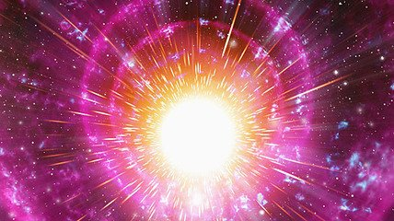
Book 3 Unit 4: Astronomy: the science of the stars
Part 1: New words encyclopaedia 单词百科
Big Bang
宇宙大爆炸
What is Big Bang?
Well, some scientists suggest that Big Bang created the universe.
It’s a huge explosion.

Slide 3
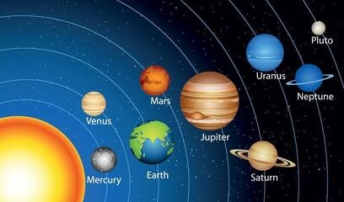
Book 3 Unit 4: Astronomy: the science of the stars
Part 1: New words encyclopaedia 单词百科
solar system
太阳系
Around 5 billion years ago, solar system came along
and our home, earth is now
part of it ,spinning tirelessly.

Slide 4
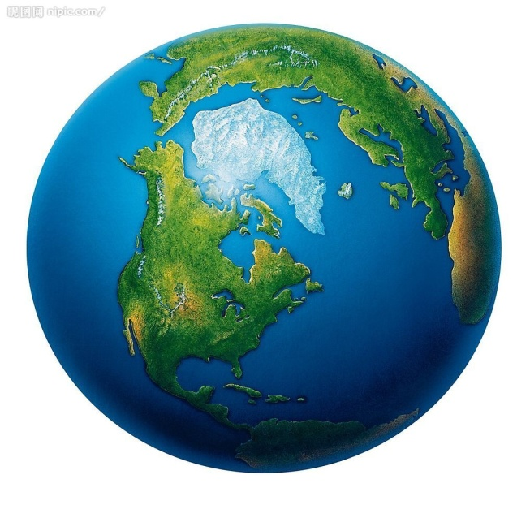
Book 3 Unit 4: Astronomy: the science of the stars
Part 1: New words encyclopaedia 单词百科
Globe
球体，地球
Look at this globe, it’s our home, earth.
Now, do you know more about these new words?

Slide 5
Book 3 Unit 4: Astronomy: the science of the stars
Part 2 : Tips of reciting the new words 背单词小技巧
astronomy n. 天文学
astronomer n. 天文学家
Suffix 后缀
biology n. 生物学
biologist n. 生物学家
-ian musician historian
Physician vegetarian
-or/ess
visitor actor waitor
actress waitress
geography& geographer
地理学(家)
chemistry & chemist
化学（家）
science & scientist
科学（家）

Slide 6
Book 3 Unit 4: Astronomy: the science of the stars
Part 3 : brain storming translation
be harmful(adj) to 对…有害
exist vi. 存在
unlike prep. 不像，与…不同
be fundamental(adj) to 是…的基础
prevent…from… vt. 阻止…做…

Slide 7
Book 3 Unit 4: Astronomy: the science of the stars
Part 3 : brain storming translation
1.吃太多零食对健康有害。
2.地球上有生命吗?
3.不像水，果汁很甜。
勤奋工作是成功的基础。
什么都不能阻止他上学。
Eating too much junk food is harmful to health.
Dose life exist on earth?
Unlike water, juice is sweet.
Hard work is fundamental to success.
Nothing could prevent him from going to school.

Slide 8
Book 3 Unit 4: Astronomy: the science of the stars
Big Bang exist unlike fundamental harmful
prevent astronomy astronomer
biology biologist globe
Solar system

Slide 9
Book 3 Unit 4: Astronomy: the science of the stars
Practice: use these new words to
make new sentences.

Slide 10
Book 3 Unit 4: Astronomy: the science of the stars
Class over!!!

