Slide 1
How life began on the earth
Book 3 Unit 4
华南师范大学外国语言文化学院付恒悦
Notes:
预览及使用此模板前先下载英文Segoe Script、中文新蒂小丸子小学版字体，预览效果会更加美观！

Slide 2
1
Legends
PPT模板下载：www.1ppt.com/moban/ 行业PPT模板：www.1ppt.com/hangye/
节日PPT模板：www.1ppt.com/jieri/ PPT素材下载：www.1ppt.com/sucai/
PPT背景图片：www.1ppt.com/beijing/ PPT图表下载：www.1ppt.com/tubiao/
优秀PPT下载：www.1ppt.com/xiazai/ PPT教程： www.1ppt.com/powerpoint/
Word教程： www.1ppt.com/word/ Excel教程：www.1ppt.com/excel/
资料下载：www.1ppt.com/ziliao/ PPT课件下载：www.1ppt.com/kejian/
范文下载：www.1ppt.com/fanwen/ 试卷下载：www.1ppt.com/shiti/
教案下载：www.1ppt.com/jiaoan/ PPT论坛：www.1ppt.cn

Slide 3
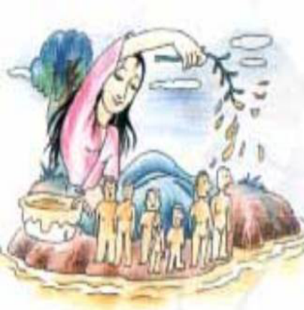
The East Legend
The Goddess Nuwa mended the heaven and created human beings from the clay.

Slide 4
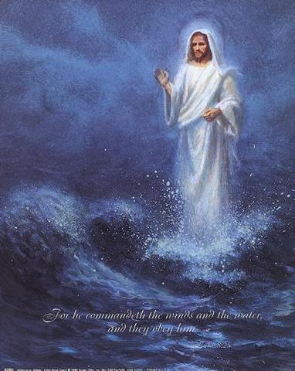
The West Legend
God created the world in seven days.

Slide 5
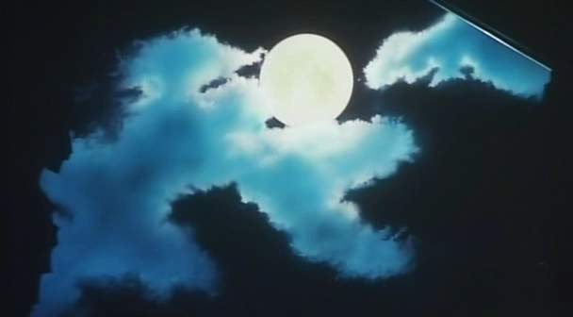
The West Legend
Day 1: God spoke and separated light from darkness creating Day and Night.

Slide 6
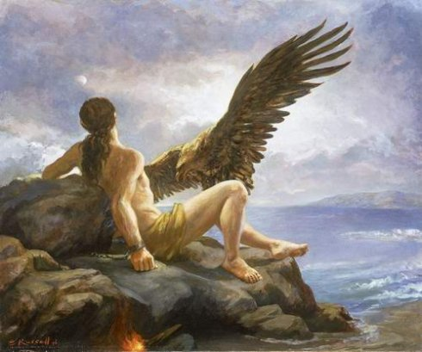
The West Legend
Day 2: God spoke and separated the water creating sky and ocean.

Slide 7
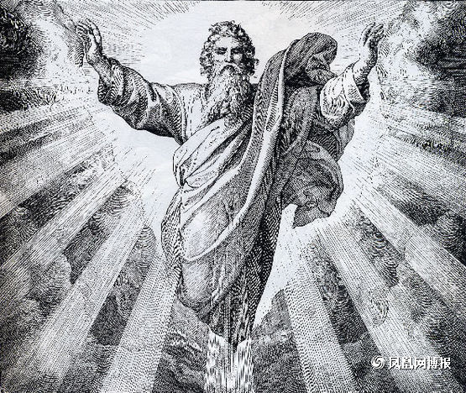
The West Legend
Day 3: God spoke and created dry land.

Slide 8
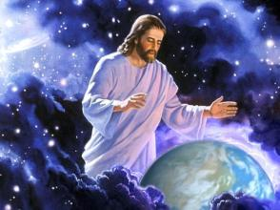
The West Legend
Day 4: God spoke and created the sun, moon and stars.

Slide 9
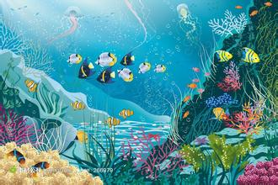
The West Legend
Day 5: God spoke and created living creatures in the air and sea.

Slide 10
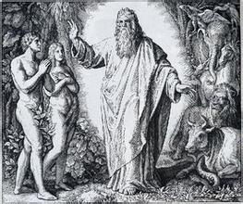
The West Legend
Day 6: God spoke and created the land animals and man.

Slide 11
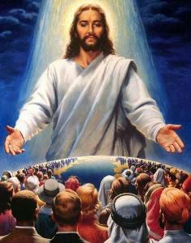
The West Legend
Day 7: God rested and blessed this day calling it Holy.

Slide 12
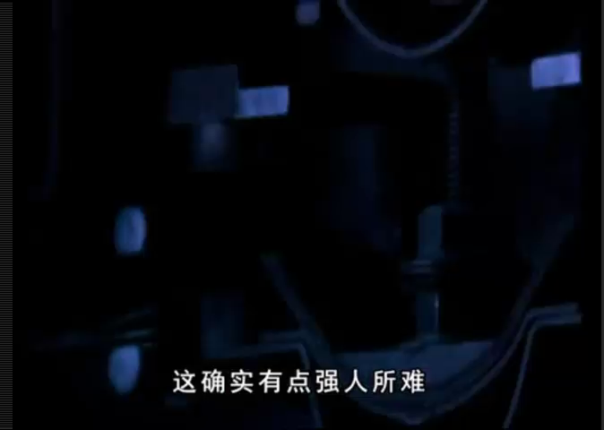
"Big Bang"
宇宙大爆炸

Slide 13
Words
shellfish
insects
amphibians
reptiles
mammals
两栖动物
哺乳动物
贝类动物
昆虫
爬行动物

Slide 14
Reading the book
1.However, according to a widely accepted theory, the universe began with a "Big Bang"
that threw matter in all directions.
2.For several billion years after the "Big Bang", the earth was still just a cloud of dust.
3.What it was to become was uncertain until between 4.5 and 3.8 billion years ago when the dust settled into a solid globe.
4. It exploded loudly with fire and rock.
5.It was not immediately obvious that water was to be fundamental to the development of
life.
6. This produced a chain reaction, which made it possible for life to develop.

Slide 15
Pre-reading
♦according to a widely accepted theory,
♢a cloud of dust
♦settled into a solid globe
♢exploded loudly with fire and rock
♦be fundamental to
♢produced a chain reaction
♦made it possible for life to develop
♦根据一种普遍为人们所接受的理论
♢一团尘埃
♦形成一个固体的球状物
♢猛烈地爆炸喷出了烈火和岩石
♦对……来说是基本
♢产生连锁反应
♦使生命发展成为可能

Slide 16
Translation
1.绿色产品被所有用户广泛接受。
1.____________________________________________.
2.我们起飞了，扬起了一阵尘土。
2.____________________________________________.
3.雨最终小下来，变成安静些的毛毛雨。
3.____________________________________________.
Green products are widely accepted by all users
We took off in a cloud of dust
The rain finally settled into a quieter drizzle

Slide 17
Translation
4.我相信真理与正义是维护社会秩序的基石。
4.___________________________________________________________.
5.那些食物使得他得以活下来。
5._____________________________________.
I believe that truth and justice are fundamental to an enduring social order
The food made it possible for him to survive

Slide 18
THANK
YOU
2016

